Slide 1


Money
Best Buys
Best Service
Best Contract
www.mathsrevision.com
Exam Type Questions

Slide 2
Starter Questions
Two numbers add to give 12 and divide to give 3. Find the two numbers.
2. Two numbers subtract to give 5 and
multiply to 24. Find the two numbers.
3. Make your own question up.
www.mathsrevision.com

Slide 3
Best Deal
Money Management
Learning Intention
Success Criteria
  1. We are learning to calculate the best deal for everyday items.
  De able to compare deals by finding the cost per unit.
www.mathsrevision.com

Slide 4
Are we expecting more or less
Best Deal
Money Management
Ex : What is the best deal for Soap Powder ?
Deal 1 - Proportion method
g £
350 ⇨ 10.50
1
Deal 1 | Deal 2
350g | 250g
£10.50 | £10.00
www.mathsrevision.com
(less)

Slide 5
Are we expecting more or less
Best Deal
Money Management
Ex : What is the best deal for Soap Powder ?
Deal 2 - Proportion method
g £
250 ⇨ 10.00
1
Deal 1 | Deal 2
350g | 250g
£10.50 | £10.00
www.mathsrevision.com
(less)
Deal 1 is Best
only 3p per gram

Slide 6
Are we expecting more or less
Best Deal
Money Management
Ex : What is the best deal for Petrol.
Deal 1- Proportion method
l £
60 ⇨ 65.40
1
Deal 1 | Deal 2
60 litres | 38 litres
£65.40 | £40.66
www.mathsrevision.com
(less)

Slide 7
Are we expecting more or less
Best Deal
Money Management
Ex : What is the best deal for Petrol.
Deal 2 - Proportion method
l £
38 ⇨ 40.66
1
Deal 1 | Deal 2
60 litres | 38 litres
£65.40 | £40.66
www.mathsrevision.com
(less)
Deal 2 is Best
£1.07 per litre

Slide 8
Are we expecting more or less
Best Deal
Money Management
Ex : What is the best deal for tennis balls ?
Deal 1 - Proportion method
T £
10 ⇨ 5.40
1
Deal 1 | Deal 2 | Deal 3
10 balls | 15 balls | 48 balls
£5.40 | £7.50 | £24.48
www.mathsrevision.com
(less)

Slide 9
Are we expecting more or less
Best Deal
Money Management
Ex : What is the best deal for tennis balls ?
Deal 2 - Proportion method
T £
15 ⇨ 7.50
1
Deal 1 | Deal 2 | Deal 3
10 balls | 15 balls | 48 balls
£5.40 | £7.50 | £24.48
www.mathsrevision.com
(less)

Slide 10
Are we expecting more or less
Best Deal
Money Management
Ex : What is the best deal for tennis balls ?
Deal 3 - Proportion method
T £
48 ⇨ 24.48
1
Deal 1 | Deal 2 | Deal 3
10 balls | 15 balls | 48 balls
£5.40 | £7.50 | £24.48
www.mathsrevision.com
(less)
Deal 2 is Best
£0.50 per ball

Slide 11

Best Deal
Money Management
Now Try
TJ N4 Lifeskills
Exercise 1
Ch28 (page 224)
www.mathsrevision.com

Slide 12
Starter Questions
www.mathsrevision.com

Slide 13
Best Deal
Service
Learning Intention
Success Criteria
  1. We are learning to calculate the best deal for service items.
  Be able to compare deals by calculating over cost.
www.mathsrevision.com

Slide 14
Best Deal
Service
No Power
Burst Pipe
Why would you need to call out a
electrician , joiner , plumber etc.........
Broken front door
www.mathsrevision.com
These types of jobs work for the Service Industry.
They serve the general public.

Slide 15
Best Deal
Service
The cost of work carried out by these professions
are broken into two parts:
Call out charge :
To come out to investigate problem
Hourly rate :
Cost per hour worked to complete
job.
www.mathsrevision.com

Slide 16
Who should I pick ?
Best Deal
Service
I have a bust pipe in by house. I get two quotes
to fix the problem.
The job should take 3 hours to fix.
 | Mr Fix -It | Easy-job
Call-out Charge | £30 | £70
Hourly -rate | £32 | £20
www.mathsrevision.com
BODMAS
Mr Fix-It = 30 + 3 x 32 =
£126
Easy-job = 70 + 3 x 20 =
£130
Mr Fix-It

Slide 17
Who should I pick ?
Best Deal
Service
Turns out that the job will take 5 hours.
 | Mr Fix -It | Easy-job
Call-out Charge | £30 | £70
Hourly -rate | £32 | £20
www.mathsrevision.com
Mr Fix-It = 30 + 5 x 32 =
£190
Easy-job = 70 + 5 x 20 =
£170
Easy-job

Slide 18
Electrician Job Rate
The cost for hiring a electrician per hour is shown in graphical form.
V
(a) What is his call-out fee
£30
100
90
What is his hourly rate.
£10
80
70
Cost £
60
50
What is the total cost
for a 6 hours job.
40
(0,30)
30
20
10
T
Total C = 30 + 6 x 10 = £90
0
1
2
3
4
5
6
7
8
9
10
Time (hours)

Slide 19
Best Deal
Service
Now Try
TJ N4 Lifeskills
Exercise 2
Ch28 (page 226)
www.mathsrevision.com

Slide 20
Starter Questions
www.mathsrevision.com

Slide 21
Best Deal
Rates & Contracts
Learning Intention
Success Criteria
  1. We are learning about best contract deal.
  Understand and compare contract deals.
www.mathsrevision.com
  2. Be able to choose best contract deal by estimating usage.

Slide 22
Can you name some Providers
Sky, BT, Virgin-Media etc...
Best Deal
Rates & Contracts
Most people have a contract for there
mobile phone, internet and TV provider
Why ?
Contracts can be very confusing !
www.mathsrevision.com
You can save ALOT of money if you do the maths.

Slide 23
Who gives the best value and by how much to nearest penny ?
Best Deal
Rates & Contracts
I have just come back from a Holiday in
Coney Island New York.
I want to convert $500 back to £’s.
 | Exchange Rate
Rate-R-Us | 1.55
Super-Rates | 1.50
www.mathsrevision.com

Slide 24
Are we expecting more or less
Best Deal
Rates & Contracts
 | Ex. Rate (per £)
Rate-R-Us | 1.55
Super-Rates | 1.50
(Rate-R-Us) - Proportion method
$ £
1.55 ⇨ 1
1
www.mathsrevision.com
(more)

Slide 25
Are we expecting more or less
Best Deal
Rates & Contracts
 | Ex. Rate (per £)
Rate-R-Us | 1.55
Super-Rates | 1.50
(Super-Rates) - Proportion method
$ £
1.50 ⇨ 1
1
www.mathsrevision.com
Super-Rates
by £0.75
(more)

Slide 26
Who gives the best value and by how much after one year ?
Best Deal
Rates & Contracts
APR means
Annual Percentage Rate
Ethan wants to put some money into the bank.
He has two options.
He has £3000 to invest.
 | APR %
Bank of Mr Lafferty | 3.5
Bank for Money | 3
www.mathsrevision.com

Slide 27
Best Deal
Rates & Contracts
 | APR %
Bank of Mr Lafferty | 3.5
Bank for Money | 3
3.5
3
x 3000 =
£105
x 3000 =
£90
100
100
www.mathsrevision.com
Total in Bank £3105
Total in Bank £3090
Best Deal is
Bank of Mr Lafferty by
£15

Slide 28
Paul is always looking for the best deal. He uses
5 minutes per day on calls, 11 texts per day and lots of online searches.
What tariff is best ?
Tom uses very little calls or internet but sends 10 texts a day.
What tariff is best ?
Caitlin loves to be online, calls her friend
10 minutes per day and sends 80 texts a day.
What tariff is best ?
Best Deal
Rates & Contracts
Below is a typical set of contracts for a mobile phone
Provider | Free minutes | Free Text | Internet Usage | Contract months | Cost per month
O₄ | 120 | 300 | Unlimited | 12 | £9
Talkie | 180 | 500 | Unlimited | 24 | £15
Blue | 500 | 3000 | Unlimited | 18 | £25
V-Mobile | 100 | 5000 | Unlimited | 12 | £30
Foney | 1000 | Unlimited | Unlimited | 12 | £40
www.mathsrevision.com

Slide 29

Have you updated your Learning Log ?
Foreign Currency
Now Try
TJ N4 Lifeskills
Exercise 3
Ch28 (page 228)
www.mathsrevision.com

Slide 30
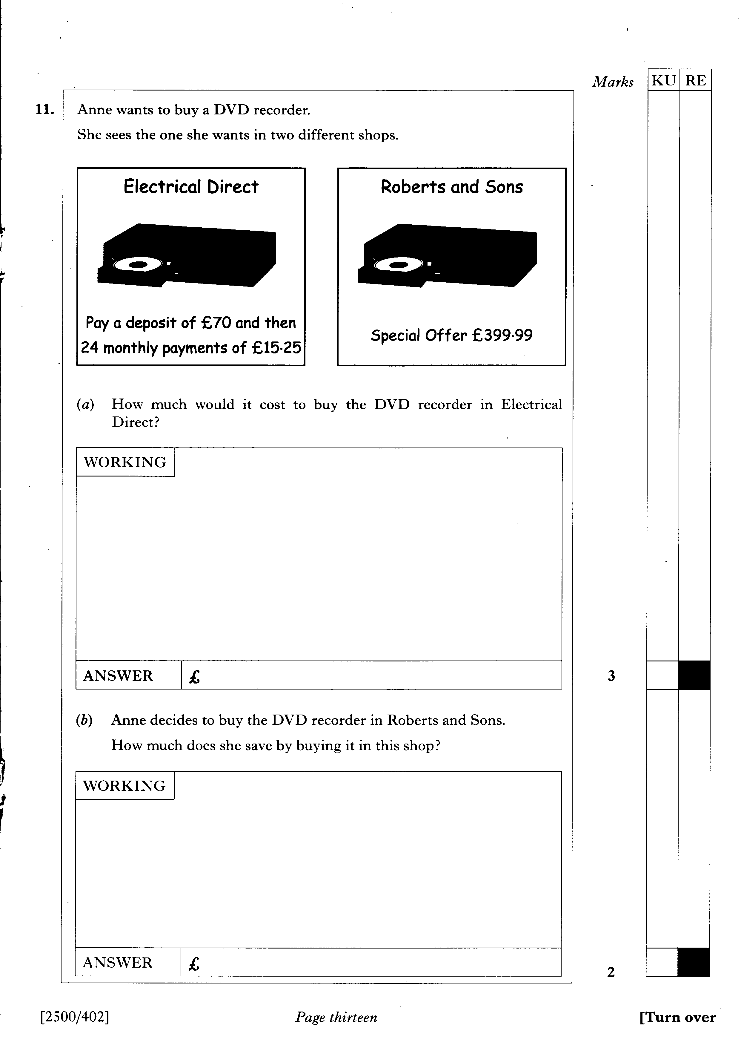

Slide 31
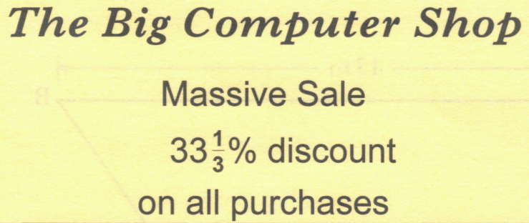

Scott sees the following notice in the window
of the Big Computer Shop.
(a) A computer was £834.
How much would Scott pay for it in the sale?
The same computer can be bought in Pete's PC Shop on hire purchase.
(b)Which shop sells the computer cheaper? Show your working.

Slide 32
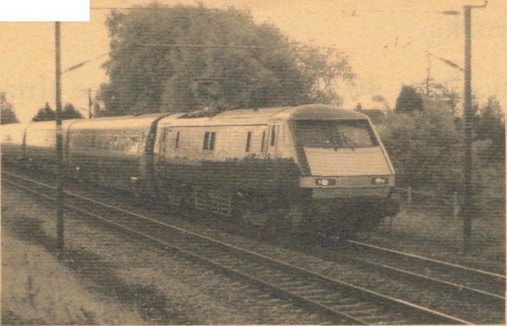
Helen travels between Glasgow and Edinburgh by train.
She buys a monthly TravelPass which costs £264.30.
A daily return ticket would cost £16.90.
Last month Helen made 19 return journeys.
How much did she save by buying the TravelPass?
19 x £16.90=£321.10
Saving=£321.10-£264.30
=£56.80

Slide 33

Andrea sees this advertisement for a computer in CompCo.
CompCo SPECIAL OFFER £779 + VAT (17.5%)
(a) Andrea buys the
computer from CompCo.
VAT is 17.5%.
What is the total cost of the computer?
Round your answer to the
nearest penny
OUR PROMISE :
If you find the same computer at a cheaper price within 1 month, we will refund double the difference.
(a) £77.90+£38.95+£19.48
VAT=£136.33
TOTAL=£136.33+£779
=£915.33
(b) One week later, Andrea sees the
same computer in a different shop
at £900 including VAT.
She remembers the promise in the
CompCo advertisement and returns
to the shop to claim a refund.
How much money should be
refunded to her?

Slide 34
A basic cable television package, which includes 30 channels, costs £8.75 per month.
The cost of installation is £75 which will be included in the first month's bill.
Additional channels can be added to the basic service.
The movie channels package costs £12-50 per month.
The music channels package costs £7.50 per month.
The sports channels package costs £14.50 per month.
The Mackie family's first bill after having cable television installed was £98.25.
They chose the basic cable television package plus one additional channels package.
Which additional package did they choose? Give a reason for your answer.

Slide 35
Mara travels 1850 miles every month.
Currently her car runs on unleaded petrol, which costs 76.9p per litre and her car travels 8.5 miles per litre.
(a) What is her monthly petrol bill?
Mara is thinking of having her car converted to run on Liquid Petroleum Gas (LPG).LPG costs 38.9p per litre and using this fuel her car will travel 7.8 miles per litre.
(b) What will be her monthly saving if she converts her car to run on LPG?
(c) The cost of converting Mara's car to run on LPG is £800.
How many months of savings will it take to recover the cost of the conversion?

Slide 36
2 KU

Slide 37
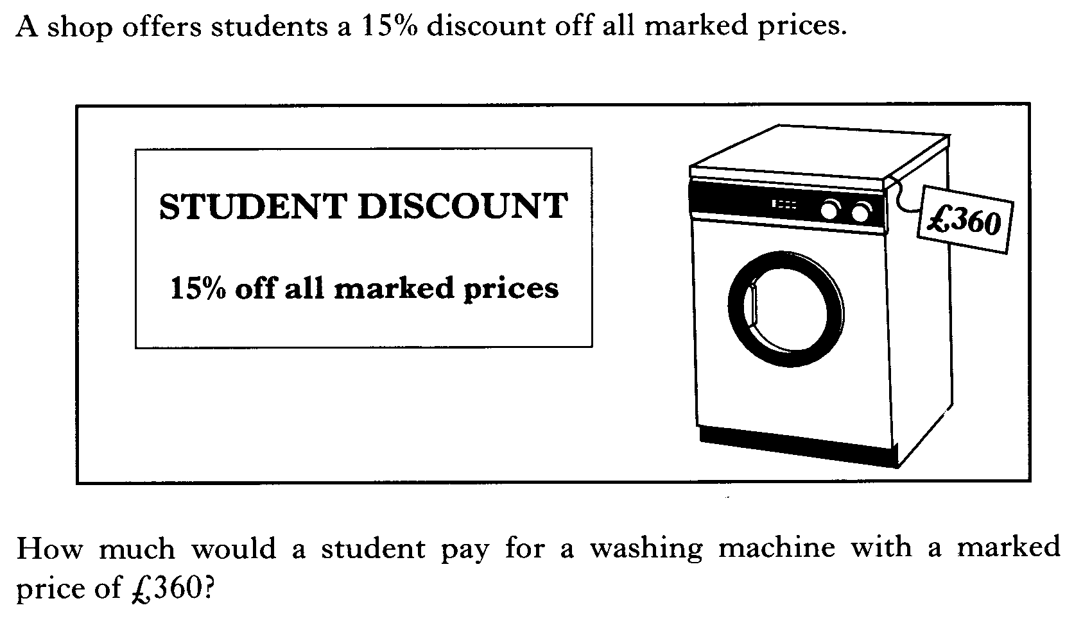

Slide 38
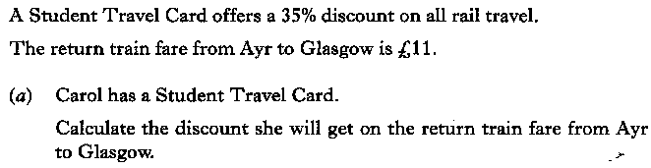

Slide 39
4 RE

Slide 40
1 KU
3 RE

Slide 41
2 KU
4 RE

Slide 42
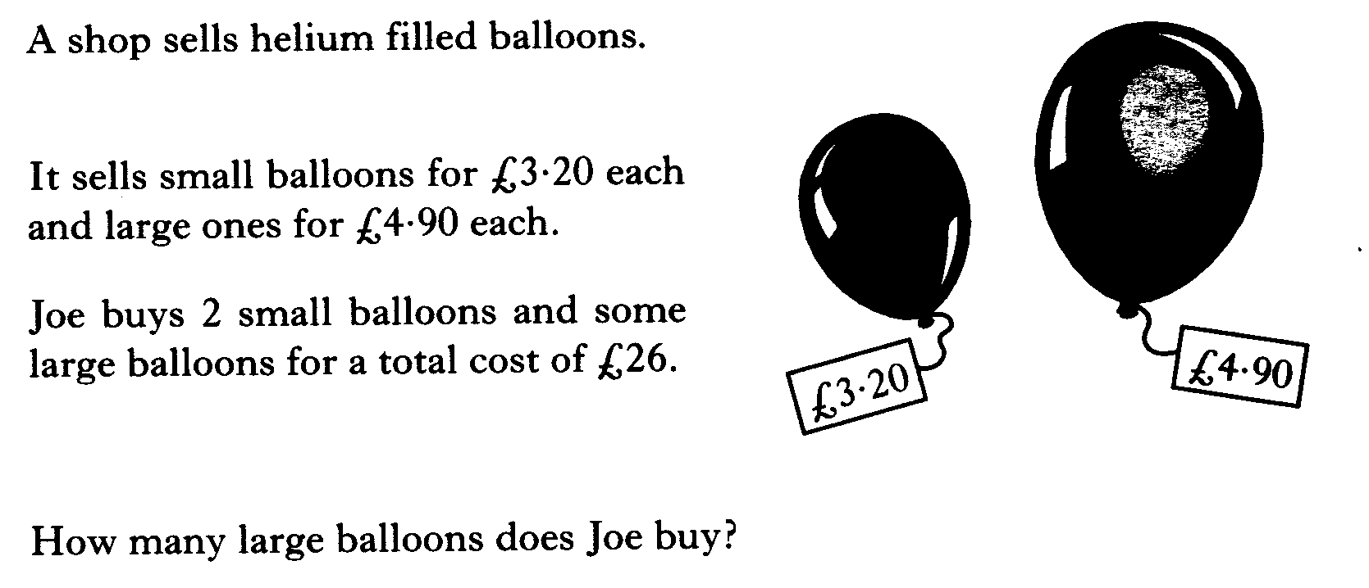

Slide 43
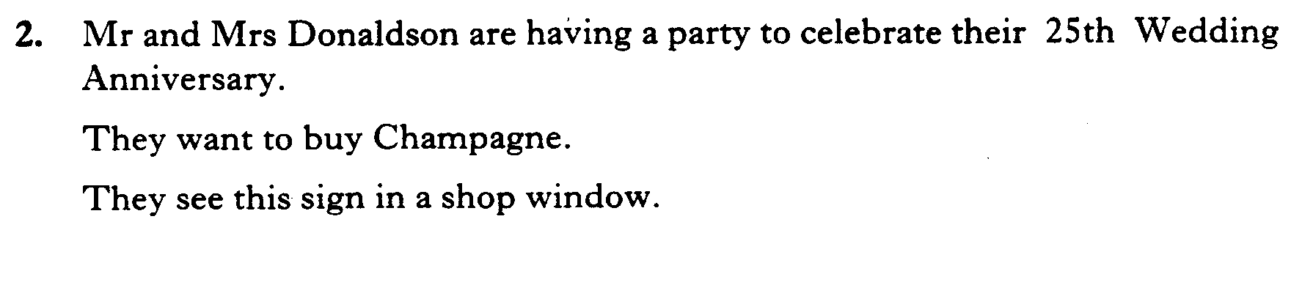
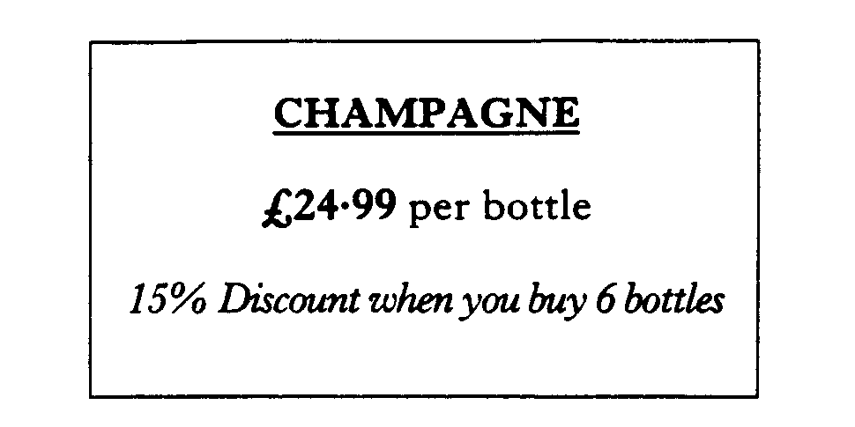
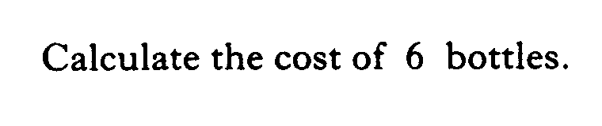

Slide 44
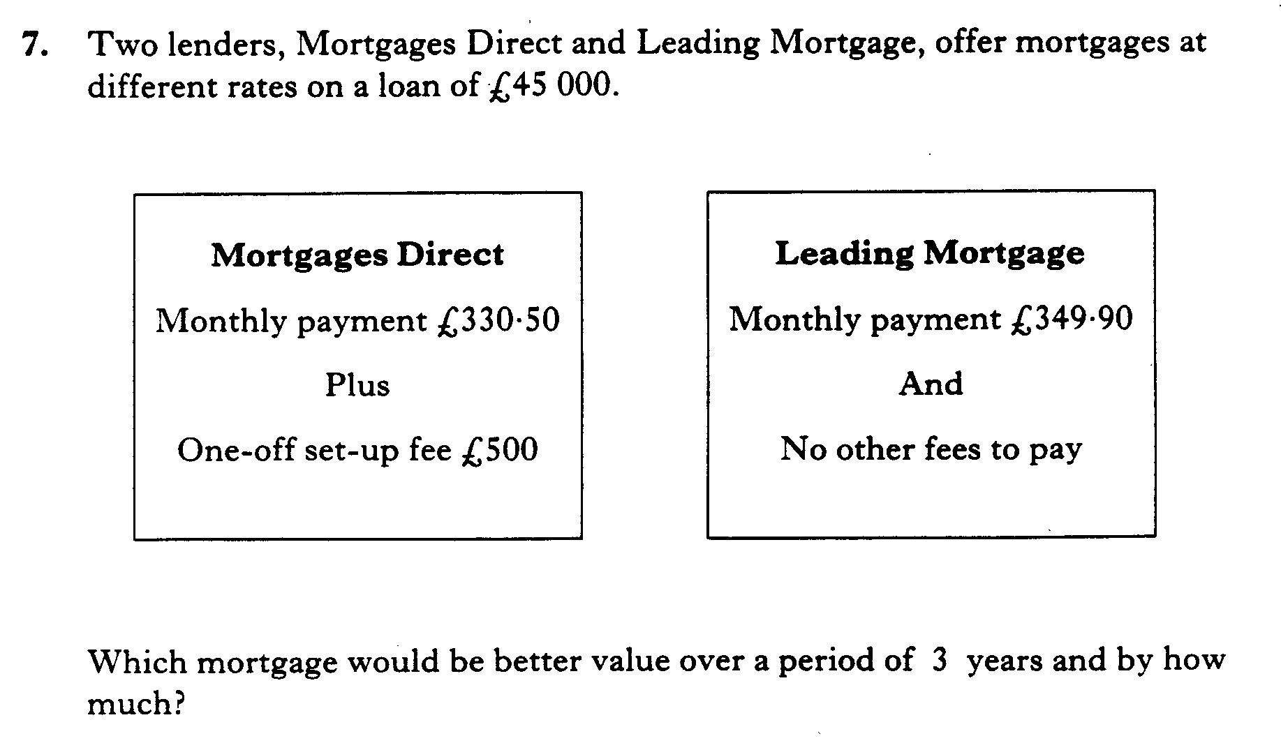

Slide 45
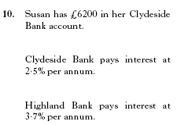
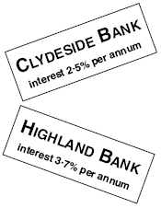

Slide 46
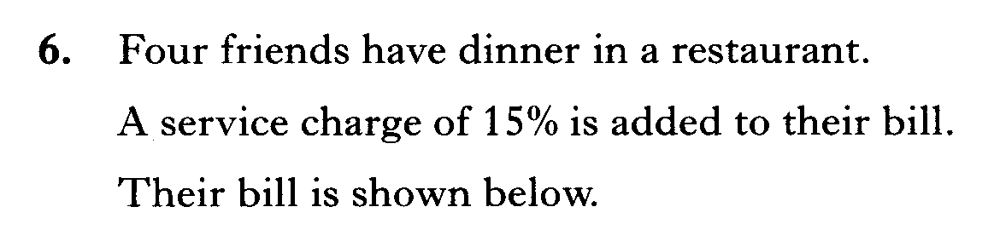
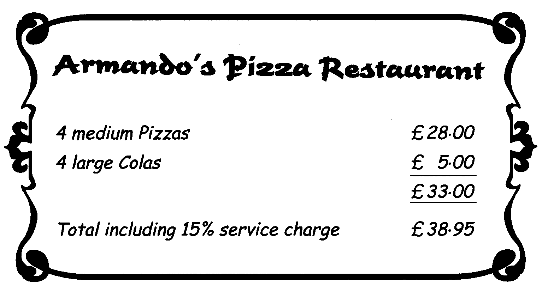
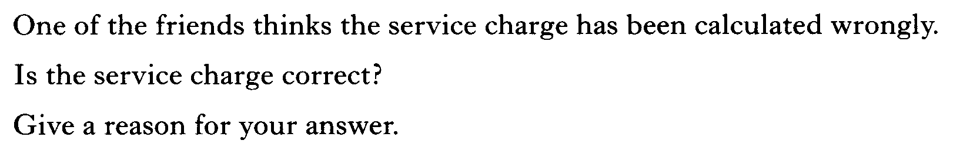

Slide 47
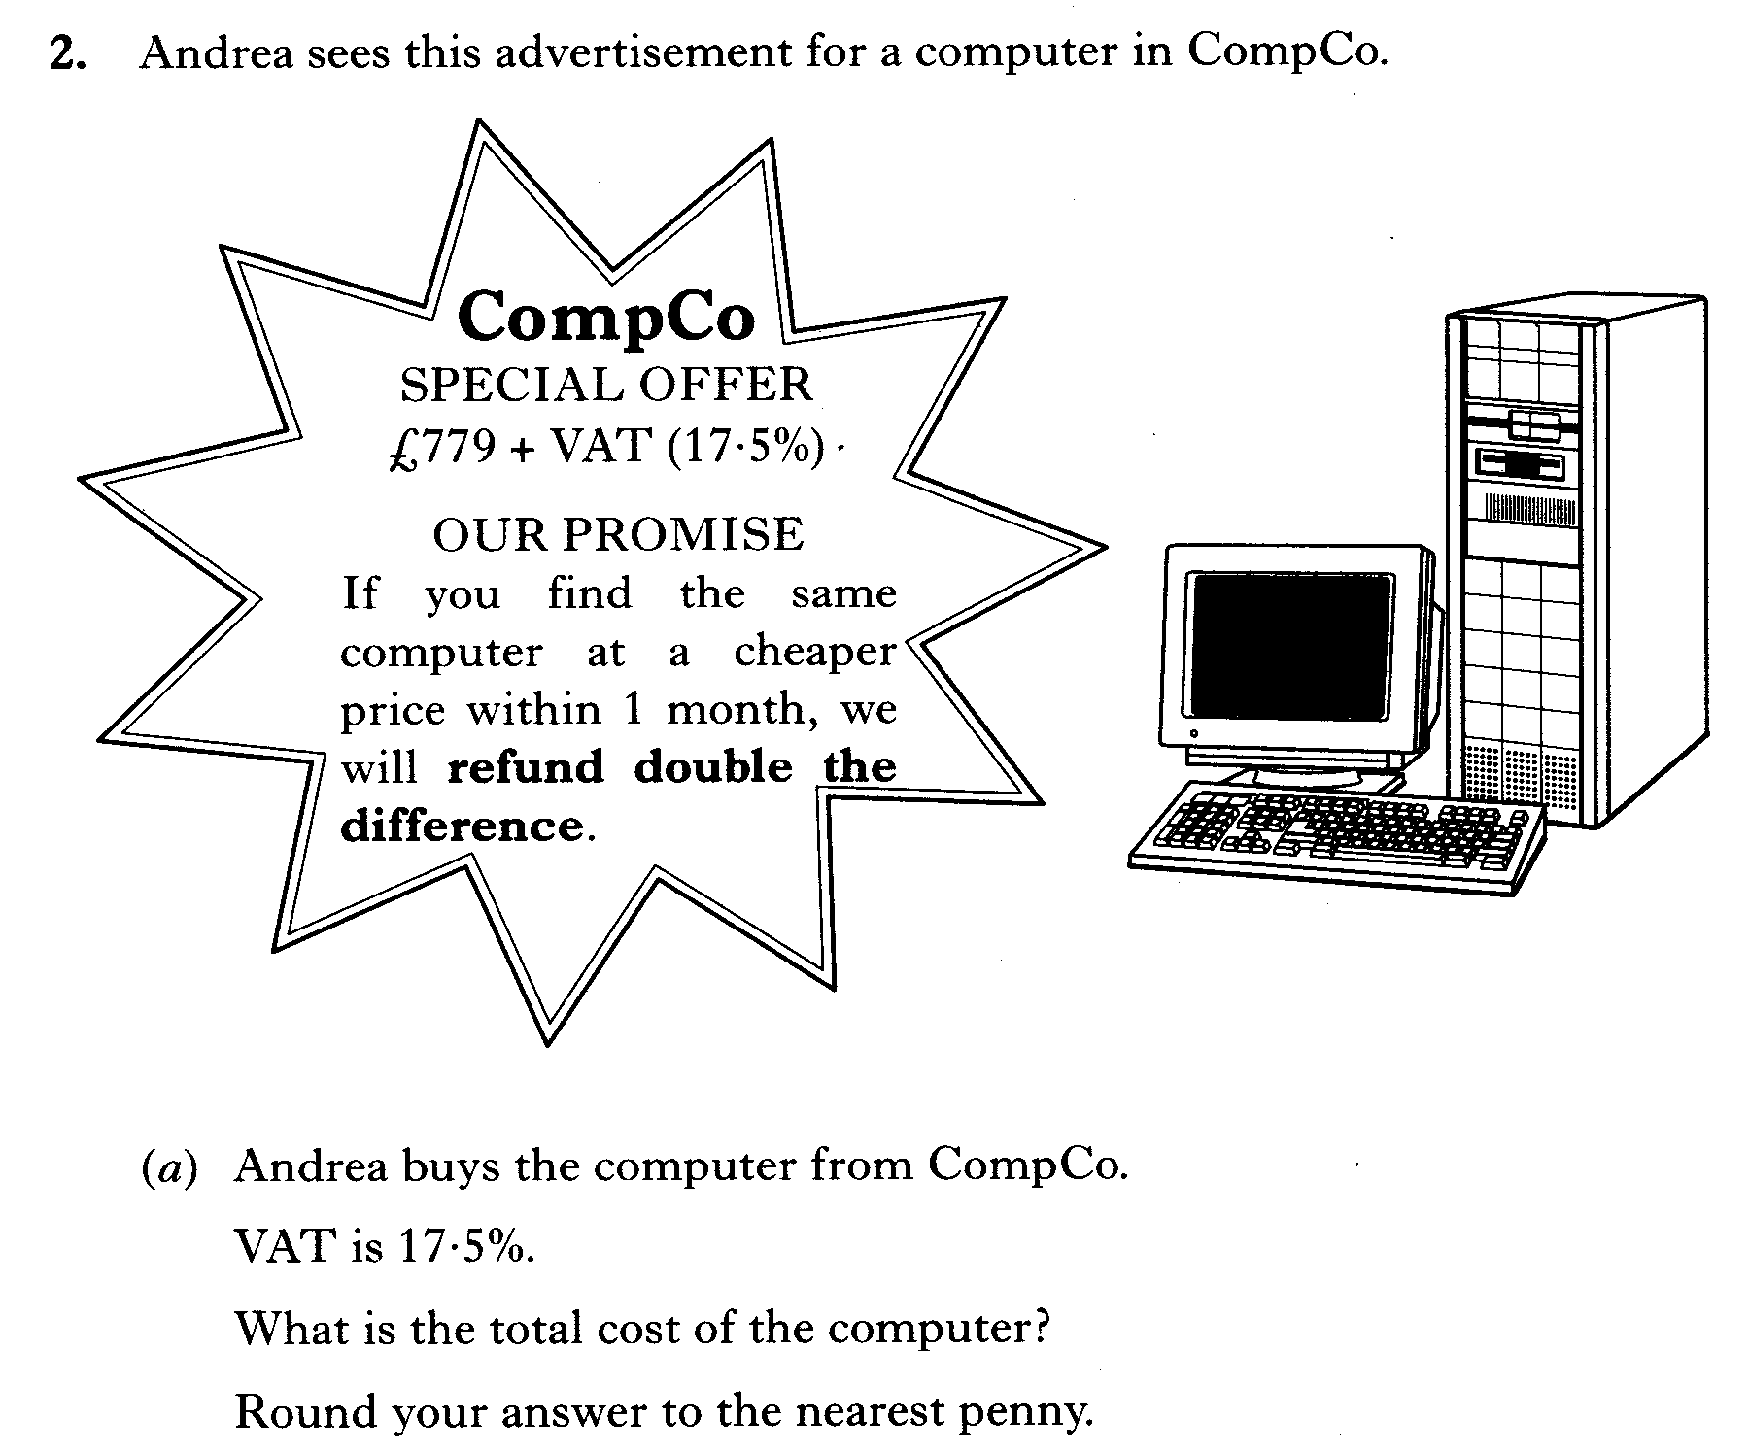
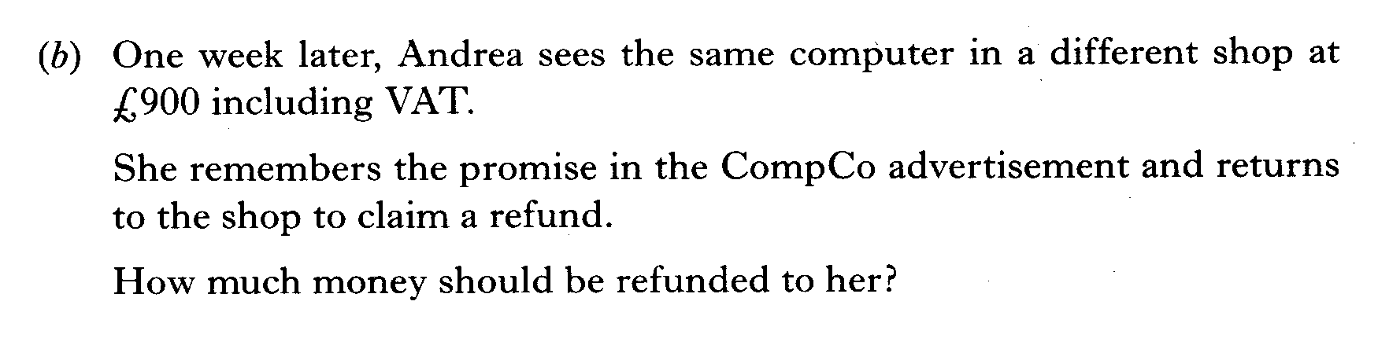

Slide 48
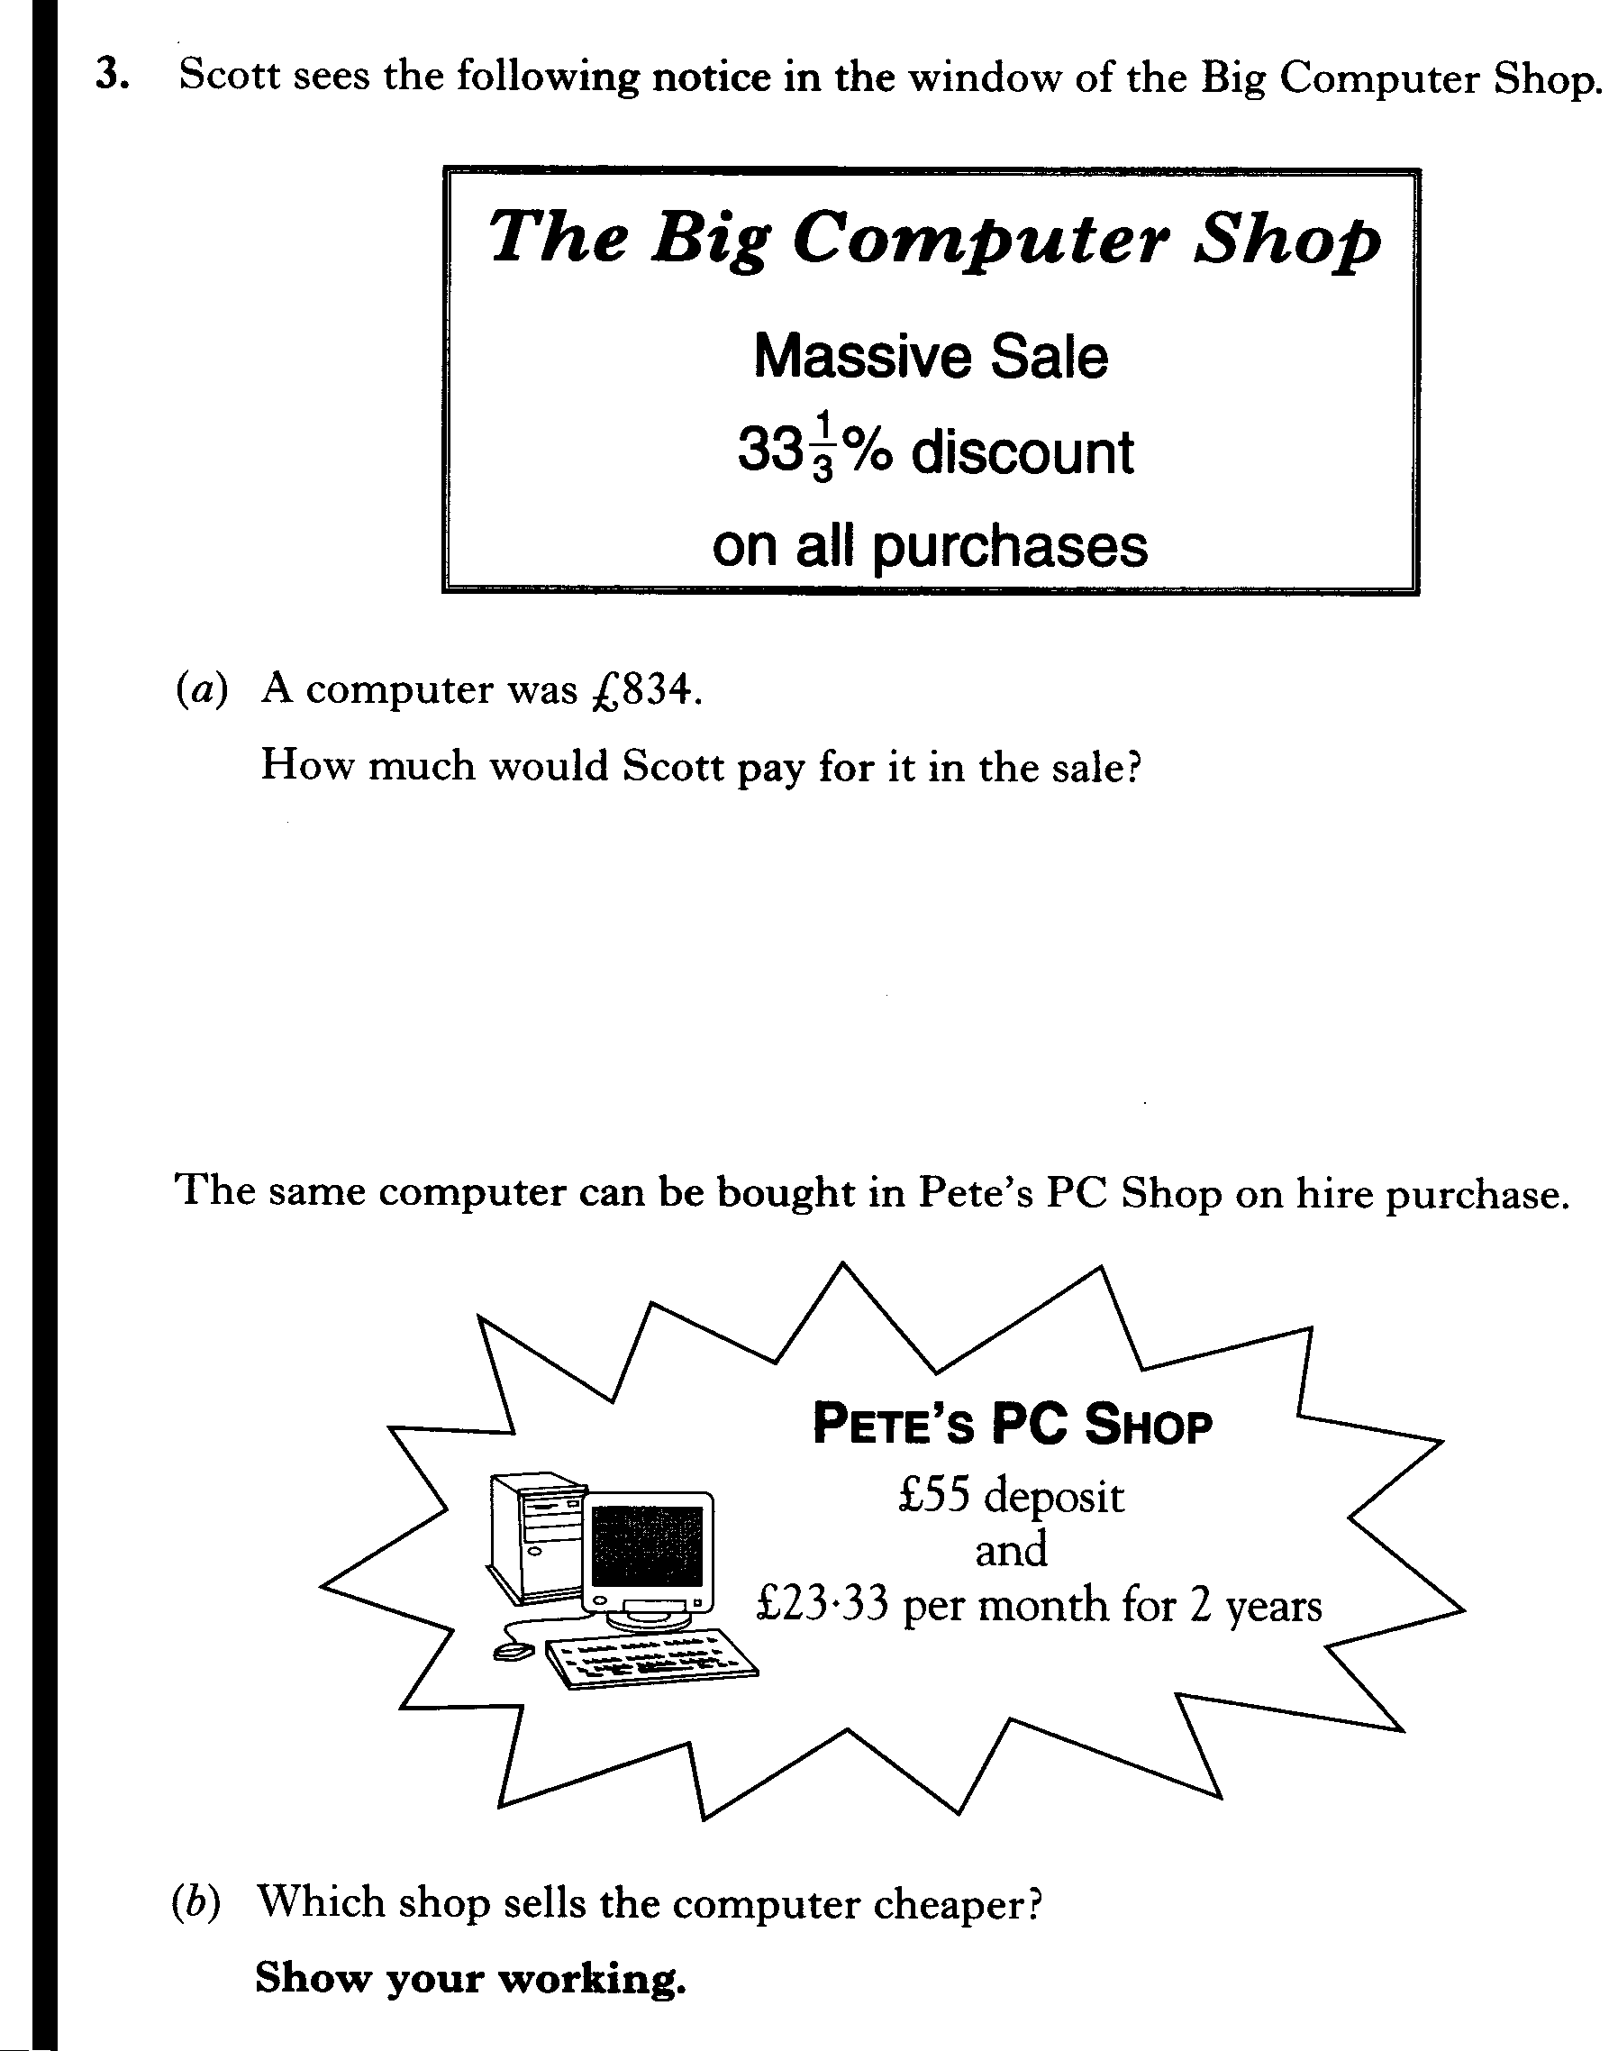

Slide 49
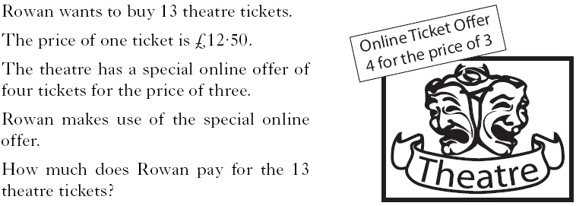

Slide 50
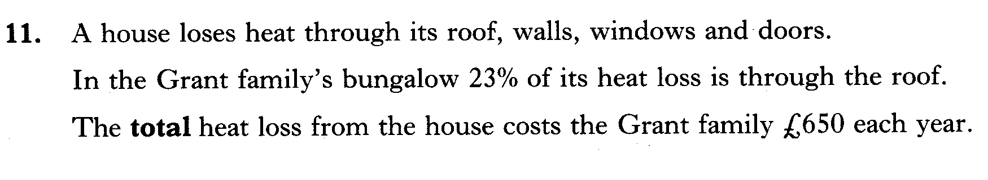

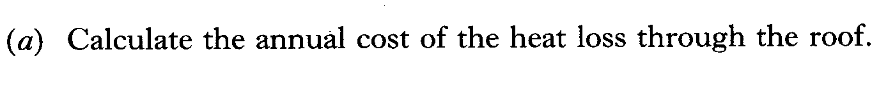
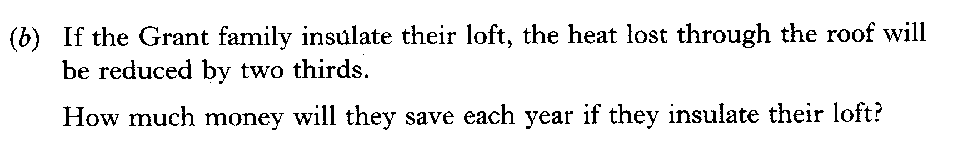
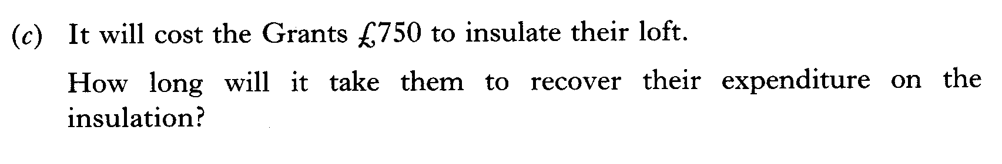

Slide 51
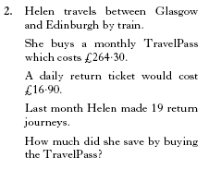
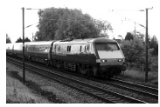

Slide 52
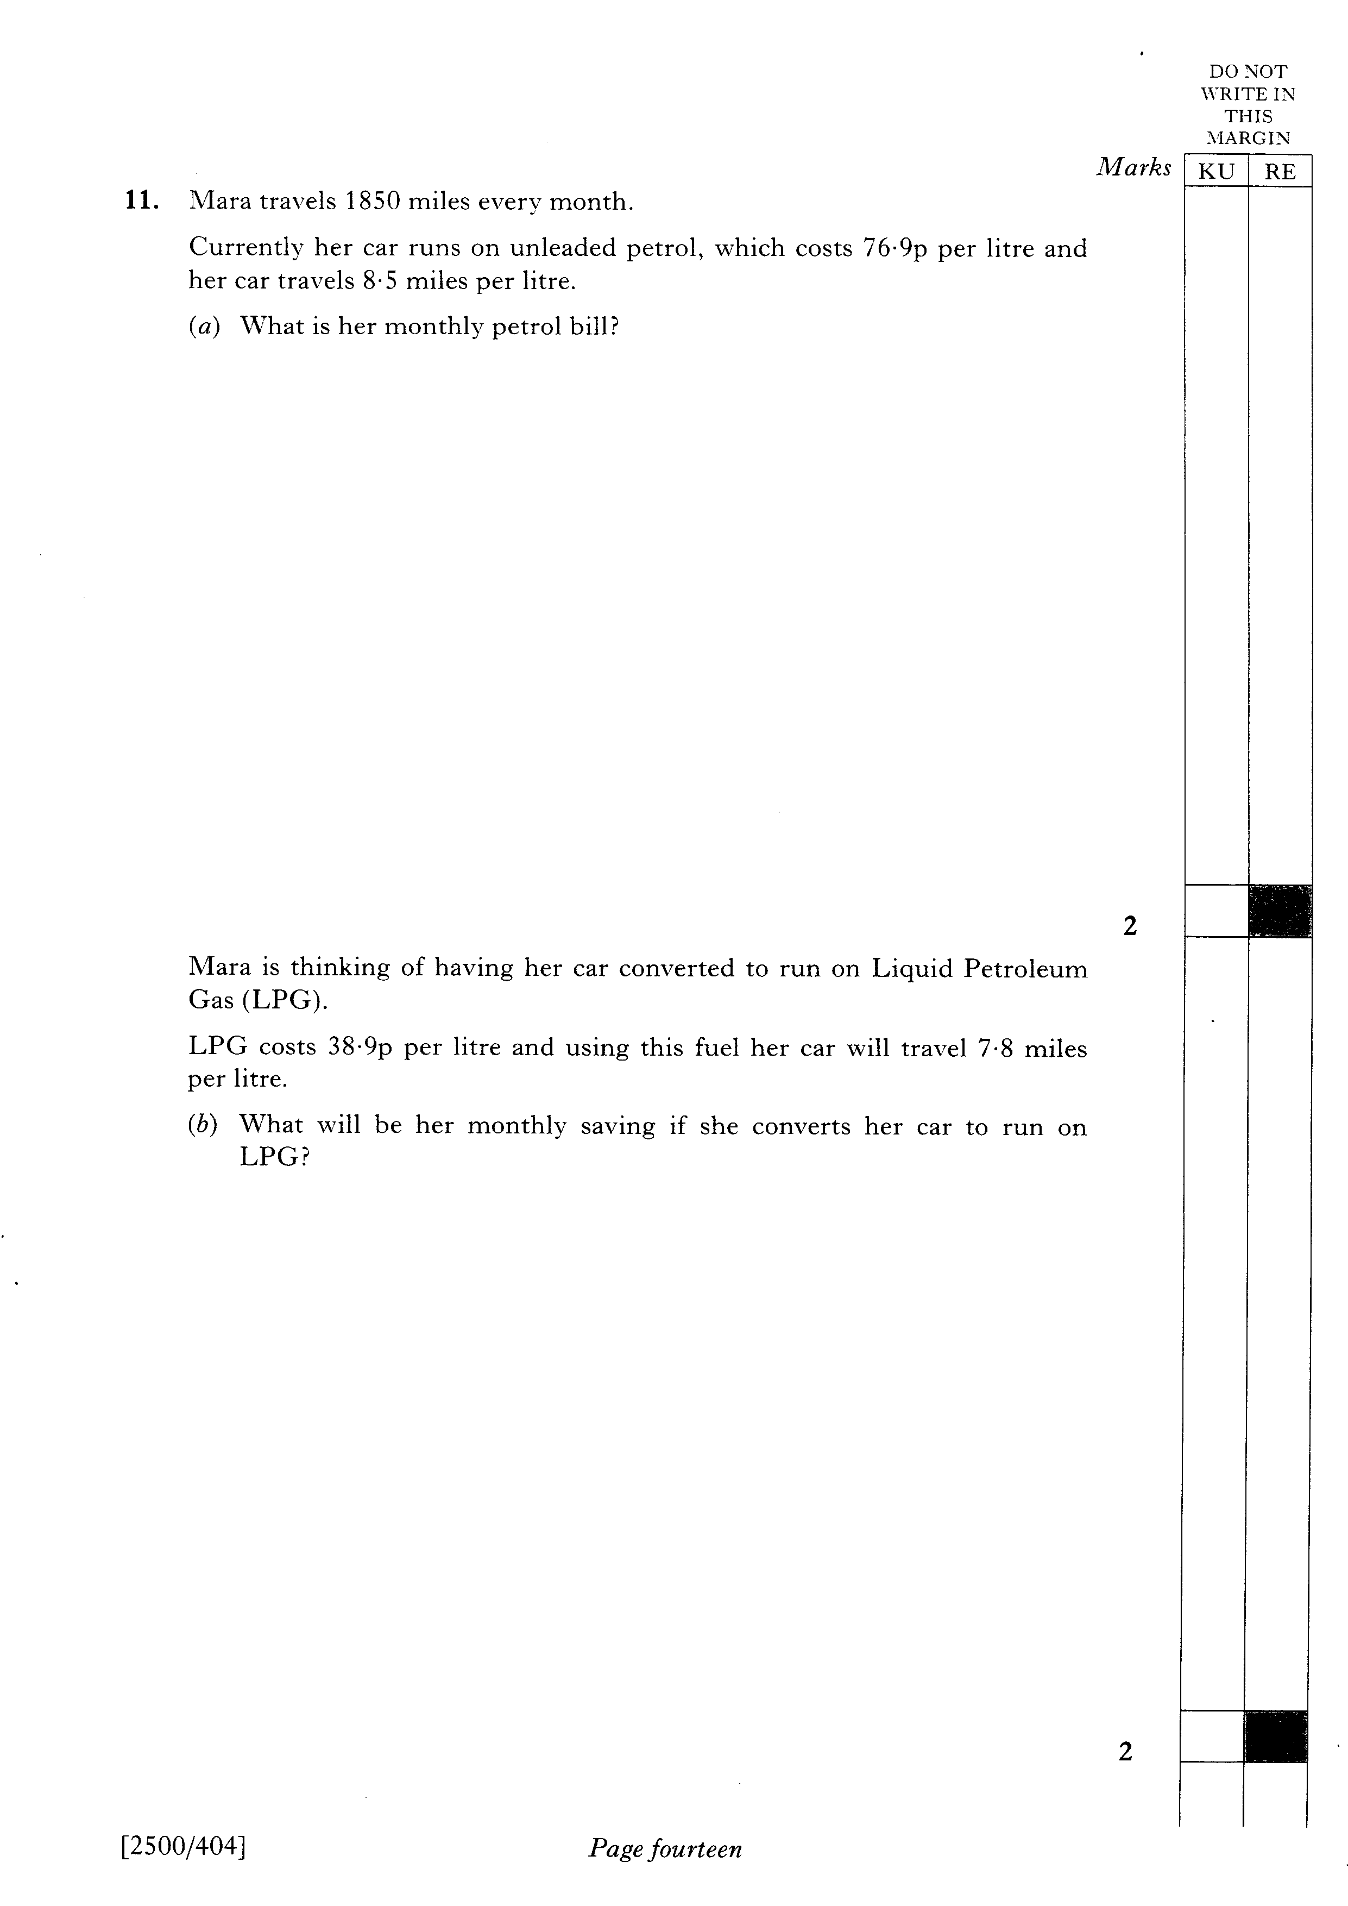

Slide 53
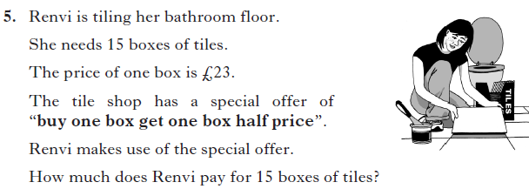
4 marks

