Slide 1
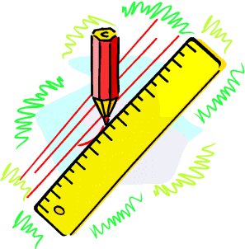

Tolerance
Tolerance
Tolerance Notation
www.mathsrevision.com
Exam Type Questions

Slide 2
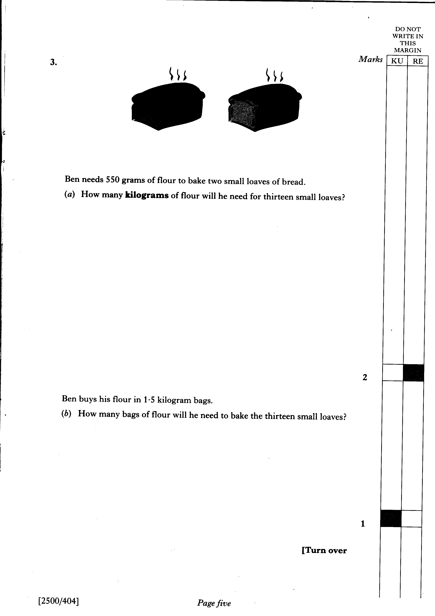
Starter Questions
www.mathsrevision.com

Slide 3
Tolerance
Learning Intention
Success Criteria
  1. We are learning what
  Tolerance is.
  Understand the term Tolerance. .
  2. Calculate and simplify basic Tolerances.
www.mathsrevision.com

Slide 4
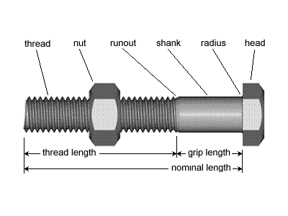
Tolerance
When a builder orders steel bolts to help to a house,
he would like them to be 50 millimetres long EXACTLY.
This is not always possible so the builder allows a ‘little error’ either side of this.
www.mathsrevision.com

Slide 5
Tolerance
Tolerance is written as
(50±2)mm
www.mathsrevision.com
He might be prepared to accept any bolt as long as it
lies between 48mm and 52mm
This means he will accept a bolt which is
within 2mm of the 50mm he asked for.
This is referred to as the
TOLERANCE for the measurement.

Slide 6

Tolerance
Now Try
TJ N4 Lifeskills
Exercise 1
Ch24 (page 191)
www.mathsrevision.com

Slide 7
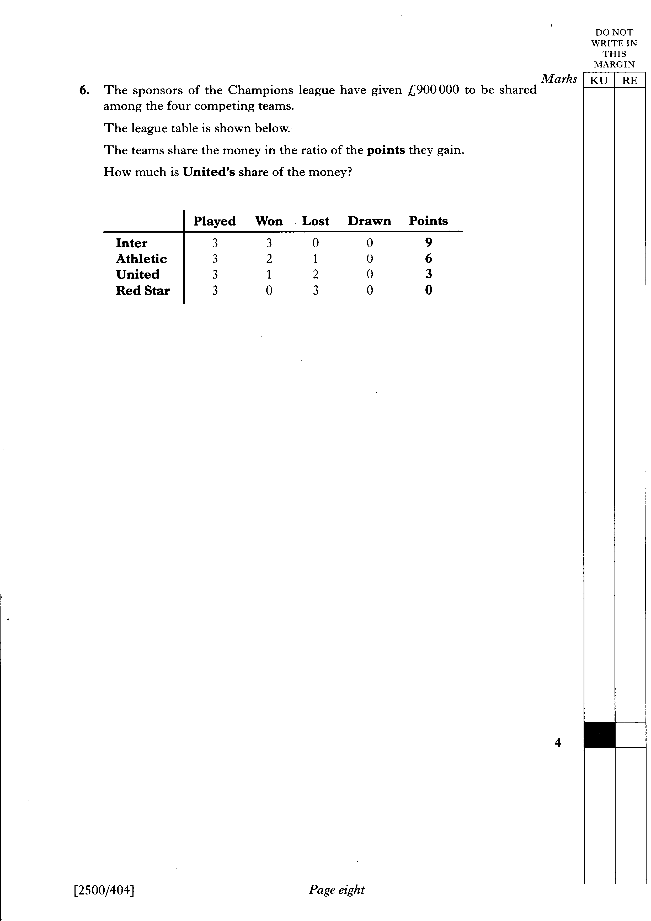
Starter Questions
www.mathsrevision.com

Slide 8
Tolerance
Tolerance Notation
Learning Intention
Success Criteria
  We are learning how to write tolerances in standard notation.
  Write tolerances in standard notation.
www.mathsrevision.com

Slide 9

Tolerance
Tolerance Notation
Example : An acceptable size of apples on sale at Asda
must have a diameter between 8cm and 12cm.
Write the tolerance level in standard notation.
Calculate the middle value
www.mathsrevision.com
Tolerance is written as
(10±2)cm
8 + 12
= 10
2

Slide 10
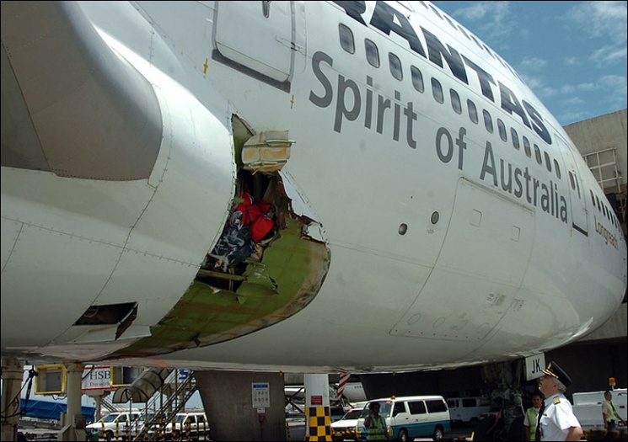
Tolerance
Tolerance Notation
Example : For safety reasons an acceptable rivet joint
for an aeroplane joint must be between
19.9mm and 20.1mm in diameter.
Write the tolerance level in standard notation.
www.mathsrevision.com
Calculate the middle value
Tolerance is written as
(20±0.1)mm
19.9 + 20.1
= 20
2

Slide 11

Have you updated your Learning Log ?
Tolerance
Tolerance Notation
Now Try
TJ N4 Lifeskills
Exercise 2
Ch24 (page 193)
www.mathsrevision.com

Slide 12
