Slide 1
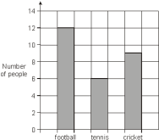
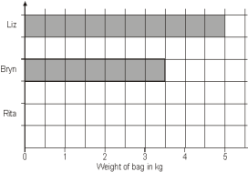
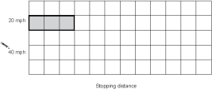
Bar Charts
WALT:
WILF:
Understand and draw different kinds of bar charts
Is the answer to:
Is the answer to:
Is the answer to:
How many people like cricket?
Rita’s bag weighs 1.5kg. Complete the chart.
The stopping distance for 20mph is 12m, 40mph is 36m and 60mph is 72m. Complete the chart. The bar for60mph will not fit. Explain why?
Bar Chart Category Frequency Grouped data
Table Compound bar chart Difference
Keywords

Slide 2

Bar Charts
Starter:
Complete the missing information in the table (Pictogram)
Favourite Subject
Pictogram
Frequency
Key:
= 4 people
Maths
8
English
10
Science
9
Art
12
PE
14
History
7

Slide 3

Bar Charts
Starter:
Complete the Tally Chart Below
Favourite Animal
Tally
Frequency
Dog
Cat
Rabbit
4
Hamster
13
Other
6

Slide 4
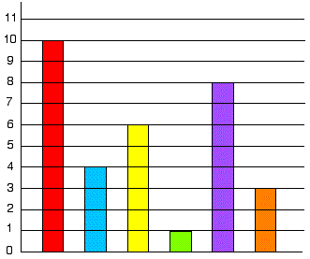
Bar Charts
Key Question:
Tim's class collected information about all their pets. They have six different kinds of pets between them.
This is the block graph they are making to show how many of each pet the class has altogether.
The children have not yet put in the animal names under each column. Can you do this for them using the information below?
There are two less cats than dogs.
Only one child has a parrot at home.
The number of fish added to the number of gerbils is equal to the number of dogs.
There are twice as many fish as hamsters.
There are half the number of gerbils as there are cats.

Slide 5
Bar Charts:
Draw a bar chart for this set of data.
Favourite Subject
Freq.
14
Frequency
13
Maths
8
12
11
English
10
10
Science
9
9
8
Art
12
7
6
PE
14
5
4
History
7
3
2
1
0
Maths
English
Science
Art
PE
History
a
Which subject was most popular?
PE
b
Work out the difference between PE and History.
14 – 7 = 7

Slide 6
Comparative Bar Charts:
Fav. Sport | Football | Netball | Basketball | Tennis | Other
Boys | 8 | 2 | 5 | 3 | 2
Girls | 3 | 10 | 2 | 4 | 3
The information in the table shows the sports boys and girls in year 7 enjoy the most.
Key:
Boys
Girls
Frequency
10
9
a
Draw a bar chart
8
7
b
Using the bar chart work out the difference between the boys favourite sport and the girls favourite sport.
6
5
4
3
2
1
10 – 8 = 2
0
Football
Netball
Basketball
Tennis
Other

Slide 7
Composite Bar Charts:
Age | TV | Newspapers | Internet | Social Media | Other
10 - 20 | 2 | 0 | 5 | 7 | 1
21 – 40 | 3 | 2 | 6 | 3 | 2
41 + | 5 | 5 | 2 | 2 | 2
The table above shows where people get their news from.
Frequency
Key:
13
12
10 - 20
11
21 - 40
10
40+
9
a
Draw a bar chart
8
7
6
b
Where do most people like to get there news from?
5
4
3
2
1
0
TV
N. Papers
Internet
S. Media
Other

Slide 8
Bar Charts
Key Question:
Tim's class collected information about all their pets. They have six different kinds of pets between them.
This is the block graph they are making to show how many of each pet the class has altogether.
The children have not yet put in the animal names under each column. Can you do this for them using the information below?
There are two less cats than dogs.
Only one child has a parrot at home.
The number of fish added to the number of gerbils is equal to the number of dogs.
There are twice as many fish as hamsters.
There are half the number of gerbils as there are cats.

Slide 9
Bar Charts
WALT:
WILF:
Understand and draw different kinds of bar charts
Is the answer to:
Is the answer to:
Is the answer to:
How many people like cricket?
Rita’s bag weighs 1.5kg. Complete the chart.
The stopping distance for 20mph is 12m, 40mph is 36m and 60mph is 72m. Complete the chart. The bar for60mph will not fit. Explain why?
Bar Chart Category Frequency Grouped data
Table Compound bar chart Difference
Keywords

