Slide 1
Level 1
Interpreting Pie

Slide 2
How many degrees is the Pink sector?
90⁰

Slide 3
How many degrees is the orange sector?
45⁰

Slide 4
In a class of 32, how many always do their homework?
^{Sometimes}
180⁰
^{always}
^{Never}
16

Slide 5
In a class of 40, how many liked ICT?
ICT
English
PE
History
5

Slide 6
A group 68 pupils were surveyed on their favourite flavour of crisps. How many liked ready salted?
^{Beef}
^{Bacon}
17
^{Cheese &}
^{Onion}
^{Ready}
^{salted}

Slide 7
24 people, how many like pink?
18

Slide 8
32 people, how many like blue?
8

Slide 9
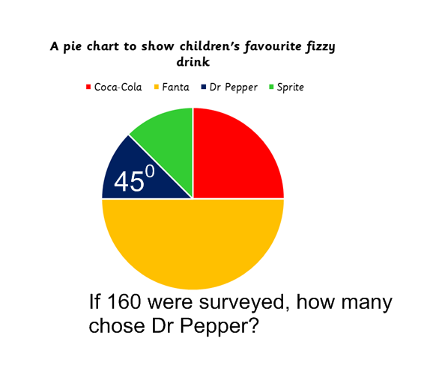
20

Slide 10
45
If 180 were surveyed, how many chose coca-cola

Slide 11
270 pupils surveyed on how they came to school. How many cycled to school?
^{Walk}
^{Bus}
90
120⁰
^{Cycle}

Slide 12
Level 2
Interpreting Pie

Slide 13
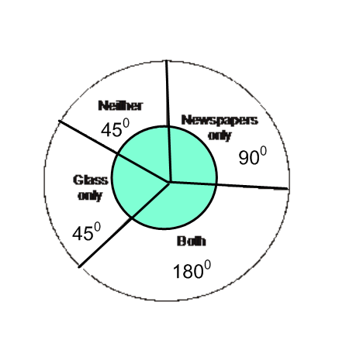
A teacher asked her pupils if they recycled newspapers and glass.
The pie chart shows the results. 5 pupils answered ‘Neither’.How many pupils answered ‘Newspapers only’?
10

Slide 14
270 pupils surveyed on how they came to school. How many cycled to school?
Not drawn accurately
^{Walk}
^{Bus}
15
20⁰
^{Cycle}

Slide 15
333 pupils surveyed on how they came to school. How many came by bus to school?
Not drawn accurately
40⁰
^{Bus}
^{Walk}
37
^{Cycle}

Slide 16
240 pupils surveyed on how they came to school. How many car to school?
Not drawn accurately
40⁰
^{Bus}
^{Walk}
^{Cycle}
40
^{Car}
60⁰

Slide 17
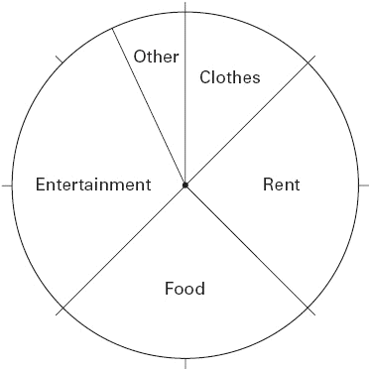
The pie chart shows how John spent his weekly wage.
Workout the size of the angle for Other.
45⁰
22.5⁰
112.5⁰
90⁰
90⁰

Slide 18
The pie chart shows how John spent his weekly wage.
If he earns £250, how much does he spend on entertainment? ( Answers to nearest )
45⁰
£78
112.5⁰
90⁰
90⁰

Slide 19
Workout the size of the angle for walk.
Not drawn accurately
40⁰
^{Bus}
^{Walk}
^{Cycle}
170
^{Car}
60⁰

Slide 20
The pie chart shows how pupils travel to school.
What fraction is represented by car.
Not drawn accurately
40⁰
^{Bus}
^{Walk}
1
6
^{Cycle}
^{Car}
60⁰

Slide 21
The pie chart shows how pupils travel to school.
What fraction is represented by bus.
Not drawn accurately
30⁰
^{Bus}
^{Walk}
^{Cycle}
1
12
^{Car}
60⁰

Slide 22
48 pupils were asked to name their favourite soup. The pie chart represents the results.
How many of the 48 pupils chose vegetable?
45⁰
^{Onion}
^{Chicken}
8
^{Tomato}
^{Vegetable}
60⁰
Not drawn accurately

Slide 23
A teacher asked her pupils if they recycled newspapers and glass.
The pie chart shows the results. 16 pupils answered ‘Both’.How many pupils answered ‘Glass only’?
4
Not drawn accurately

Slide 24
A teacher asked her year group (184) if they recycled newspapers
and glass.
The pie chart shows the results. How many pupils answered ‘Glass only’?
23
Not drawn accurately

Slide 25
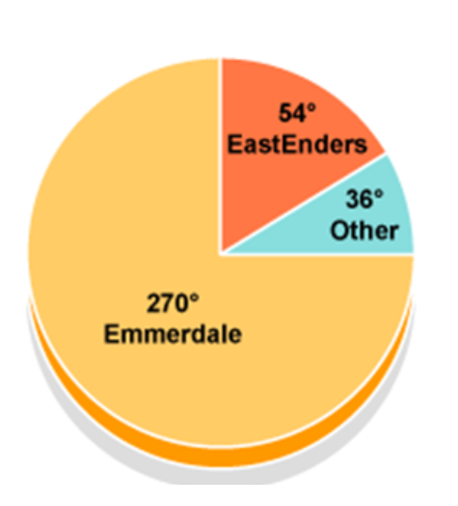
In a survey, 120 school students were asked to name their favourite soap. How many chose Emmerdale?
90

Slide 26
In a survey, 300 school students were asked to name their favourite soap. How many chose Eastenders?
45

Slide 27
In a survey, 190 school students were asked to name their favourite soap. How many chose Others?
19

Slide 28
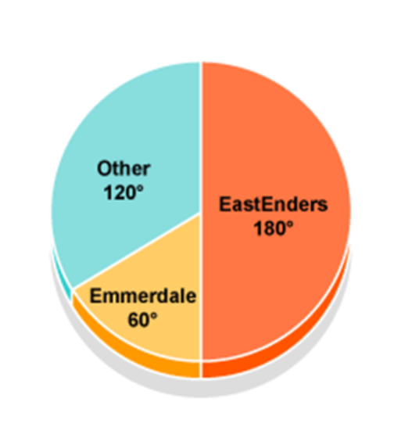
In a survey, 150 school students were asked to name their favourite soap. How many chose other?
50

Slide 29
In a survey, 10 students stated Emmerdale ( represented by 60⁰ in the pie chart) as their favourite soap. How many were surveyed in total?
60

