Slide 1
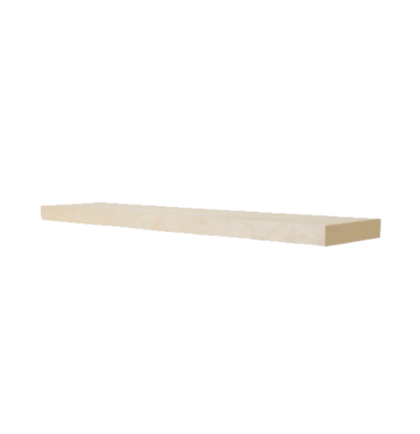

Horizontally
What about if we wanted to store the books horizontally instead?
What do we need to know now?
Length of the shelf
Length of the books

Slide 2
Example 1
How many books can you fit onto the bookshelf horizontally?
5cm
15cm
We can fit 3 books onto the shelf exactly
All the space is used
How can we do this without drawing out a picture every time?
book
5cm
5cm
5cm
book
book
shelf
15 ÷ 5 = 3
15cm
3 books can fit on the shelf

Slide 3
Example 2
How many books can you fit onto the bookshelf horizontally?
8cm
118cm
118 ÷ 8 = 14.75
14 books can fit on the shelf
Remember you cant have part of a book… it would fall off the edge

Slide 4
Example 3
How many books can you fit onto the bookshelf horizontally?
20cm
12cm
3cm
120cm
How many can fit along the shelf?
How many high?
20 ÷ 3 = 6.66…
6 books
120 ÷ 12 = 10 books
Multiply to get total
10 x 6
= 60 books in total

Slide 5
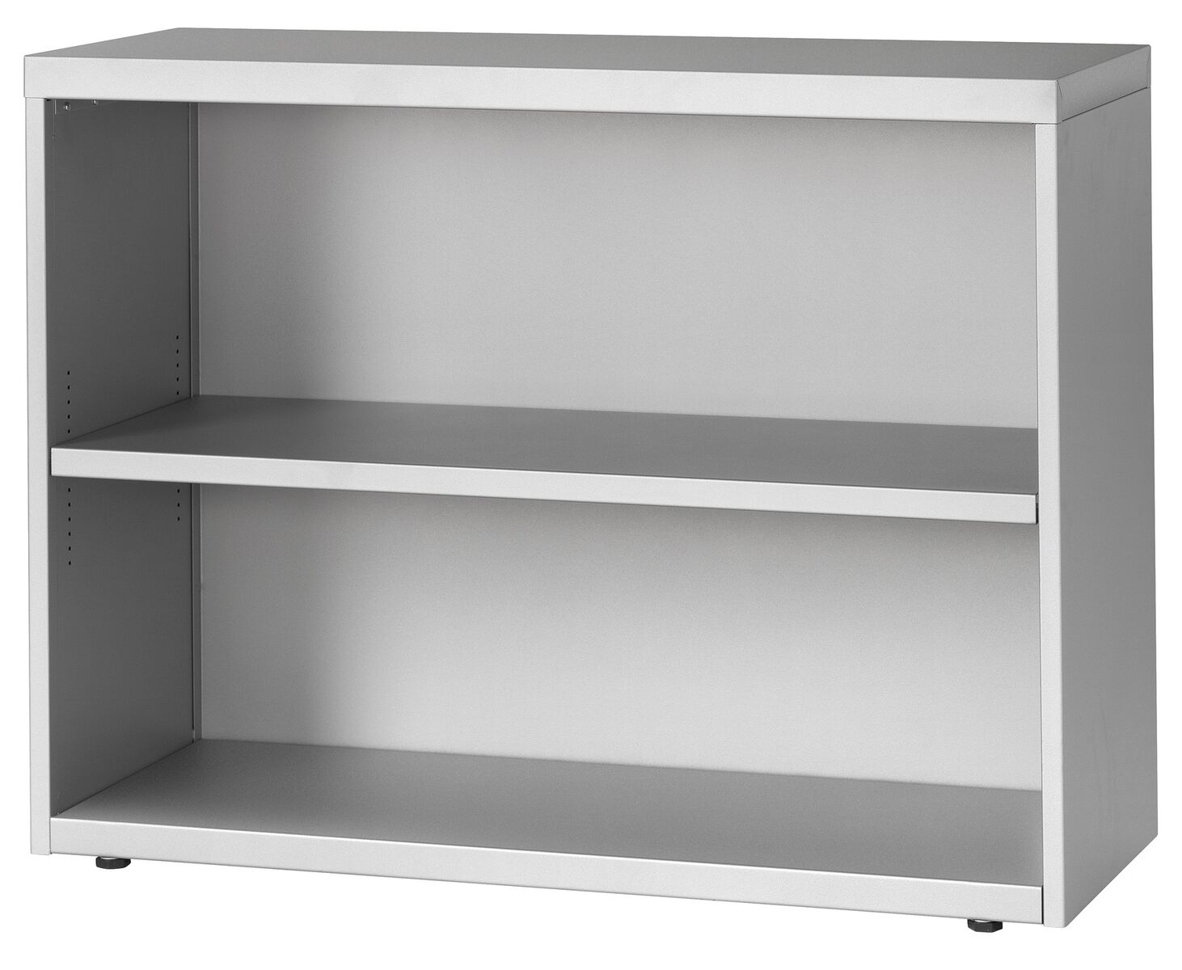
Example 4
How many books can you fit onto the bookshelf horizontally?
30cm
15cm
2.5cm
Multiply to get total
6 x 12
= 72 books in total
90cm
How many can fit along the shelf?
90 ÷ 15 = 6 books
But there are 2 shelves?
How many high?
72 x 2
= 144 books
30 ÷ 2.5 = 12 books

