Slide 1
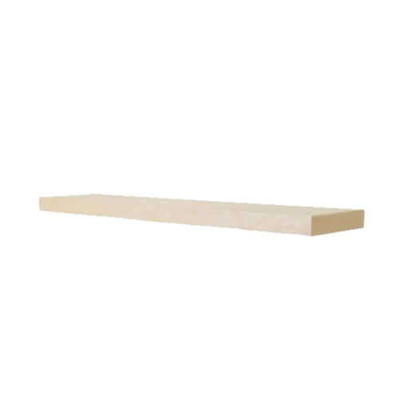
Shelf Packing
Real Life problems involving space and volume occur frequently.
How could we figure out how many books we could fit on a shelf?
What would we need to know?
Length of the shelf
Orientation of the books (vertical/horizontal)
Width of the books

Slide 2
Example 1
How many books can you fit onto the bookshelf vertically?
2cm
10cm
2cm
2cm
2cm
2cm
2cm
We can fit 5 books onto the shelf exactly
book
book
book
book
book
All the space is used
How can we do this without drawing out a picture every time?
shelf
10 ÷ 2 = 5
10cm
5 books can fit on the shelf

Slide 3
Example 2
How many books can you fit onto the bookshelf vertically?
2cm
100cm
This would be time consuming to continue this way
2cm
2cm
book
book
100 ÷ 2 = 50
50 books can fit on the shelf
shelf
100cm

Slide 4
Example 3
How many books can you fit onto the bookshelf vertically?
3cm
124cm
3cm
3cm
book
book
124 ÷ 3 = 41.3333
41 books can fit on the shelf
shelf
Remember you cant have part of a book… it would fall off the edge
124cm

Slide 5
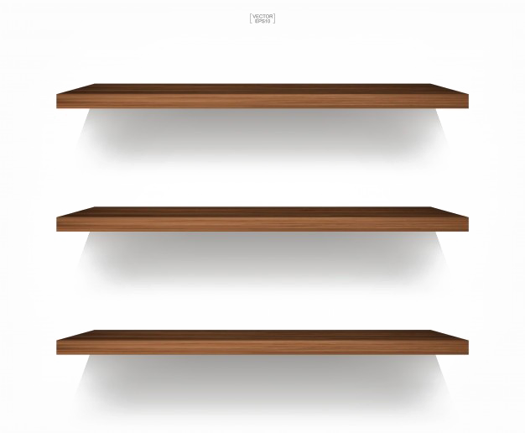
Example 4
How many books can you fit onto the bookshelf vertically?
3cm
First figure out how many can fit on one shelf
66cm
66 ÷ 3 = 22
22 books can fit on one shelf
3cm
3cm
book
book
We have three identical shelves
22 x 3
shelf
= 66 books in total
66cm

Slide 6
Example 5
How many books can you fit onto the bookshelf vertically?
2cm
75cm
75 ÷ 2 = 37.5
37 books can fit on one shelf
2cm
2cm
book
book
We have three identical shelves
37 x 3
shelf
= 111 books in total
75cm

