Slide 1


The Circle
Isosceles Triangles in Circles
Right angle in a Semi-Circle
Tangent Line to a Circle
The Tangent Kite
Finding an ARC length
www.mathsrevision.com
Finding the area of a SECTOR
Mixed questions
Finding the centre angle given ARC length
Finding the centre angle given SECTOR area
Exam questions

Slide 2
Starter Questions
Q1. True or false
Q2. How many degrees in one eighth of a circle.
www.mathsrevision.com
Q3. After a discount of 20% an iPod is £160.
How much was it originally.

Slide 3
Isosceles triangles
in Circles
Aim of Today’s Lesson
To identify isosceles triangles
within a circle.
www.mathsrevision.com

Slide 4
Isosceles triangles
in Circles
When two radii are drawn to the ends of a chord,
An isosceles triangle is formed.
Demo
A
B
xº
xº
www.mathsrevision.com
C

Slide 5
Isosceles triangles
in Circles
Special Properties of Isosceles Triangles
Two equal lengths
www.mathsrevision.com
Two equal angles
Angles in any triangle sum to 180º

Slide 6
Isosceles triangles
in Circles
Q. Find the angle xº.
Solution
Angle at C is equal to:
B
www.mathsrevision.com
xº
C
Since the triangle is isosceles
we have
A
280º

Slide 7
Isosceles triangles
in Circles
Special Properties of Isosceles Triangles
Two equal lengths
www.mathsrevision.com
Two equal angles
Angles in any triangle sum to 180º

Slide 8
Isosceles triangles
in Circles
Q. Find the length of the chord A and B.
Solution
Radius of the circle is 4 + 6 = 10.
B
Since yellow line bisect AB and passes
through centre O, triangle is right-angle.
10
O
www.mathsrevision.com
By Pythagoras Theorem we have
4
6
Since AB is bisected
The length of AB is
A

Slide 9

Isosceles triangles
in Circles
Now try N4+ TJ
Ex18.1
Ch18 (page 139)
www.mathsrevision.com

Slide 10
Starter Questions
Q1. Explain how we solve
Q2. How many degrees in one tenth of a circle.
www.mathsrevision.com
Q3. After a discount of 40% a Digital Radio is £120.
Explain why the originally price was £200.

Slide 11
Semi-circle angle
Aim of Today’s Lesson
To find the angle in a semi-circle
made by a triangle with hypotenuse
equal to the diameter and the two smaller
lengths meeting at the circumference.
www.mathsrevision.com

Slide 12
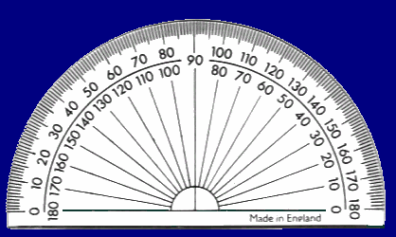

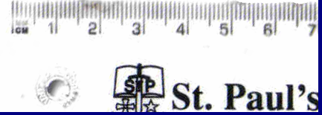
Semi-circle angle
Tool-kit required
1. Protractor
www.mathsrevision.com
2. Pencil
3. Ruler

Slide 13

Semi-circle angle
1. Using your pencil trace round
the protractor so that you have
semi-circle.
2. Mark the centre of the semi-circle.
www.mathsrevision.com
You should have
something like this.

Slide 14
Semi-Circle Angle
x
x
x
Mark three points
Outside the circle
x
x
x
x
2. On the circumference
x
x
3. Inside the circle
www.mathsrevision.com

Slide 15
Semi-Circle Angle
x
For each of the points
Form a triangle by drawing a
line from each end of the
diameter to the point.
Measure the angle at the
various points.
x
x
www.mathsrevision.com
Demo
Log your results in a table.
Outside
Circumference
Inside

Slide 16
Semi-Circle Angle
x
Demo
x
x
Outside
Circumference
Inside
< 90º
= 90º
> 90º
www.mathsrevision.com

Slide 17
 | Outer | Circumference | Inner
Circle 1
Circle 2
Circle 3
Circle Circumference Angle - Investigation Worksheet

Slide 18
Semi-Circle Angle
Now try N4+ TJ
Ex18.2
Ch18 (page 141)
www.mathsrevision.com

Slide 19
Starter Questions
If a = 7 b = 4 and c = 10
Write down as many equations as you can
www.mathsrevision.com
e.g. a + b = 11

Slide 20
Tangent line
Aim of Today’s Lesson
To understand what a tangent line is
and its special property with the
radius at the point of contact.
www.mathsrevision.com

Slide 21
Tangent line
A tangent line is a line that
touches a circle at only one point.
Which of the
lines are
tangent to
the circle?
www.mathsrevision.com

Slide 22
Tangent line
The radius of the circle that touches the tangent
line is called the point of contact radius.
Demo
Special Property
The point of contact radius
is always perpendicular
(right-angled)
to the tangent line.
www.mathsrevision.com

Slide 23
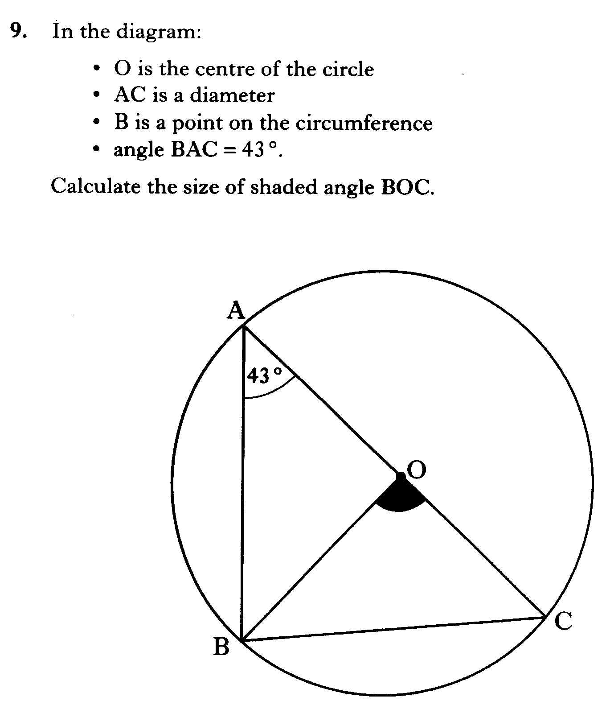

Slide 24
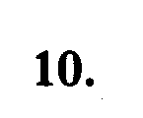
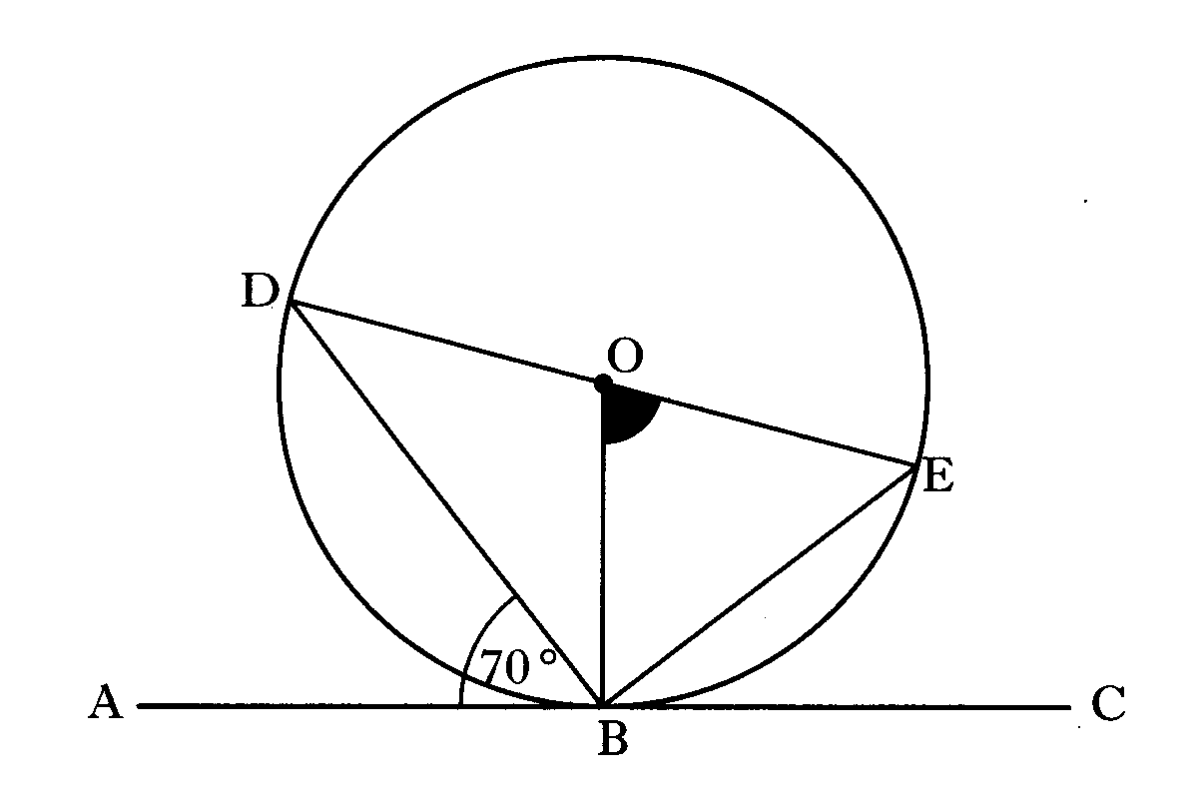
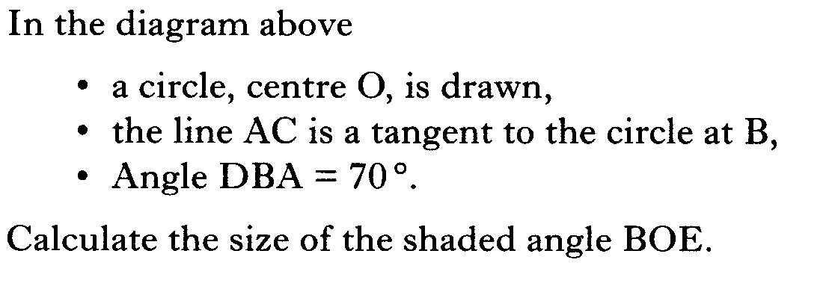

Slide 25
Tangent line
Q. Find the length of the tangent line between
A and B.
Solution
Right-angled at A since
AC is the radius at the point
of contact with the Tangent.
B
10
www.mathsrevision.com
By Pythagoras Theorem we have
A
C
8

Slide 26
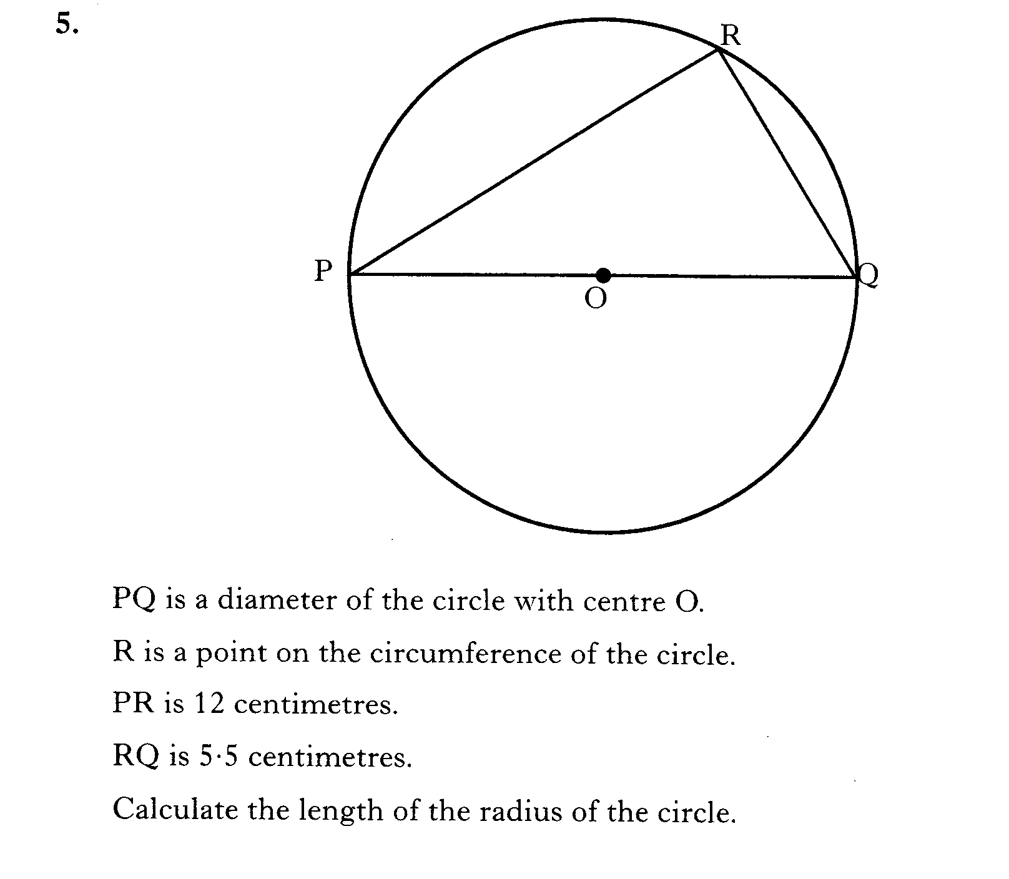

Slide 27
Tangent Line
Now try N4+ TJ
Ex18.3
Ch18.3 (page 143)
www.mathsrevision.com

Slide 28
Starter Questions
Q1. True or false
www.mathsrevision.com
Q2. Expand out (x + 3)(x – 2)

Slide 29
Tangent Kite
Learning Intention
Success Criteria
We are learning properties of a tangent kite.
  Know the properties of tangent kites.
Be able to calculate lengths and angles related to a tangent kite.
www.mathsrevision.com

Slide 30
Tangent Kite
A tangent kite has two right-angles
A tangent kite is made up of two congruent triangles

Slide 31
Tangent Kite
A
90º
138º
42º
C
90º
B
Find all angles in the tangent kite.

Slide 32
Tangent Kite
r
Find the area of the circle.
Using Pythagoras Theorem
50cm
r² = 50² - 40²
40cm
r² = 2500 - 1600
r² = 900
√
r = 30cm
A = πr²
A = π(30)²
A = 2827cm²

Slide 33
Tangent Line
Now try N4+ TJ
Ex18.4
Ch18.3 (page 145)
www.mathsrevision.com

Slide 34
Starter Questions
Q1. True or false
Q2. Expand out (x + 3)(x² + 40 – 9)
www.mathsrevision.com
Q3. I want to make 30% profit on a DVD player I
bought for £80. How much must I sell it for.

Slide 35
Arc length of a circle
Learning Intention
Success Criteria
We are learning to use the arc length formula.
  Know the arc length formula.
Be able to calculate arc length showing appropriate work.
www.mathsrevision.com

Slide 36
Arc length of a circle
Q. What is an arc ?
Answer
An arc is a fraction
of the circumference.
A
www.mathsrevision.com
minor arc
B
major arc

Slide 37
Arc length of a circle
Q. Find the circumference of the circle ?
Solution
10cm
www.mathsrevision.com

Slide 38
Arc length of a circle
Q. Find the length of the minor arc XY below ?
x
Arc length
Arc angle
connection
=
y
πD
360º
6 cm
45º
www.mathsrevision.com
360º
DEMO

Slide 39
Arc length of a circle
Q. Find the length of the minor arc AB below ?
Arc length
Arc angle
connection
=
A
πD
360º
9 cm
www.mathsrevision.com
60º
B

Slide 40
Arc length of a circle
Q. Find the length of the major arc PQ below ?
Arc length
Arc angle
connection
=
P
πD
360º
10 m
www.mathsrevision.com
260º
100º
Q

Slide 41
Arc length of a circle
Nat 5
Now try N5 TJ
Ex13.1
Ch13 (page 126)
www.mathsrevision.com

Slide 42
Starter Questions
Q1. True or false
Q2. Expand out (x + 3)(x² + 40 – 9)
www.mathsrevision.com
Q3. I want to make 30% profit on a DVD player I
bought for £80. How much must I sell it for.

Slide 43
Sector area of a circle
Nat 5
Learning Intention
Success Criteria
We are learning how to find the area of a sector.
  Know the sector formula.
Be able to calculate sector area showing appropriate work.
www.mathsrevision.com

Slide 44

Area of Sector in a circle
A
minor sector
B
www.mathsrevision.com
major sector

Slide 45
Area of Sector in a circle
Q. Find the area of the circle ?
Solution
10cm
www.mathsrevision.com

Slide 46
Area of Sector in a circle
Find the area of the minor sector XY below ?
x
connection
Area Sector
Sector angle
y
=
6 cm
πr²
360º
45º
www.mathsrevision.com
360º
DEMO

Slide 47
Area of Sector in a circle
Q. Find the area of the minor sector AB below ?
connection
A
Area Sector
Sector angle
=
πr²
360º
9 cm
www.mathsrevision.com
60º
B

Slide 48
Area of Sector in a circle
Q. Find the area of the major sector PQ below ?
connection
Sector Area
Sector angle
=
P
πr²
360º
10 m
www.mathsrevision.com
260º
100º
Q

Slide 49
Arc length of a circle
Nat 5
Now try N5 TJ
Ex13.2
Ch13 (page 127)
www.mathsrevision.com

Slide 50
Starter Questions
Q1. Using the balancing method rearrange into x =
www.mathsrevision.com
Q2. True or false 2(x - 3) + 3x = 5x - 6
Q3.

Slide 51
Mixed Question
Nat 5
Learning Intention
Success Criteria
We are doing mixed questions on the circle.
  Identify appropriate formula to use.
Be able to calculate sector / arc showing appropriate work.
www.mathsrevision.com

Slide 52
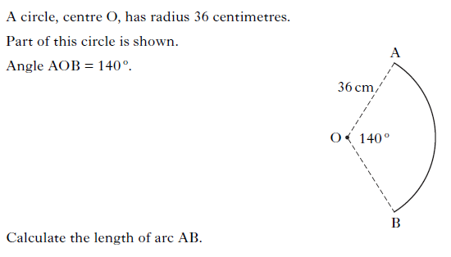

Slide 53
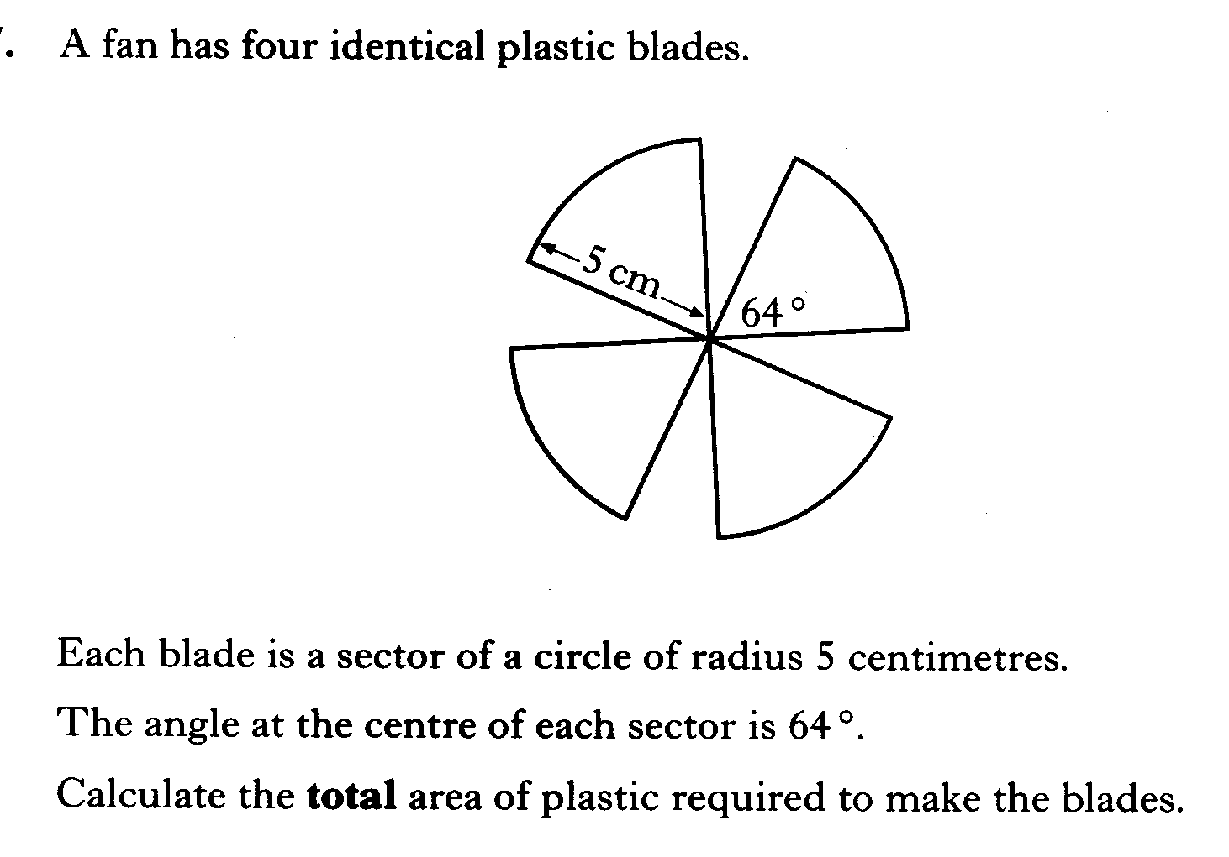

Slide 54
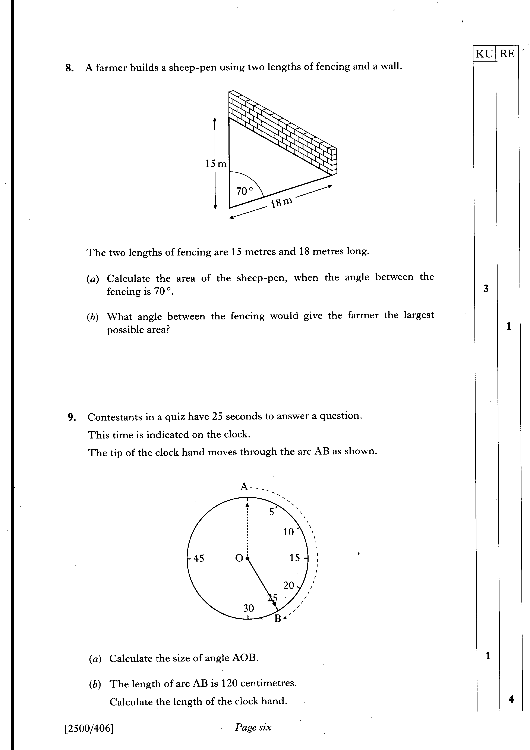

Slide 55
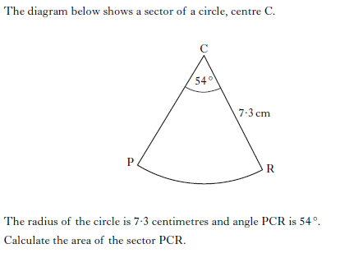

Slide 56
Arc length of a circle
Nat 5
Now try N5 TJ
Ex13.3
Ch13 (page 128)
www.mathsrevision.com

Slide 57
Starter Questions
Rearrange the formula below into xº =
www.mathsrevision.com

Slide 58
Centre Angle (Arc length)
Nat 5
Learning Intention
Success Criteria
We are learning how to find the centre angle given the arc length.
  Know formula.
Be able to calculate centre angle showing appropriate work.
www.mathsrevision.com

Slide 59
Centre Angle (Arc length)
Find the centre angle xº given the arc length is 4.71cm².
x
Arc length
Arc angle
connection
=
y
πD
360º
6 cm
45º
www.mathsrevision.com

Slide 60
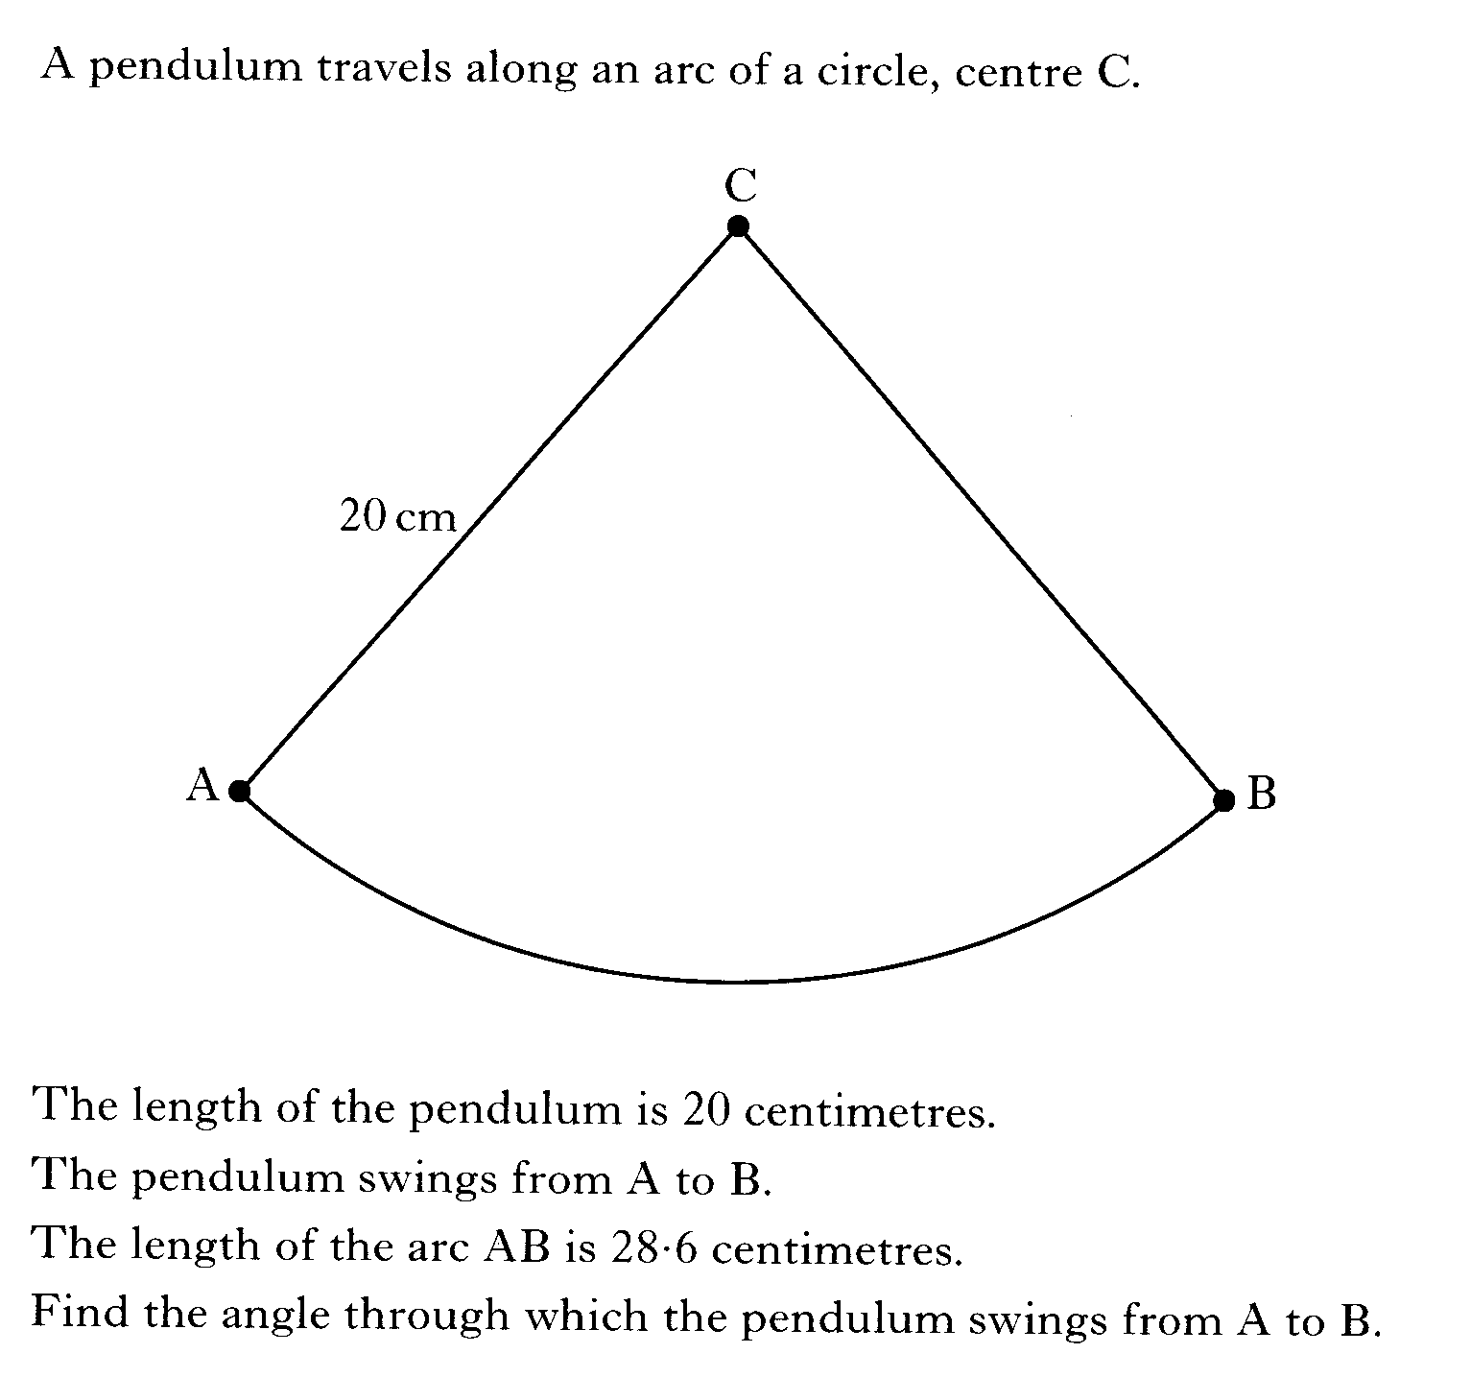

Slide 61
Centre Angle (Arc length)
Nat 5
Now try N5 TJ
Ex13.4
Ch13 (page 129)
www.mathsrevision.com

Slide 62
Starter Questions
Rearrange the formula below into xº =
www.mathsrevision.com

Slide 63
Centre Angle (AºS)
Nat 5
Learning Intention
Success Criteria
We are learning how to find the centre angle given the sector area.
  Know formula.
Be able to calculate centre angle showing appropriate work.
www.mathsrevision.com

Slide 64
Centre Angle (AºS)
Find the angle xº given that the sector area is 42.41cm².
connection
A
Area Sector
Sector angle
=
πr²
360º
9 cm
www.mathsrevision.com
xº
B

Slide 65
Centre Angle (AºS)
Find the angle xº given that the sector area is 51.3mm².
connection
A
Area Sector
Sector angle
=
πr²
360º
7 mm
www.mathsrevision.com
xº
B

Slide 66
Centre Angle (AºS)
Nat 5
Now try N5 TJ
Ex13.5
Ch13 (page 130)
www.mathsrevision.com

Slide 67
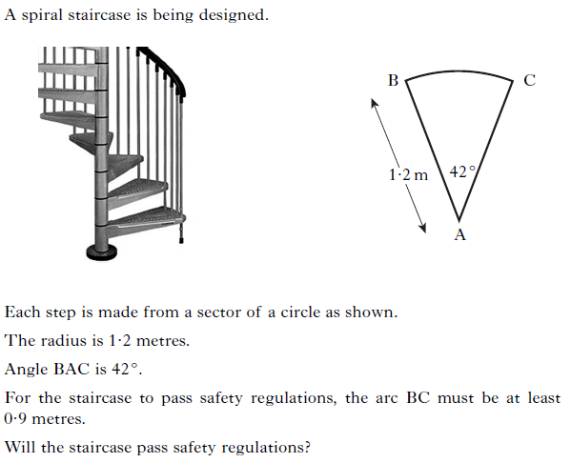

Slide 68
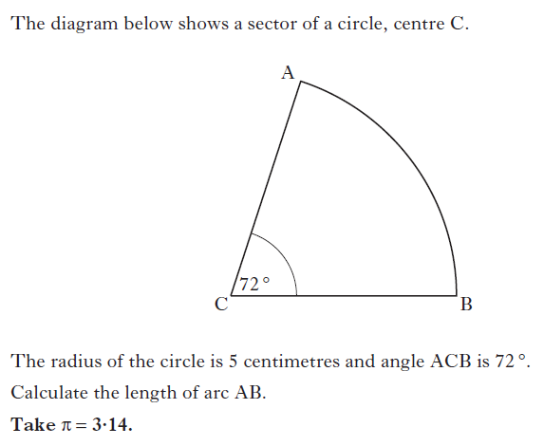

Slide 69
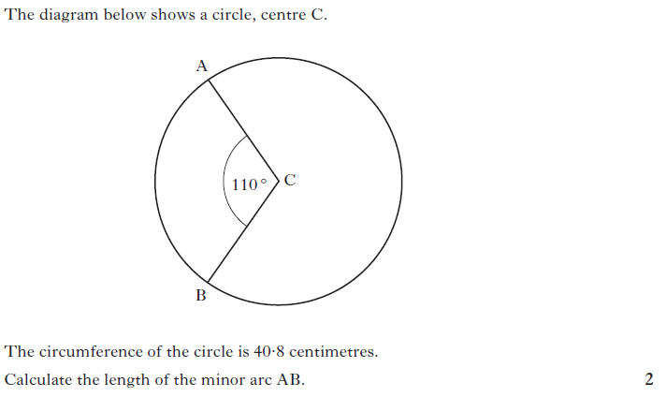

Slide 70
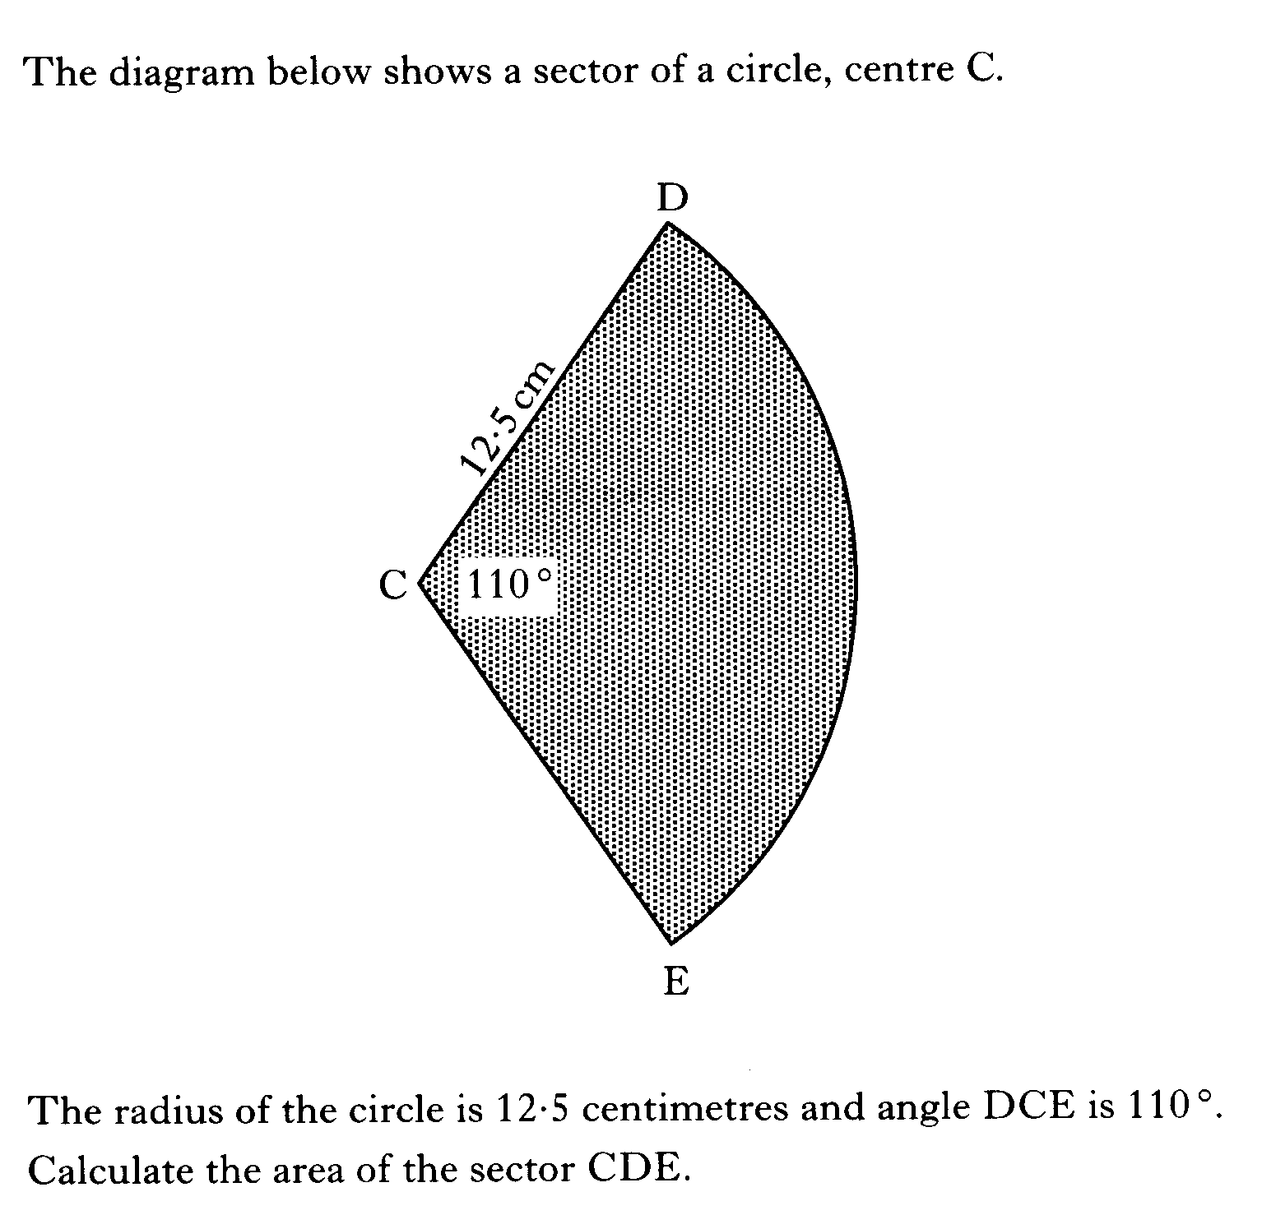

Slide 71
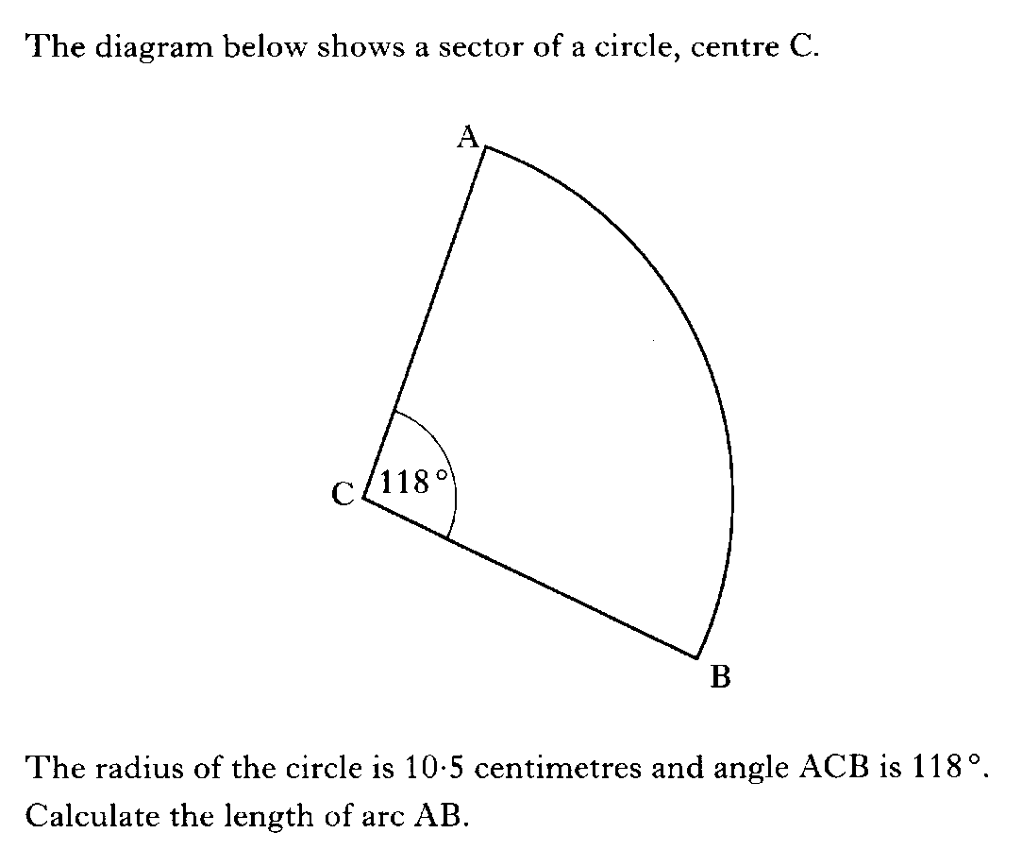

Slide 72
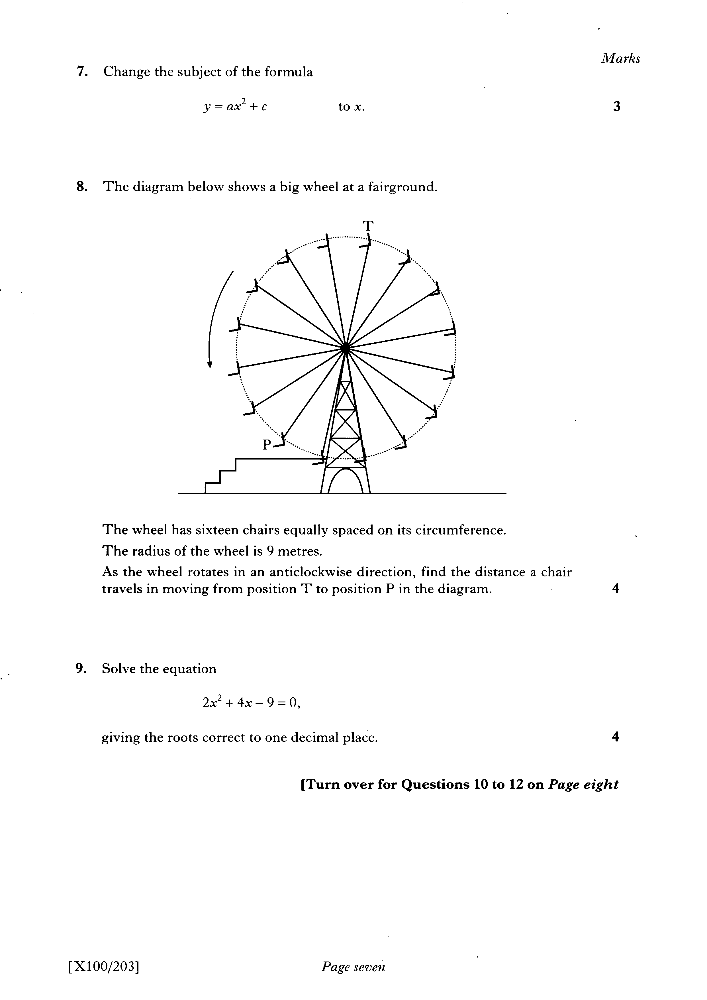

Slide 73
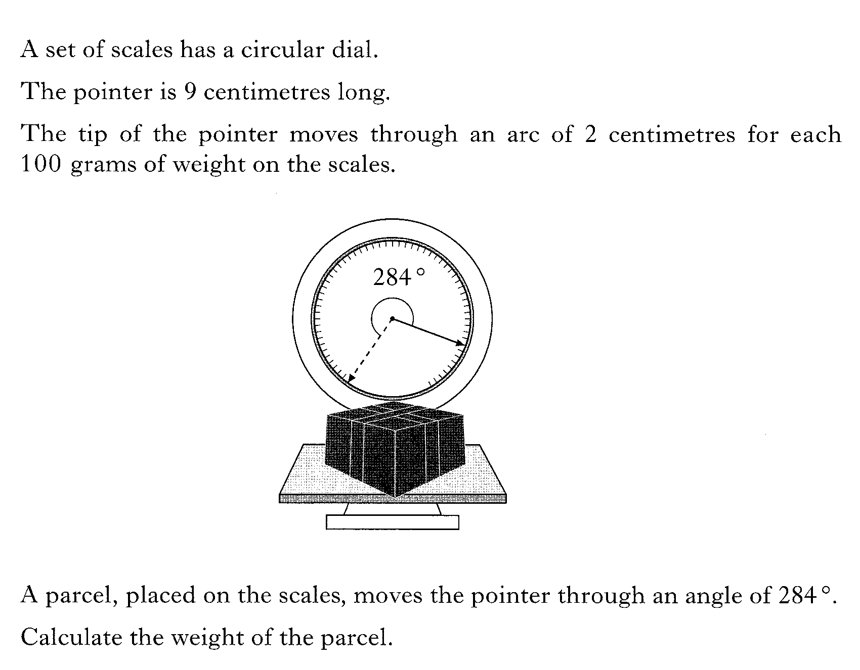

Slide 74

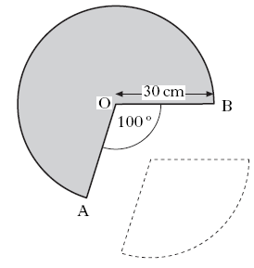
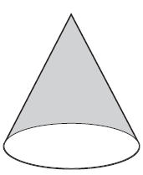


Slide 75
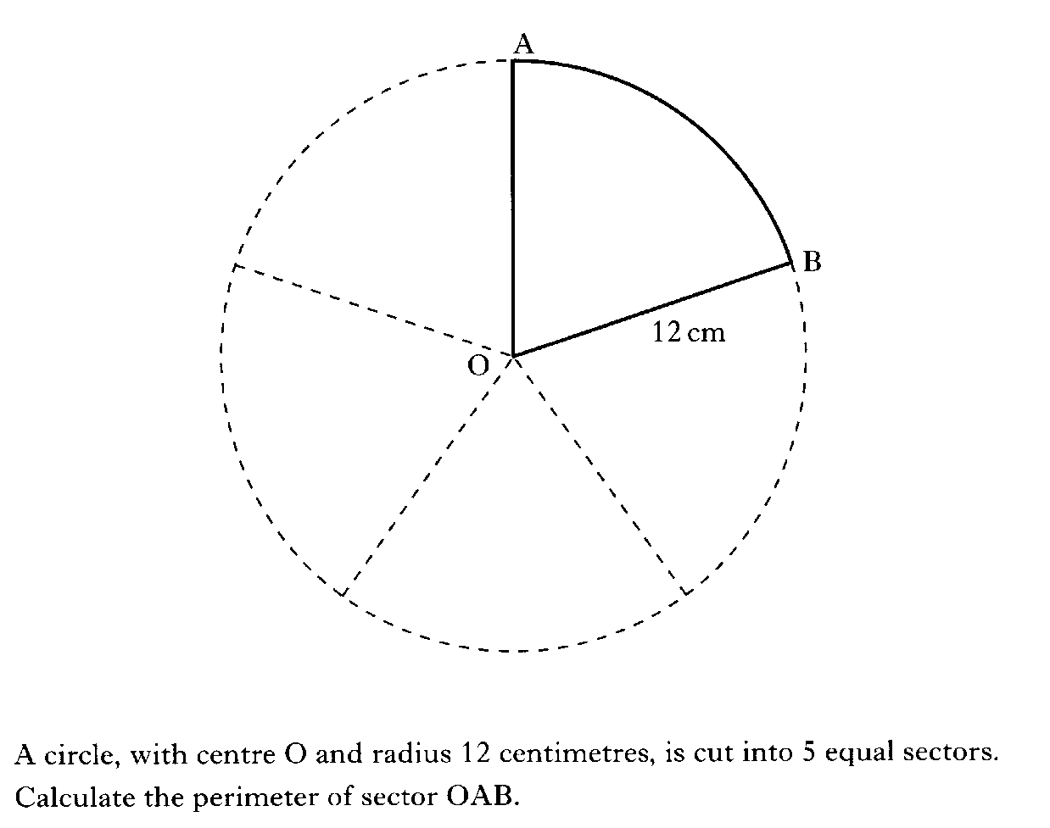

Slide 76
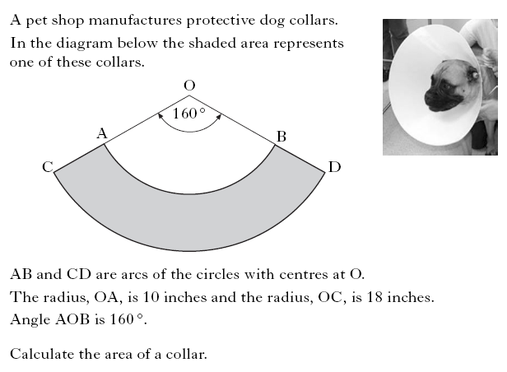

Slide 77
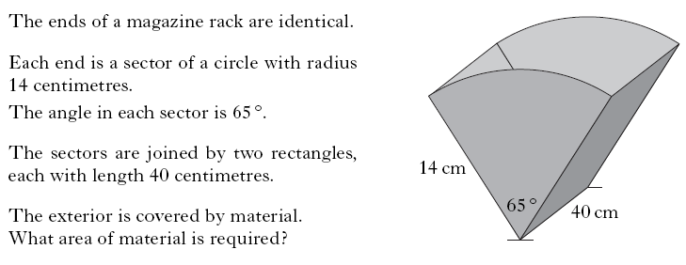

Slide 78
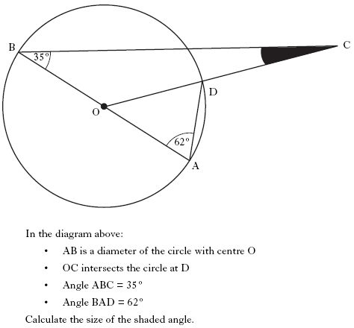

Slide 79
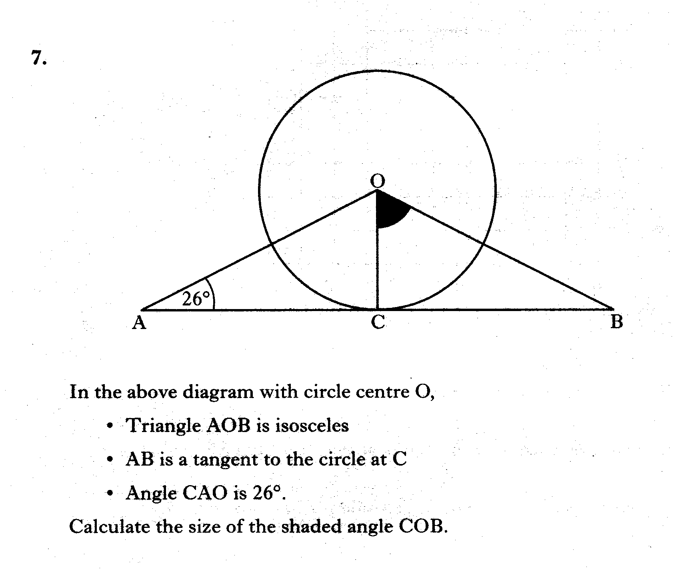

Slide 80
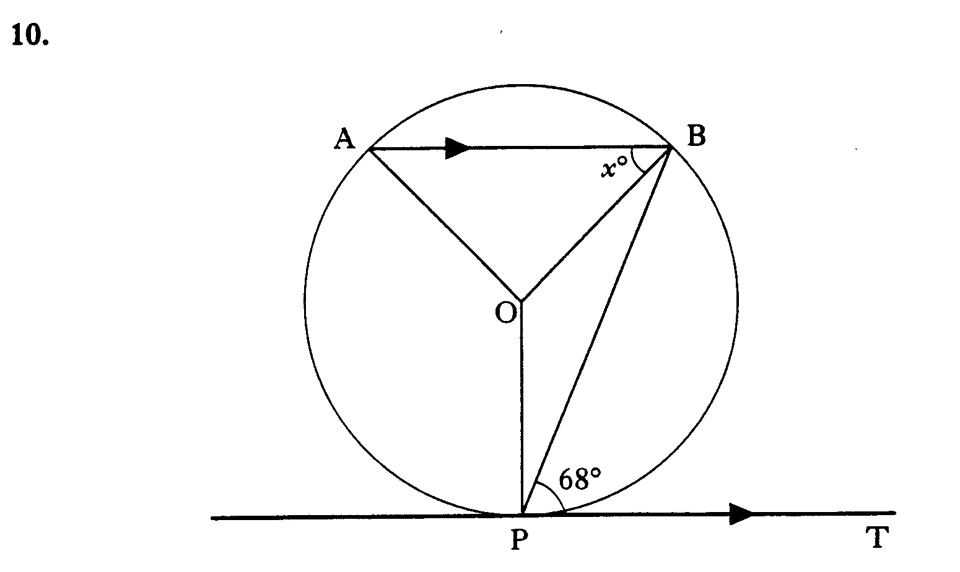
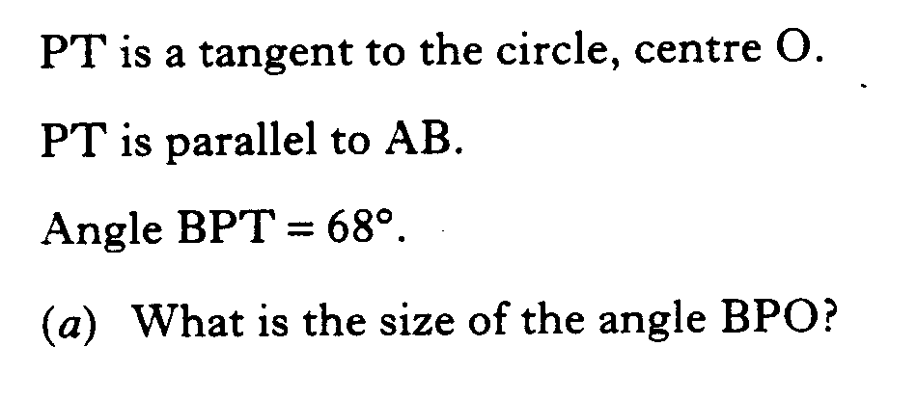
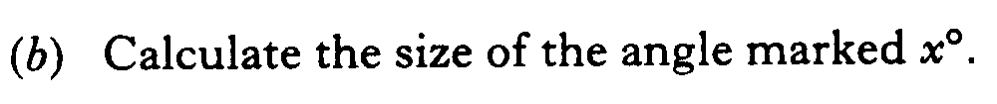

Slide 81
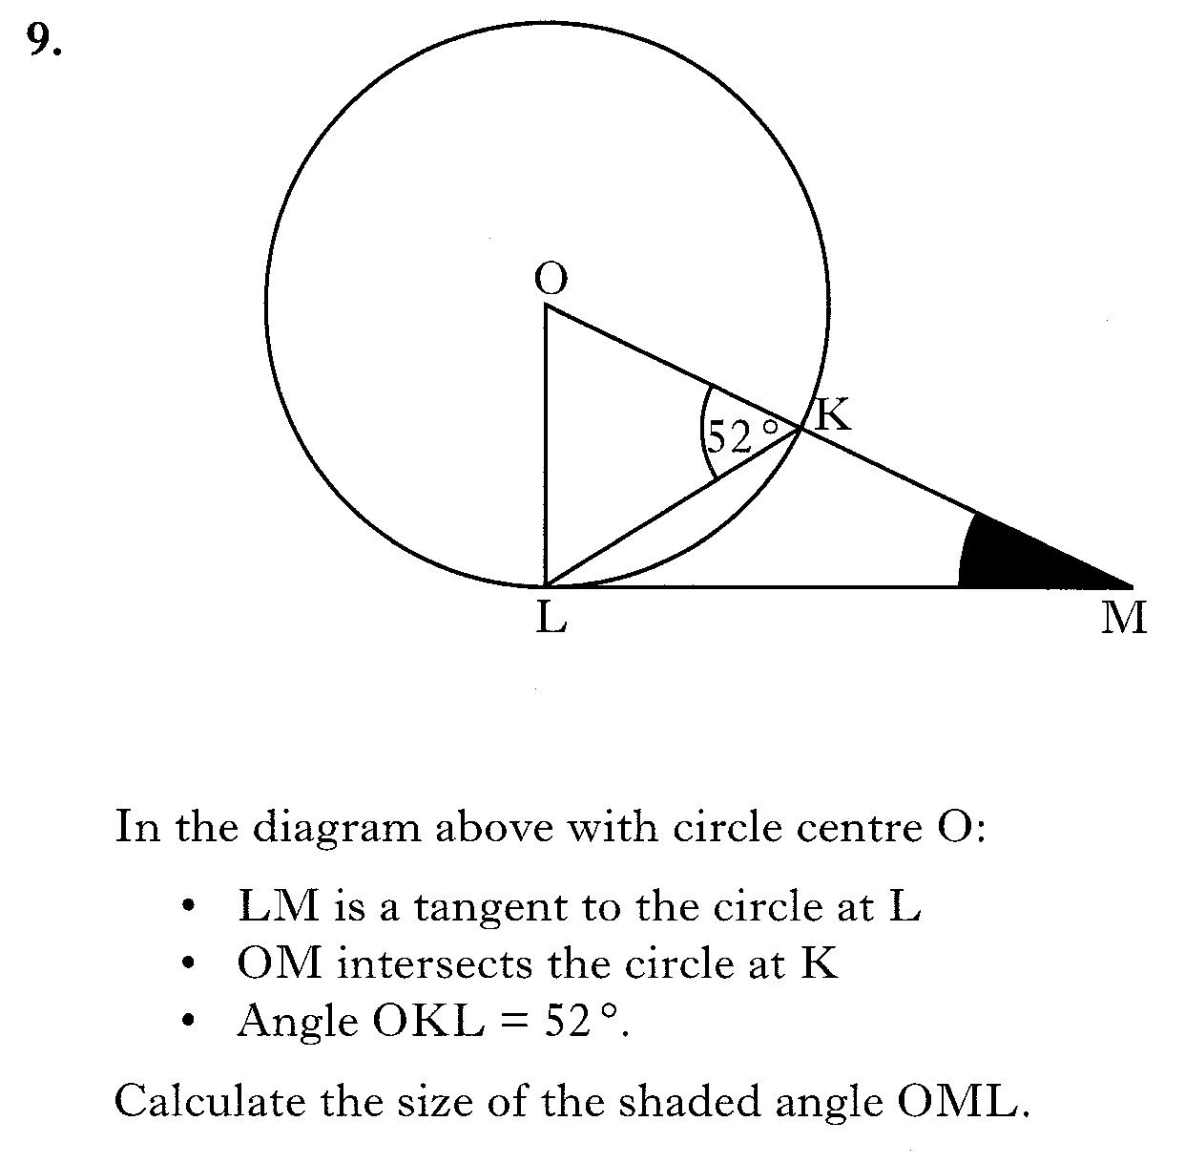

Slide 82
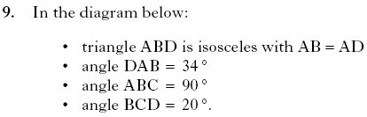
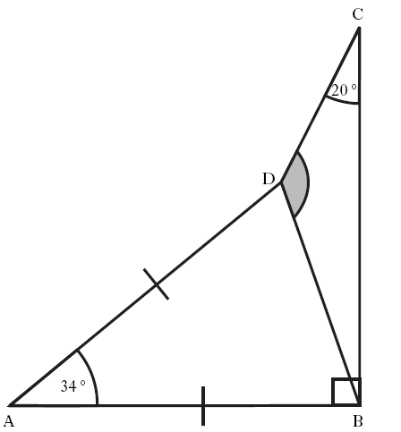

Slide 83
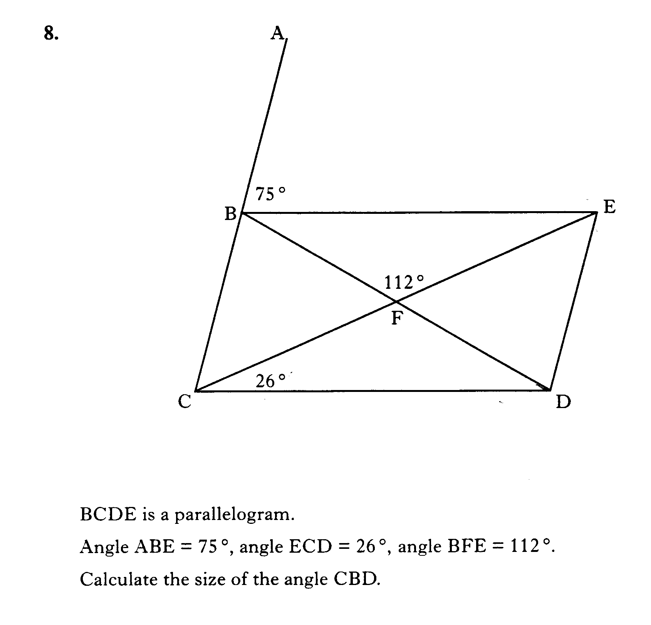

Slide 84
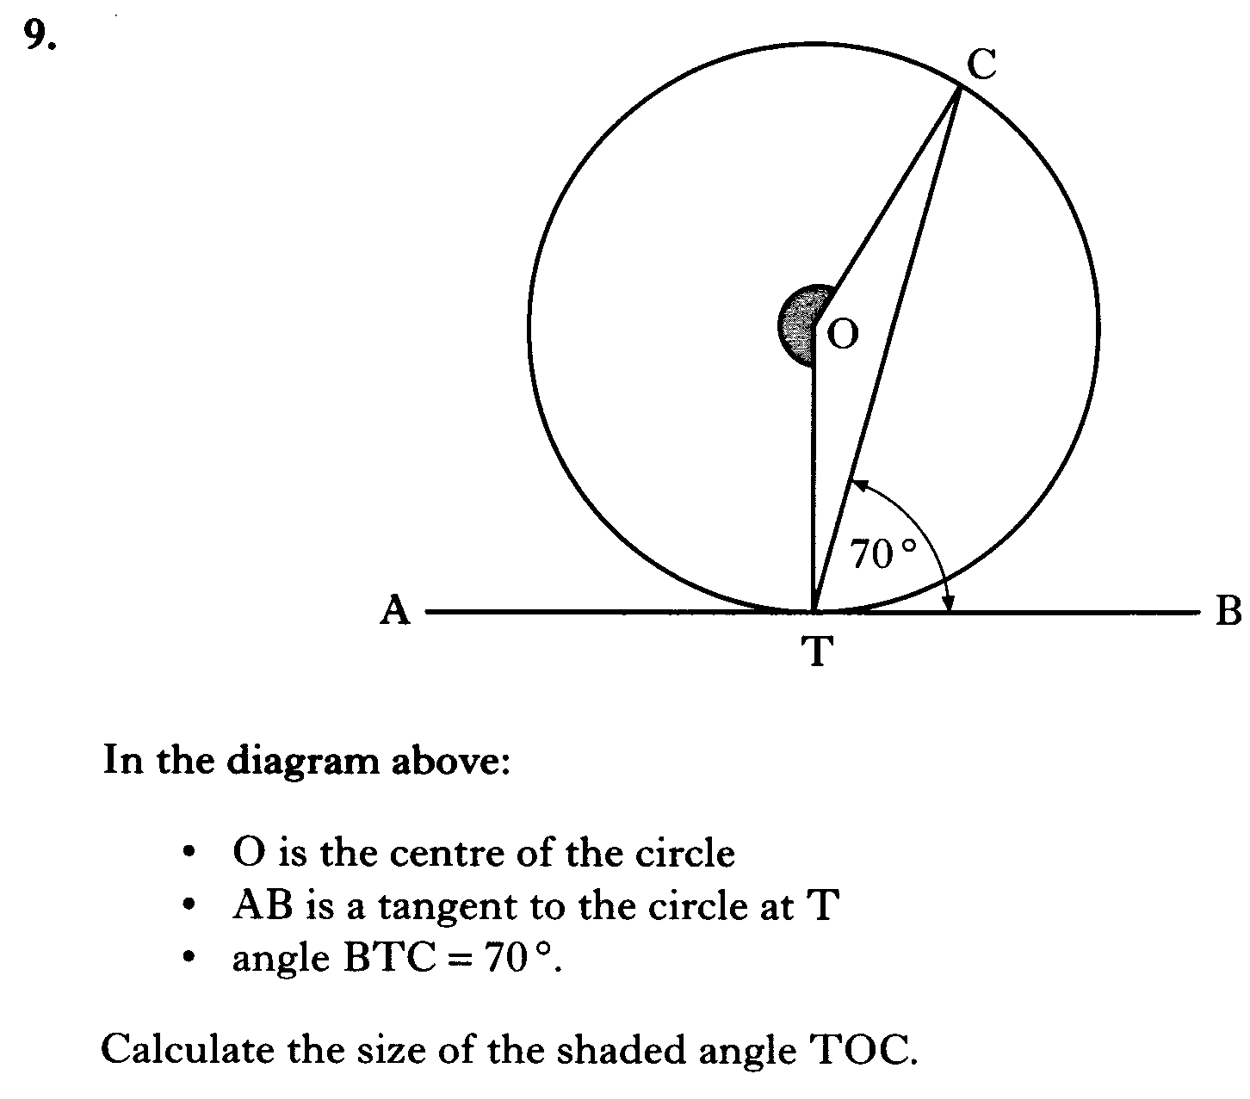

Slide 85
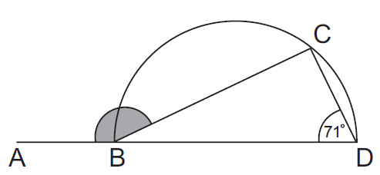
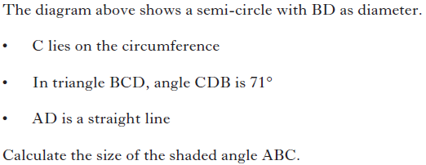
3 marks

Slide 86
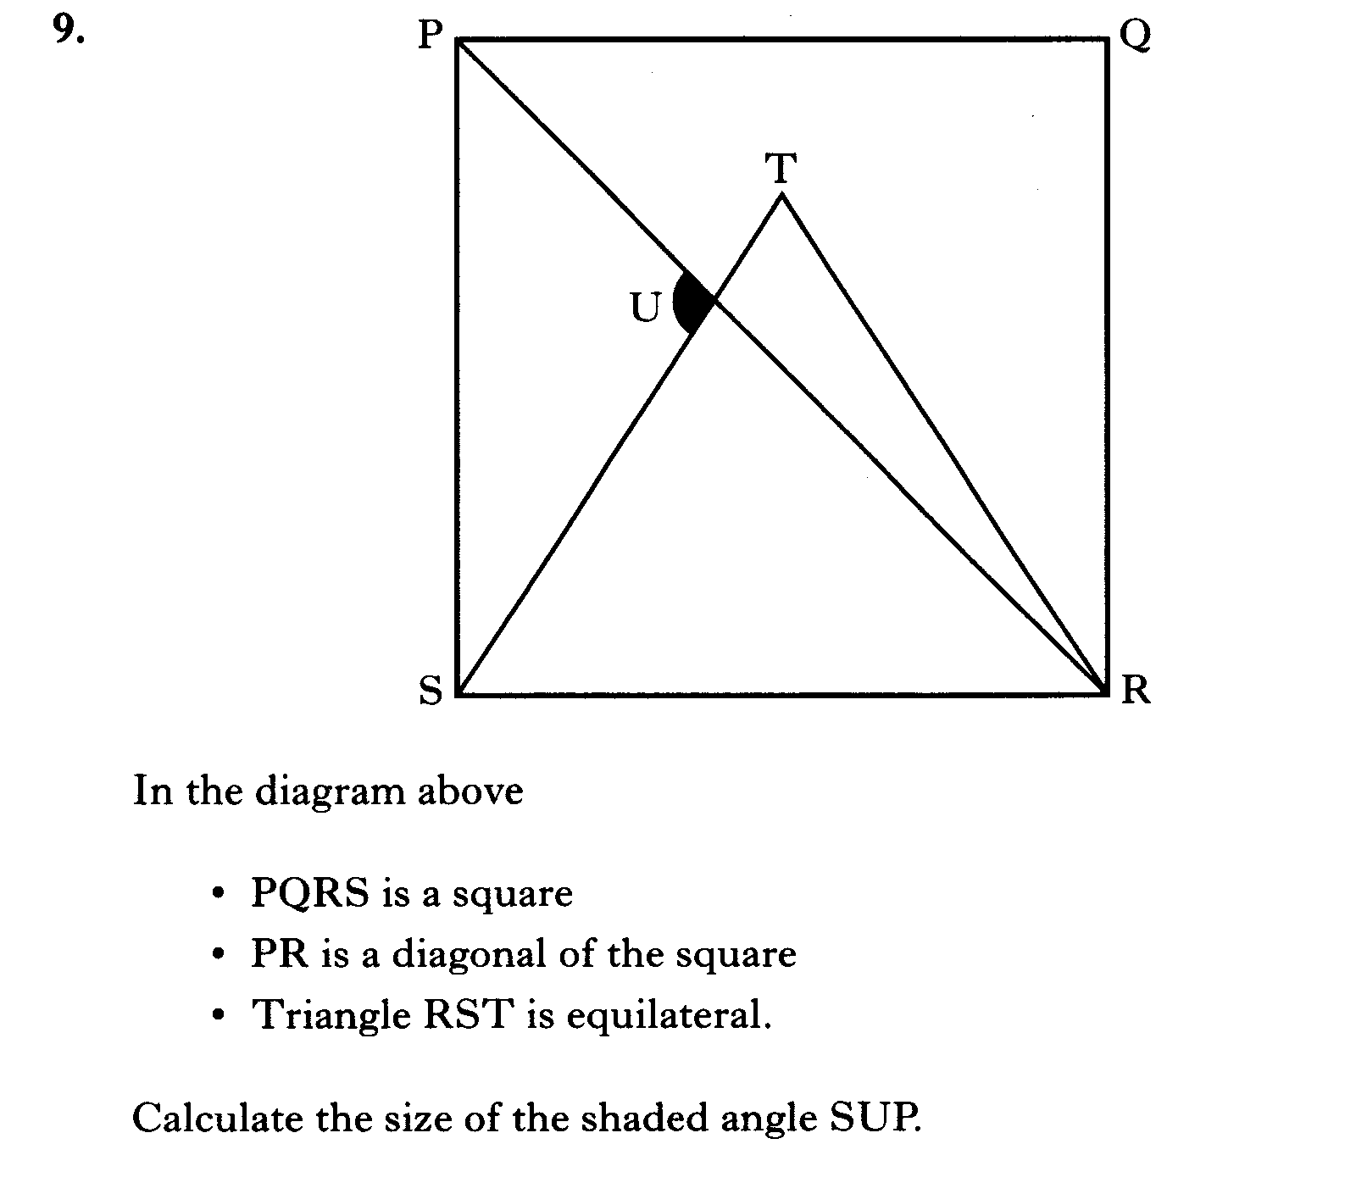

Slide 87
