Slide 1


Gradient
N5 LS
Simple Gradient
Gradient with Pythagoras Theorem
www.mathsrevision.com
Exam Type Questions

Slide 2
Starter Questions
N5 LS
In pairs
“Write down what you know
about gradient.”
www.mathsrevision.com
Give examples

Slide 3
The Gradient
N5 LS
Learning Intention
Success Criteria
  We are learning the term gradient and to calculate simple gradient using a right-angle triangle.
  Gradient is :
  change in vertical height divided by
  change in horizontal distance
www.mathsrevision.com
  2. Calculate simple gradients.

Slide 4
The Gradient
Difference in
y -coordinates
N5 LS
The gradient is the measure of steepness of a line
Change in vertical height
Change in horizontal distance
www.mathsrevision.com
Difference in
x -coordinates
The steeper a line the bigger the gradient

Slide 5
The Gradient
N5 LS
3
4
3
2
www.mathsrevision.com
3
5
2
6

Slide 6

Calculate the gradient of the uphill section
Gradient
Calculate the gradient of the downhill section
Upwards positive gradient
5
5
m =
m = -
4
5
4
4
Downwards negative gradient

Slide 7

Gradient
N5 LS
Now Try
TJ N5 Lifeskills
Revision Ex
Ch16 (page 149)
www.mathsrevision.com

Slide 8
Starter Questions
N5 LS
Q1. Is this triangle right angled ?
Explain
9
8
5
www.mathsrevision.com

Slide 9
Gradient & Pythagoras Theorem
N5 LS
Learning Intention
Success Criteria
  We are learning to find the gradient by linking it with Pythagoras Theorem.
  Be able to calculate the gradient .
www.mathsrevision.com
  2. Be able to solving problems involving gradient and Pythagoras Theorem.

Slide 10
Gradient & Pythagoras Theorem
Calculate the gradient of the triangle.
15
c
12
b
a
First we need to find the horizontal distance.
a² = c² - b²
V
m =
a² = 15² - 12²
H
a² = 81
12
=
9
a = √81
= 1.33
a = 9 cm
9 cm

Slide 11

Gradient & Pythagoras Theorem
To pass Health & Safety regulations a supermarket ramp
must not exceed a gradient of 0.4.
Does this ramp meet requirements ?
6.32m
c
b
2m
a
First we need to find the horizontal distance.
a² = c² - b²
V
m =
a² = 6.32² - 2²
H
a² = 35.94
2
=
6
a = √35.94
= 0.33
a ≈ 6 m
6 m

Slide 12
Pythagoras Theorem
N5 LS
Now Try
TJ N5 Lifeskills
Ex 15.1
Ch16 (page 150)
www.mathsrevision.com

Slide 13
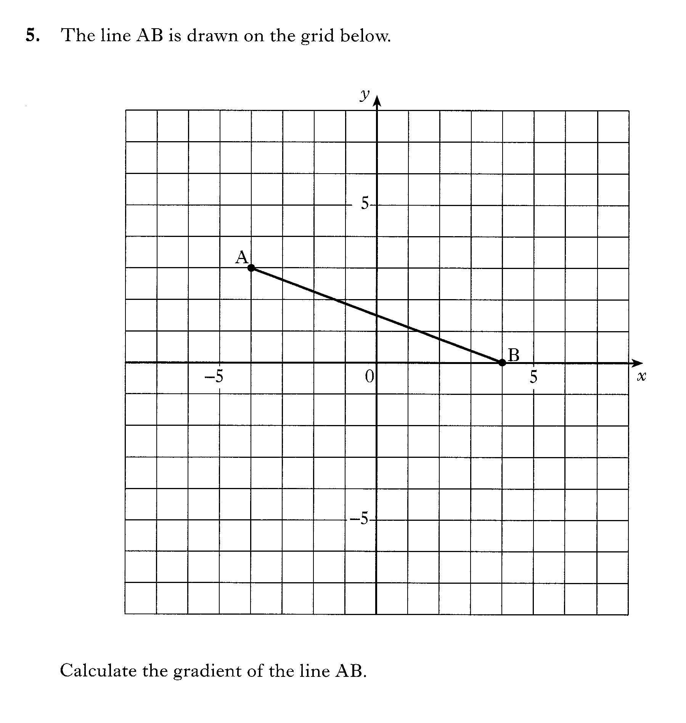

Slide 14
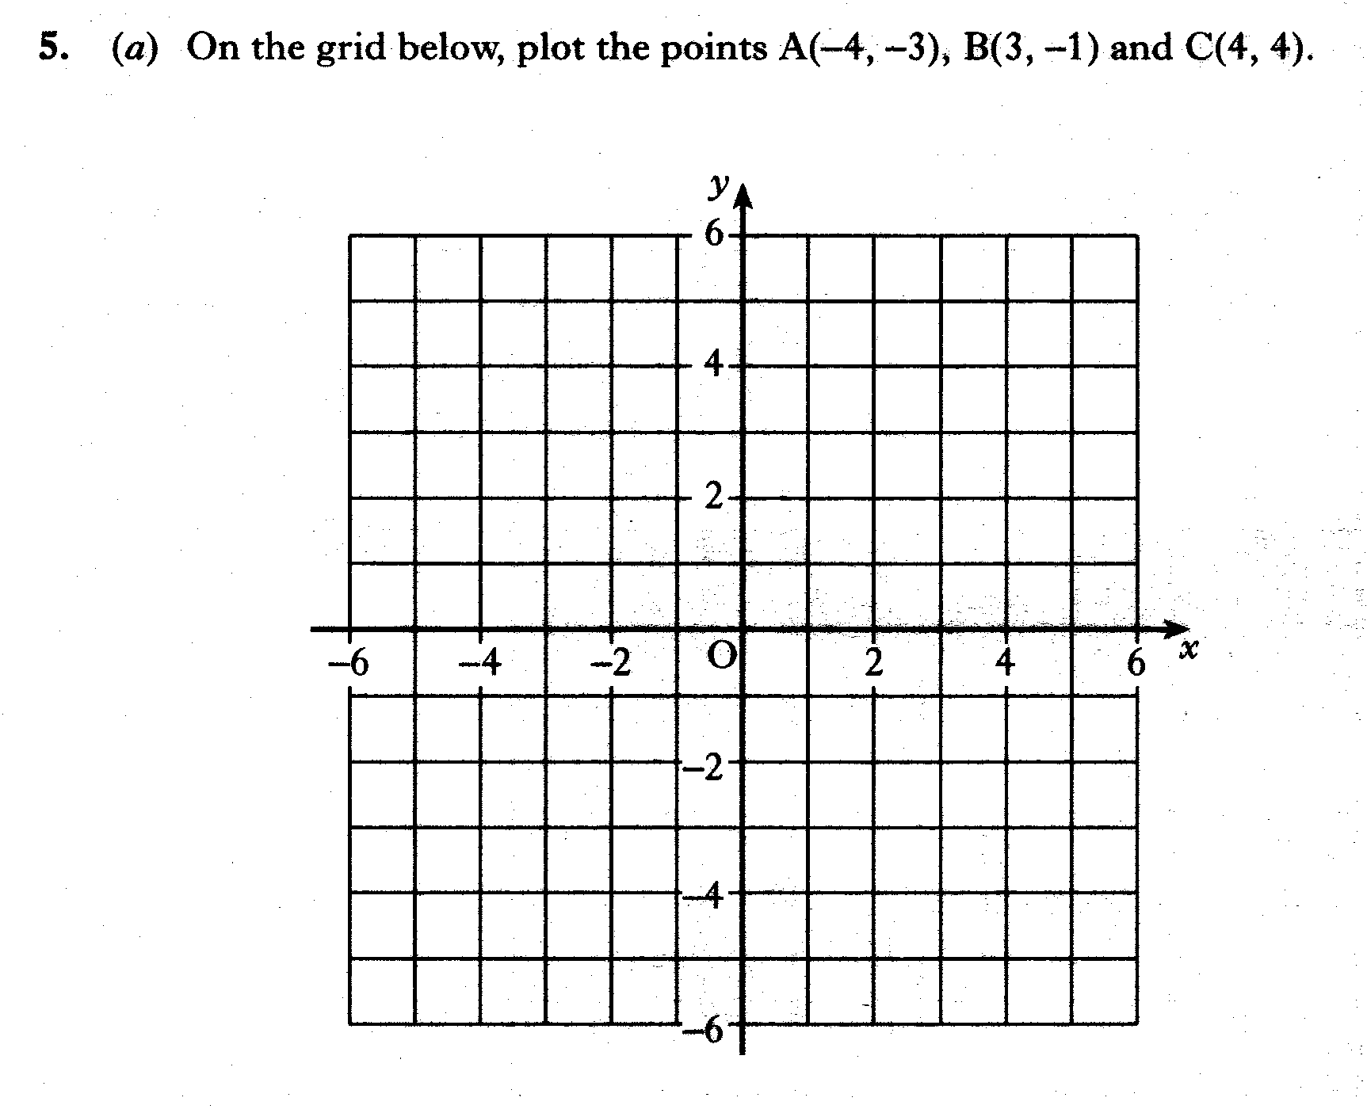
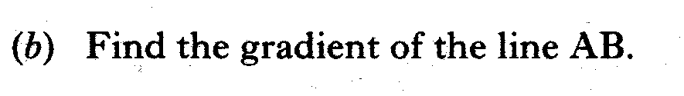
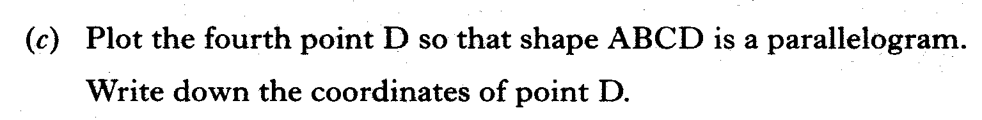

Slide 15
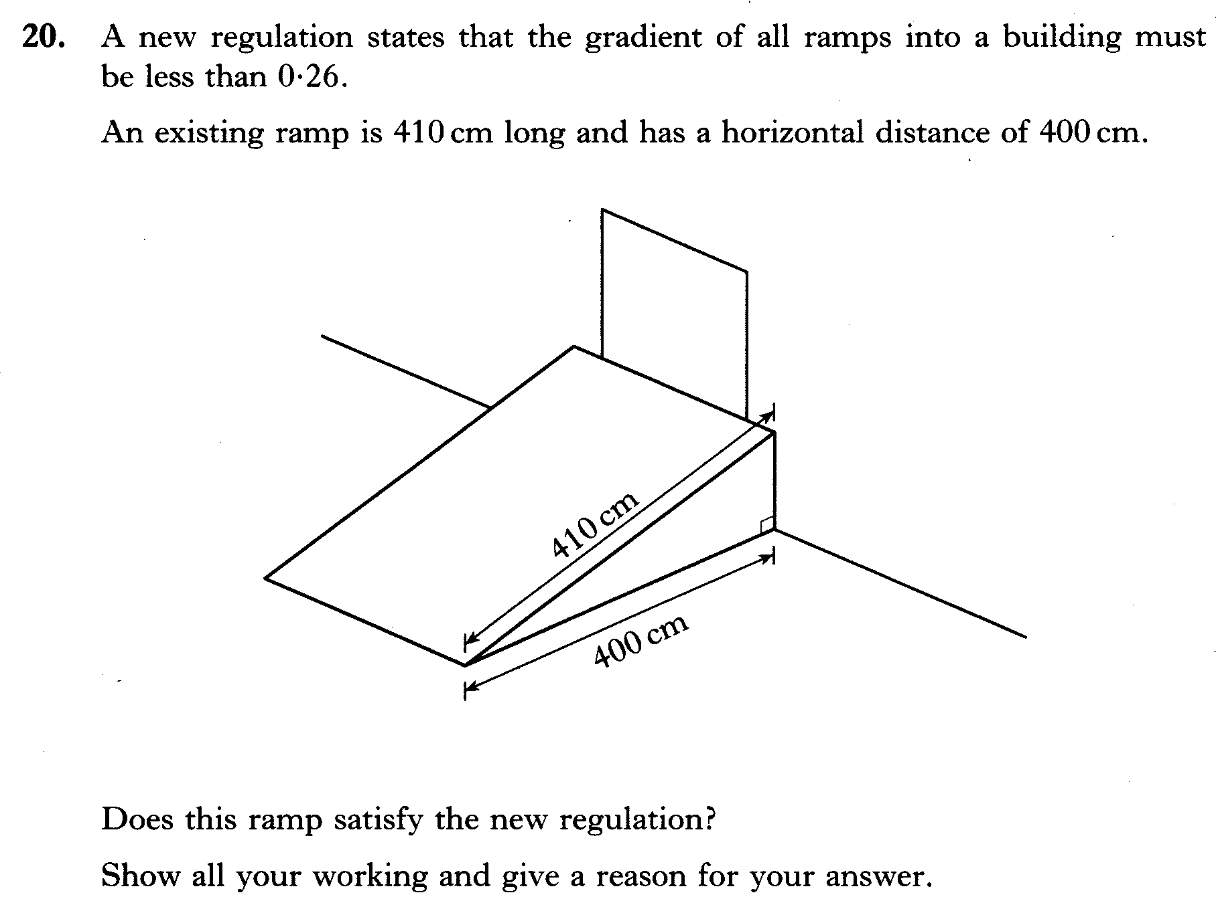

Slide 16
