Slide 1


Probability
Expected Frequency
Probability Tree
www.mathsrevision.com
Exam Type Questions

Slide 2
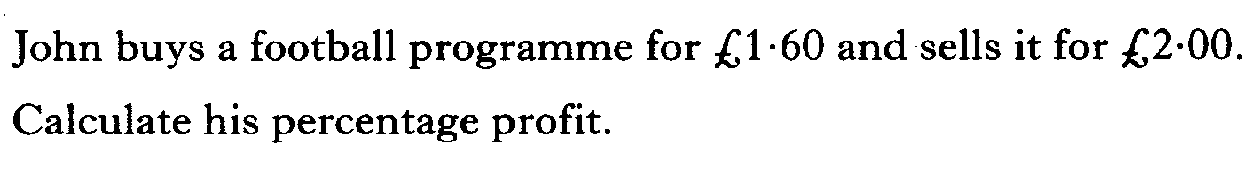
Starter Questions
www.mathsrevision.com

Slide 3
Probability
Learning Intention
Success Criteria
  We are learning to calculate probability frequency.
  Be able to calculate probability frequency.
www.mathsrevision.com

Slide 4
Probability
To work out a probability
P(A) =
www.mathsrevision.com
Probability is ALWAYS in the range 0 to 1

Slide 5
Probability
Expected Frequency
EF(A) = P(A) x ( Total number of events)
www.mathsrevision.com

Slide 6

Expected Frequency
Ball goes back into the bag.
1
2
3
4
5
What is the chance of picking the number 3 ?
1
P(3) =
= 0.2
www.mathsrevision.com
5
If I repeat this 40 times how many times can
I expect to pick out 3 ?
EF(3) =
0.2 x 40 =
8

Slide 7
Expected Frequency
In Kirkintilloch last year the chance of catching
the flu was 0.15. There are 19 700 people in town.
How many people are expect to catch the flu ?
www.mathsrevision.com
EF(flu) =
0.15 x 19700 =
2995 people

Slide 8

Expected Frequency
Now Try
TJ N5 Lifeskills
Ex 1 Q1 to Q6
Ch26 (page 252)
www.mathsrevision.com

Slide 9
Starter Questions
5 cm
3 cm
3 cm
2.5 cm
4 cm
www.mathsrevision.com

Slide 10
Probability Tree
Learning Intention
Success Criteria
  Understand Probability Tree.
  We are learning about Probability Trees.
Calculate the probability of events happening using a Probability Tree .
www.mathsrevision.com

Slide 11
Probability Tree
P(E1) = 0.2
P(E2 )= 0.3
Overall Probability
E2
P(E1) then P(E2)
0.3
0.2 x 0.3 = 0.06
E1
0.2
0.7
P(E1) then P(NOTE2)
NOT E2
0.2 x 0.7 = 0.14
E2
P(NOTE1) then P(E2)
www.mathsrevision.com
0.3
0.8 x 0.3 = 0.24
0.8
NOT E1
P(NOTE1) then P(NOTE2)
0.7
0.8 x 0.7 = 0.56
NOT E2

Slide 12


It’s Raining
P(R) = 0.6
P(D)= 0.4
P(R) – probability RAIN
P(D) – probability DRY
In November it rained on 18 days out of 30.
(i) Create a probability tree.
(ii) Calculate the probability that it will rain on
any two consecutive days.
www.mathsrevision.com

Slide 13

It’s Raining
What the chance on 3 consecutive days of rain ?
P(R) = 0.6
P(D )= 0.4
P(3R)= 0.6x0.6x0.6
= 0.216
What the chance on 3 consecutive dry days
P(3R)= 0.4x0.4x0.4
= 0.064
Overall Probability
R
P(R) then P(R)
0.6
0.6 x 0.6 = 0.36
R
0.6
0.4
P(R) then P(D)
D
0.6 x 0.4 = 0.24
R
P(D) then P(R)
www.mathsrevision.com
0.6
0.8 x 0.3 = 0.24
0.4
D
P(D) then P(D)
0.4
0.4 x 0.4 = 0.16
D

Slide 14

Have you updated your Learning Log ?
Probability Tree
Now Try
TJ N5 Lifeskills
Ex 1 Q7 ......
Ch26 (page 253)
www.mathsrevision.com

Slide 15
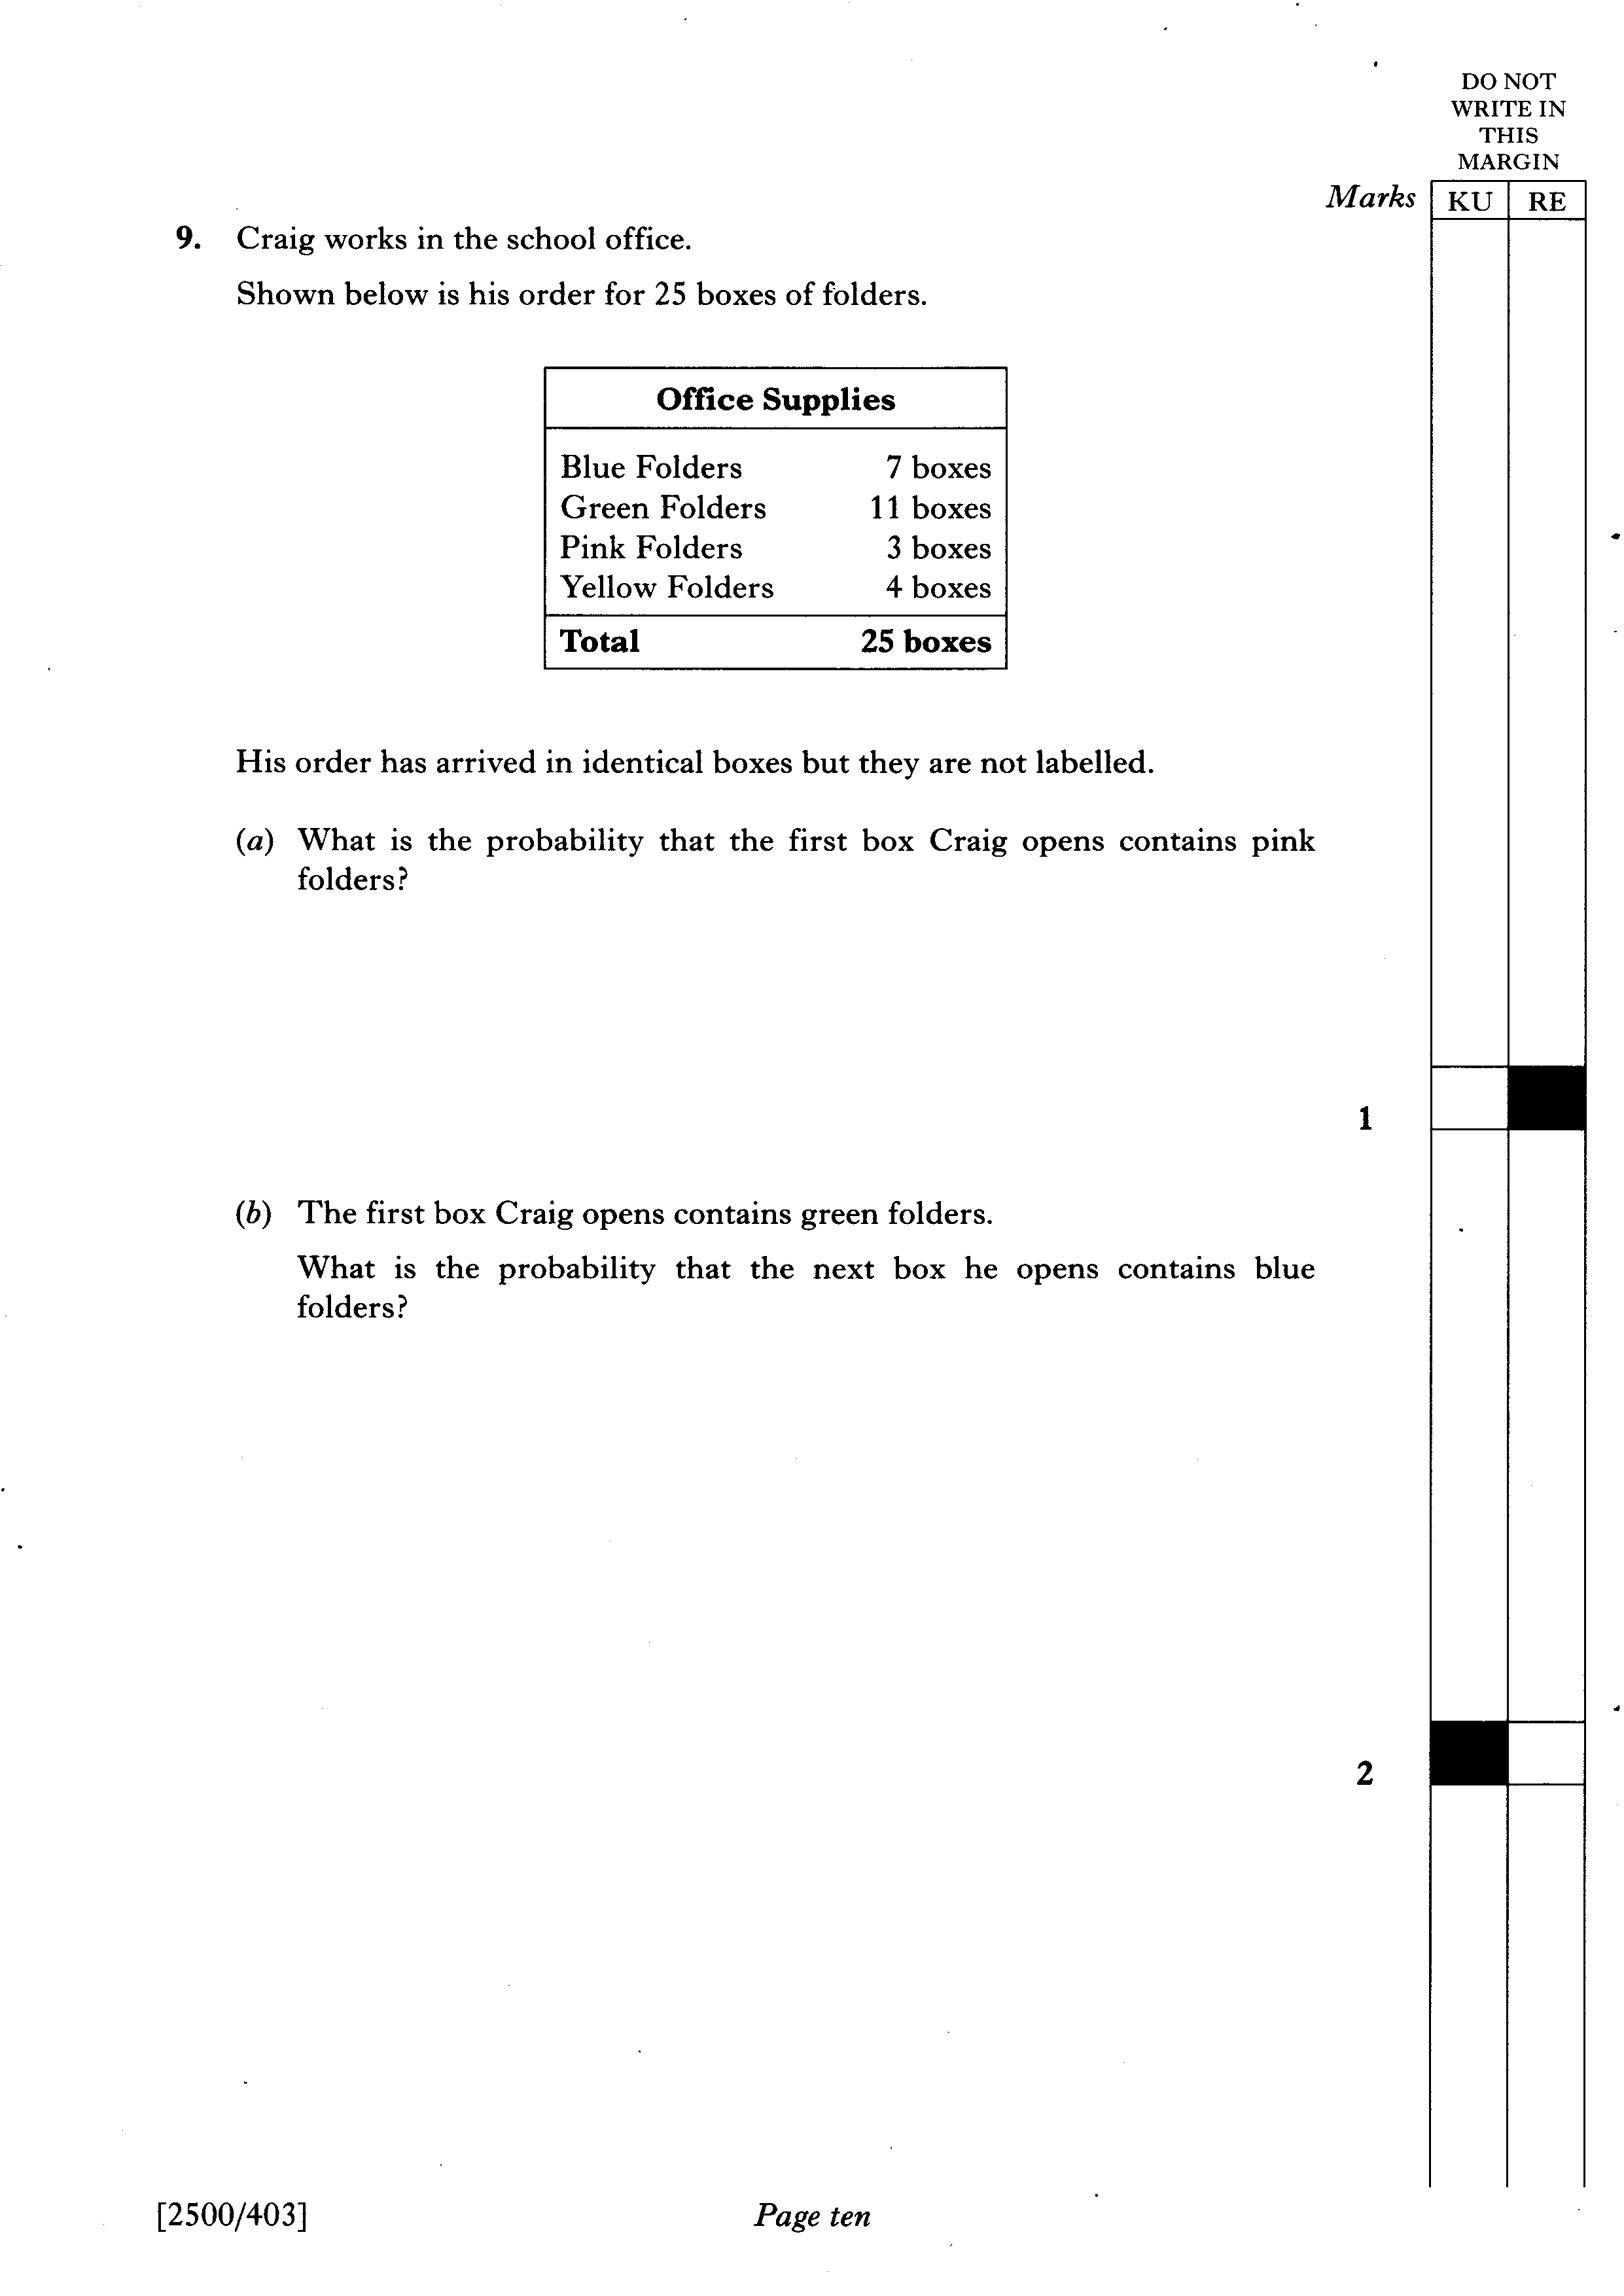

Slide 16
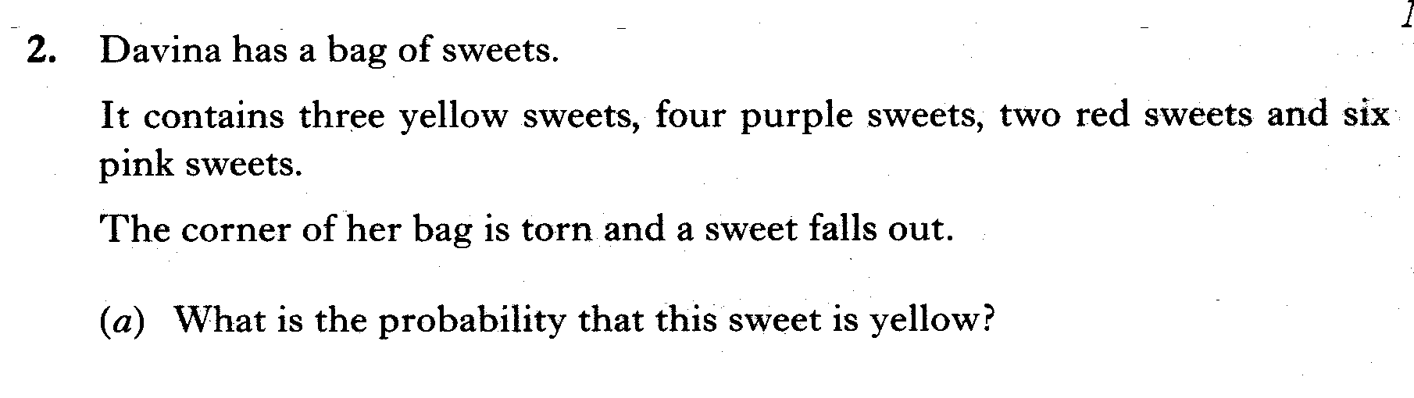
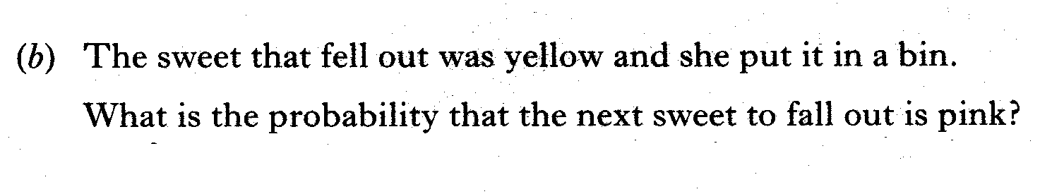

Slide 17
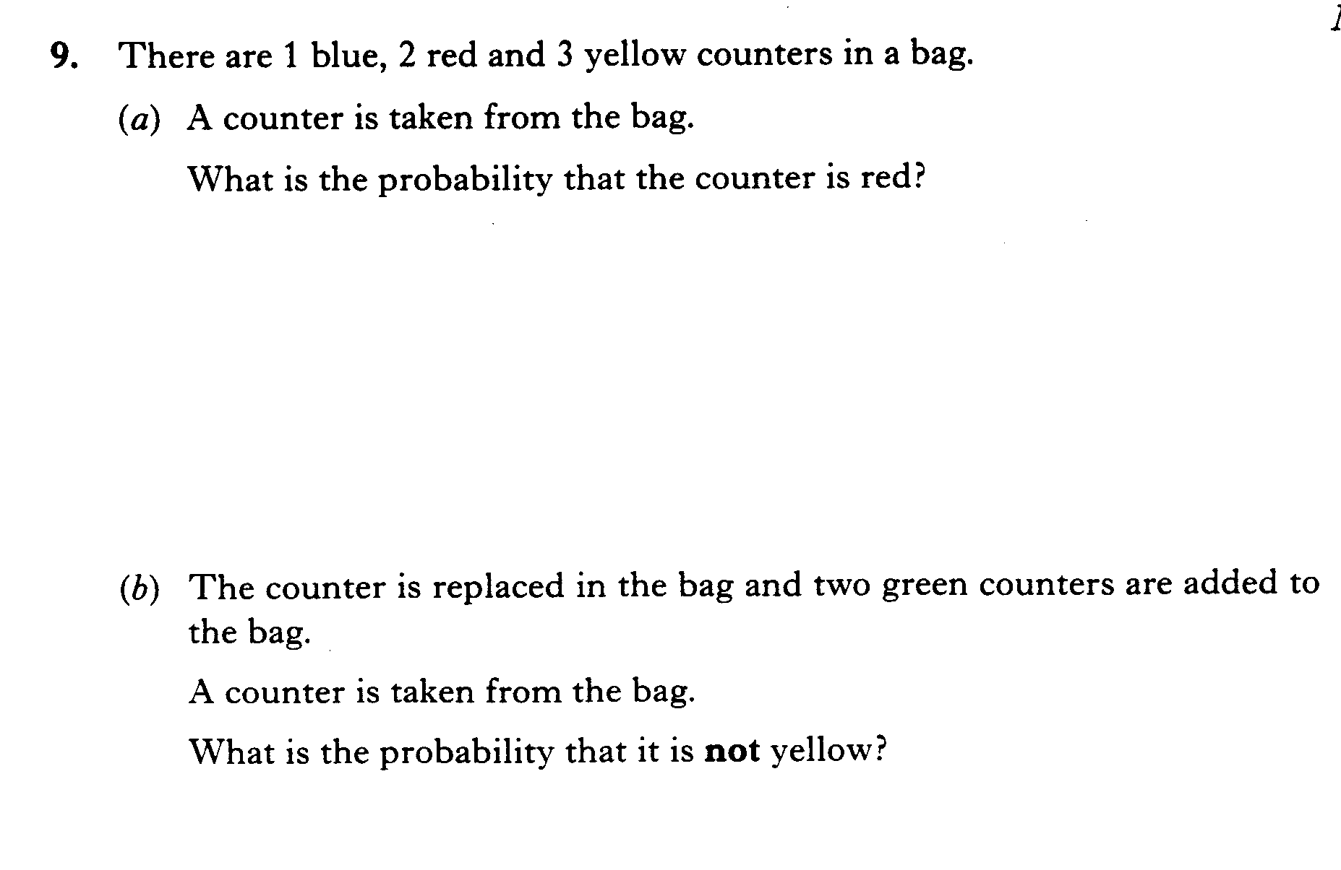

Slide 18
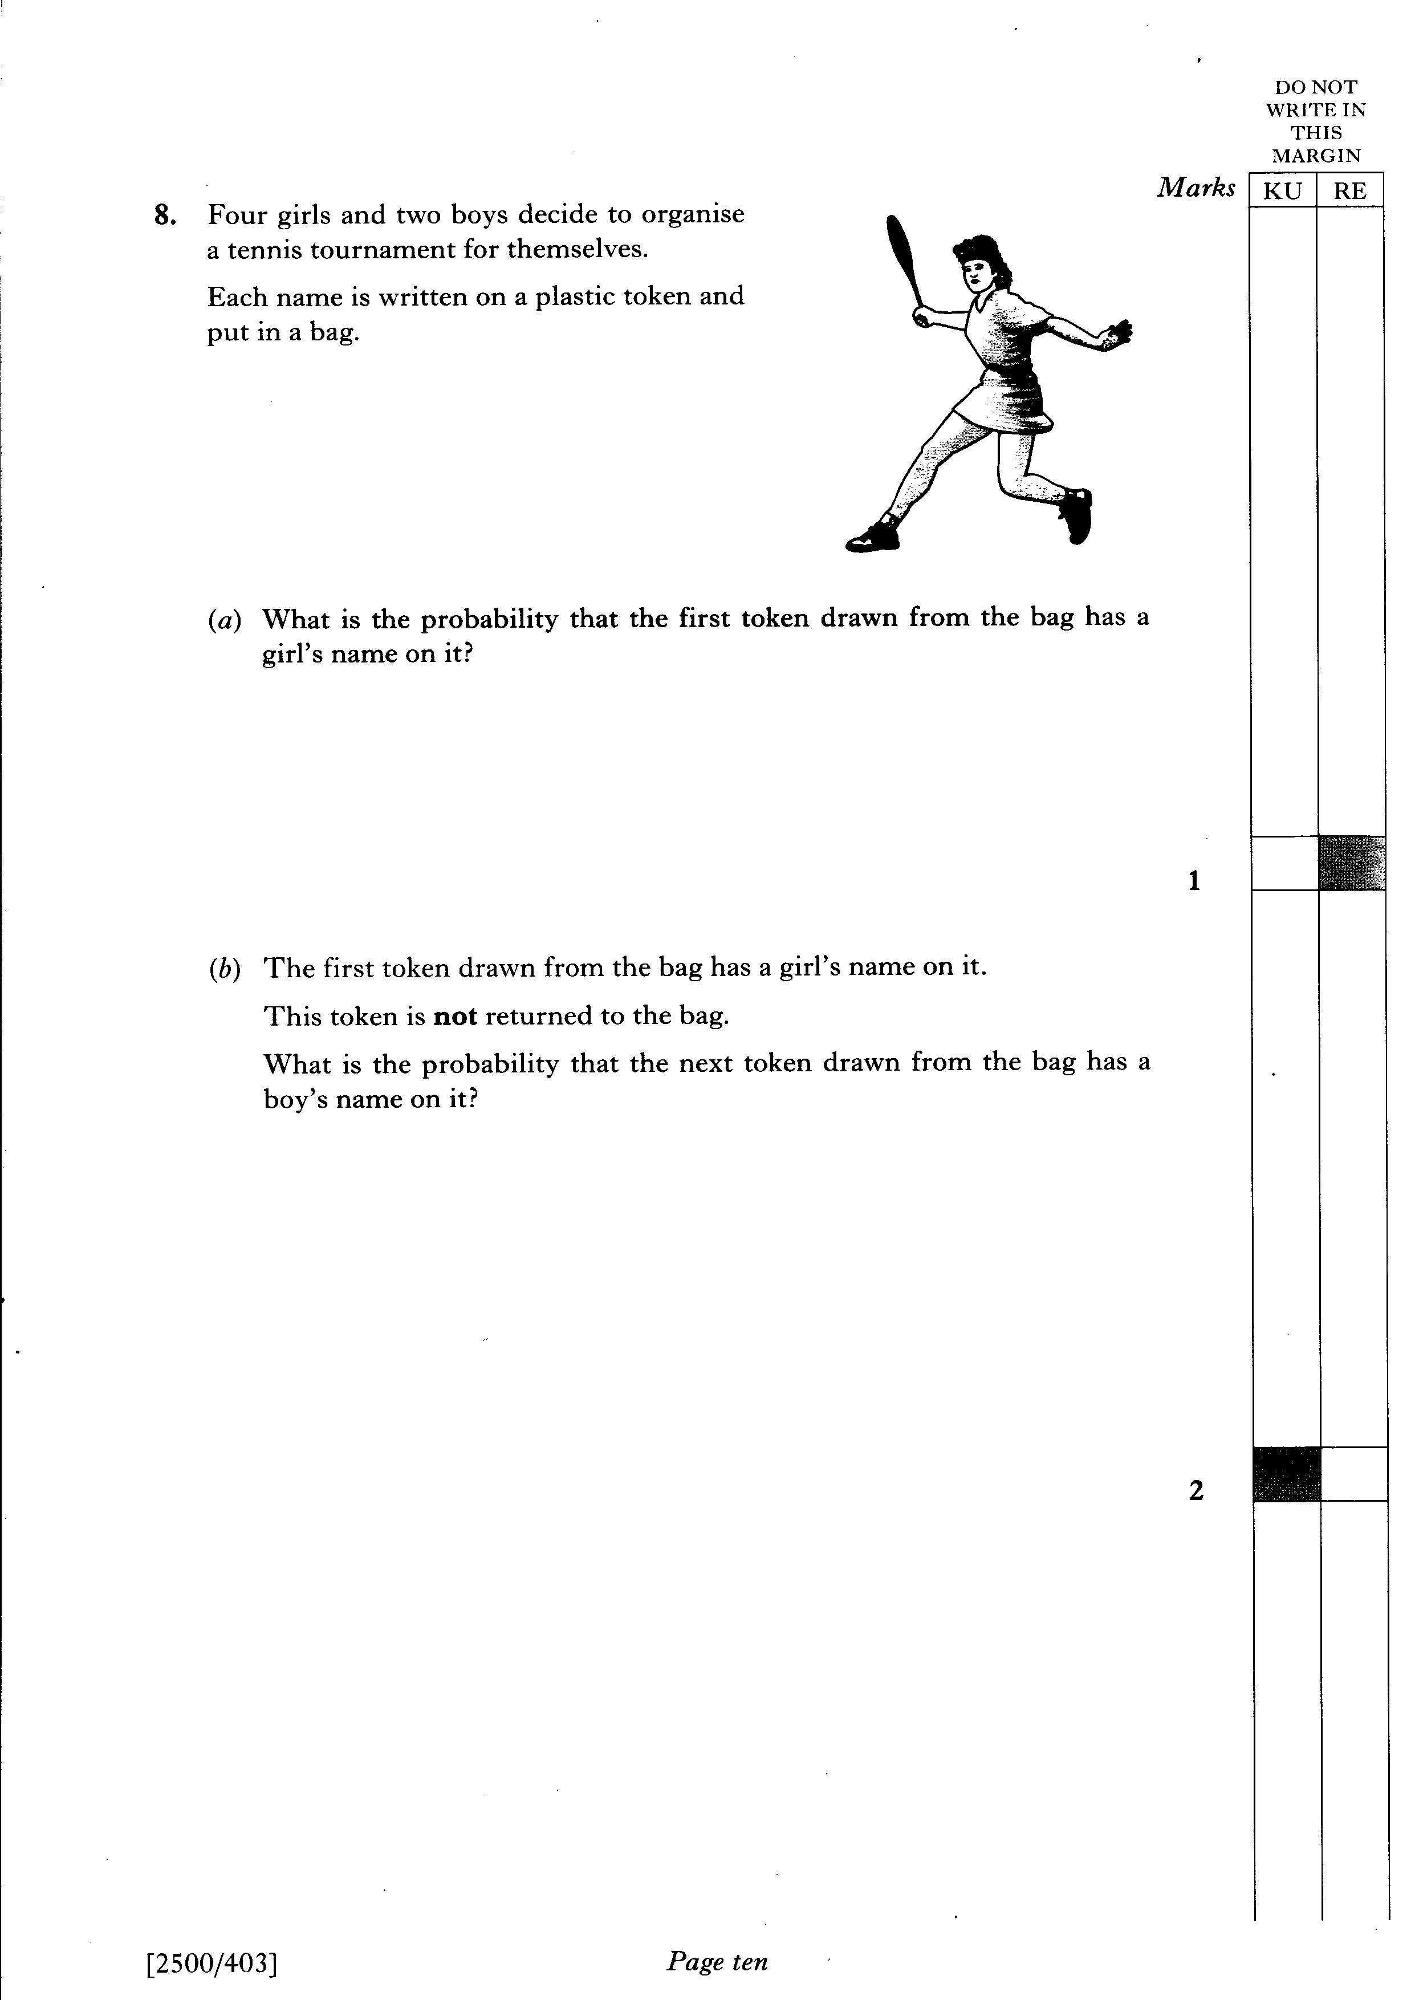

Slide 19
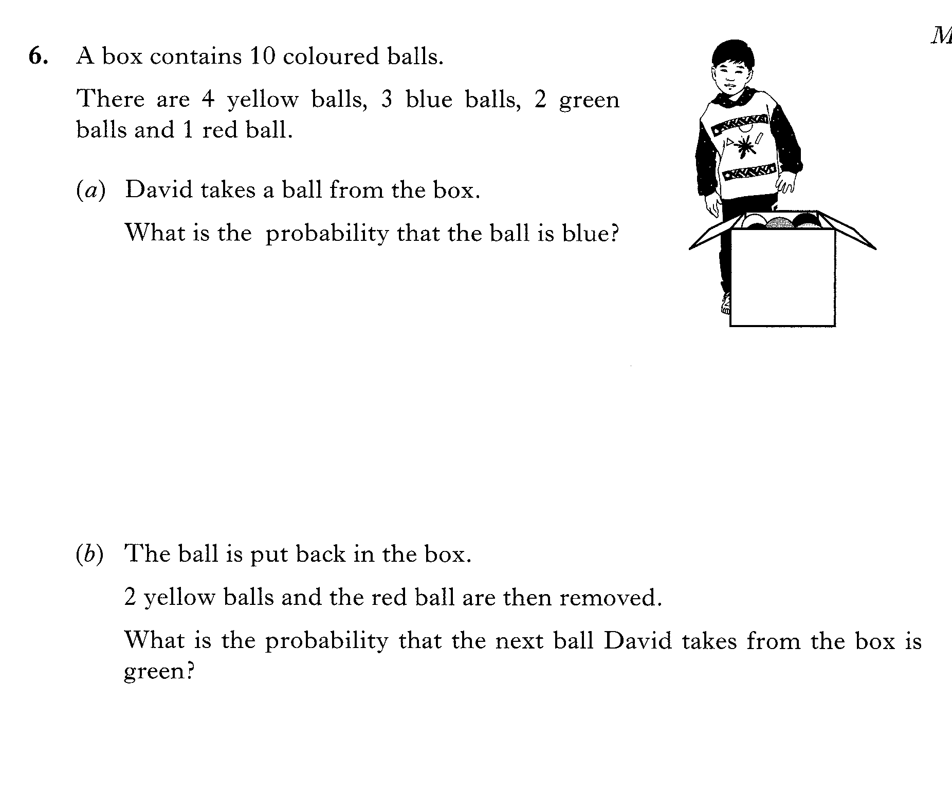

Slide 20
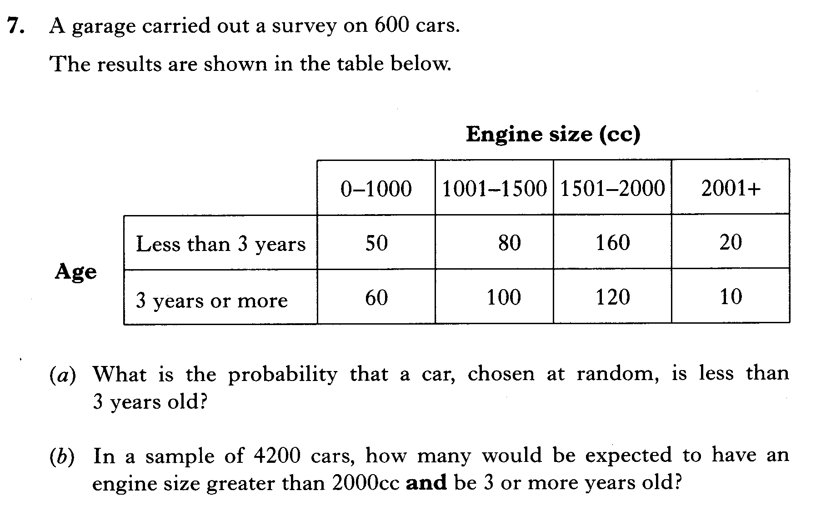

Slide 21
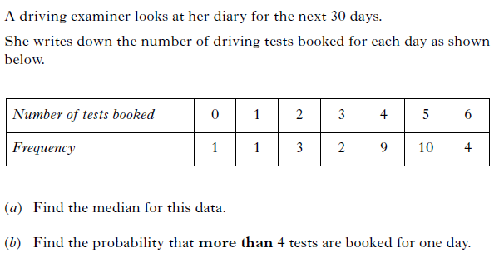

Slide 22
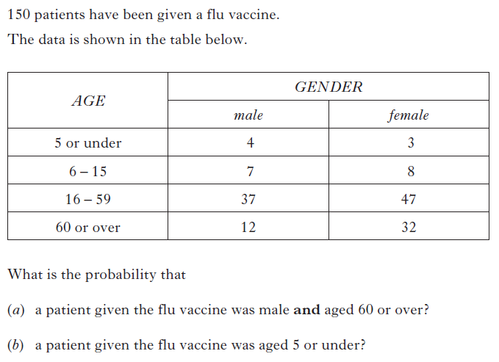

Slide 23
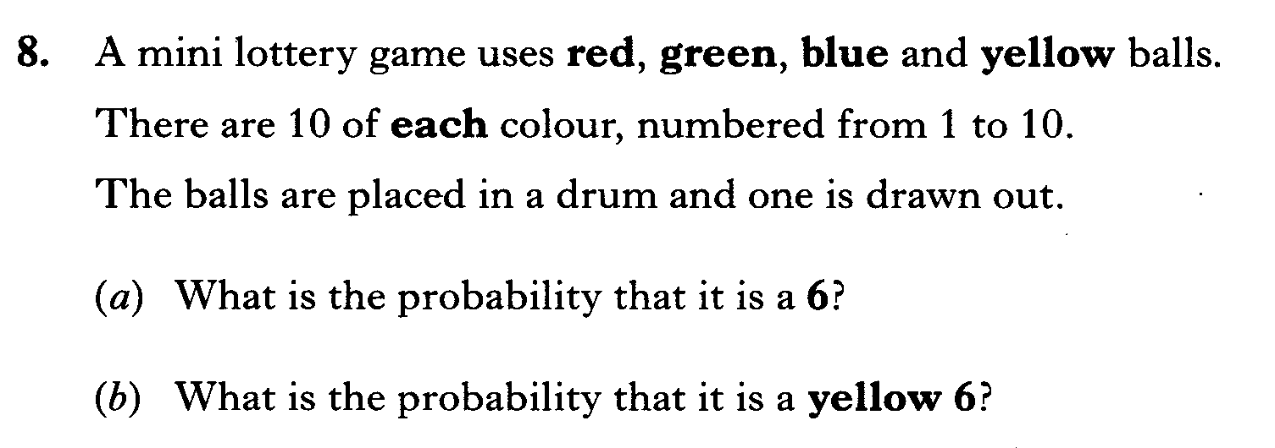

Slide 24
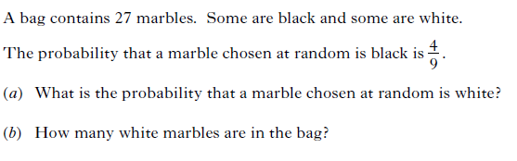

Slide 25
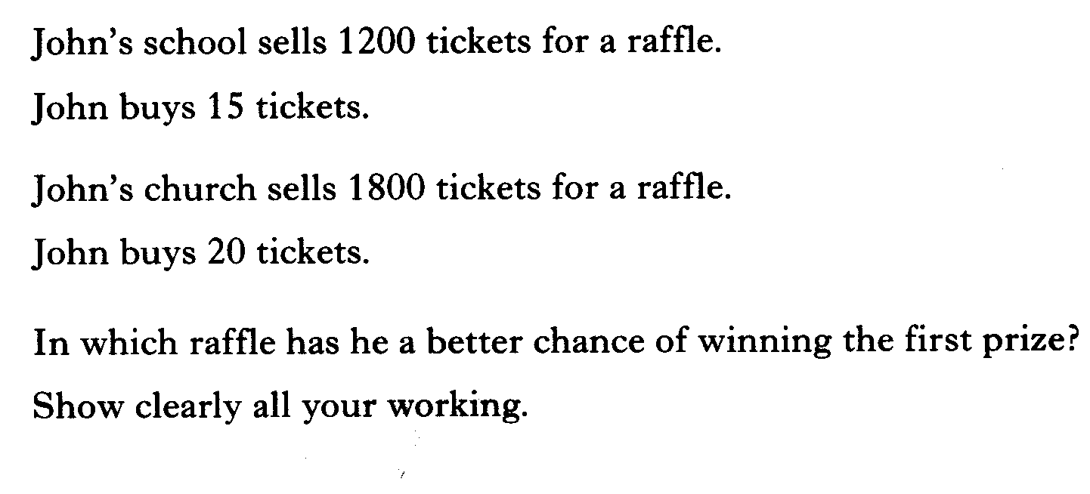

Slide 26
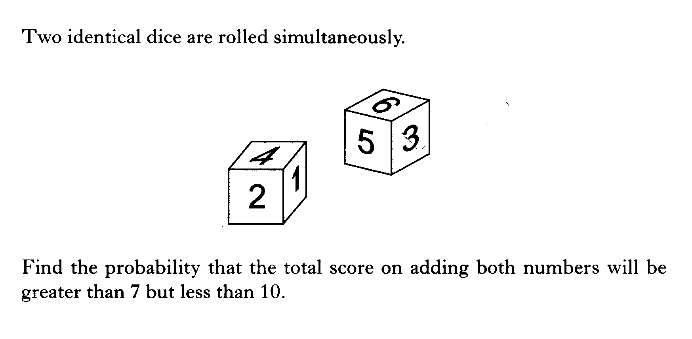

Slide 27
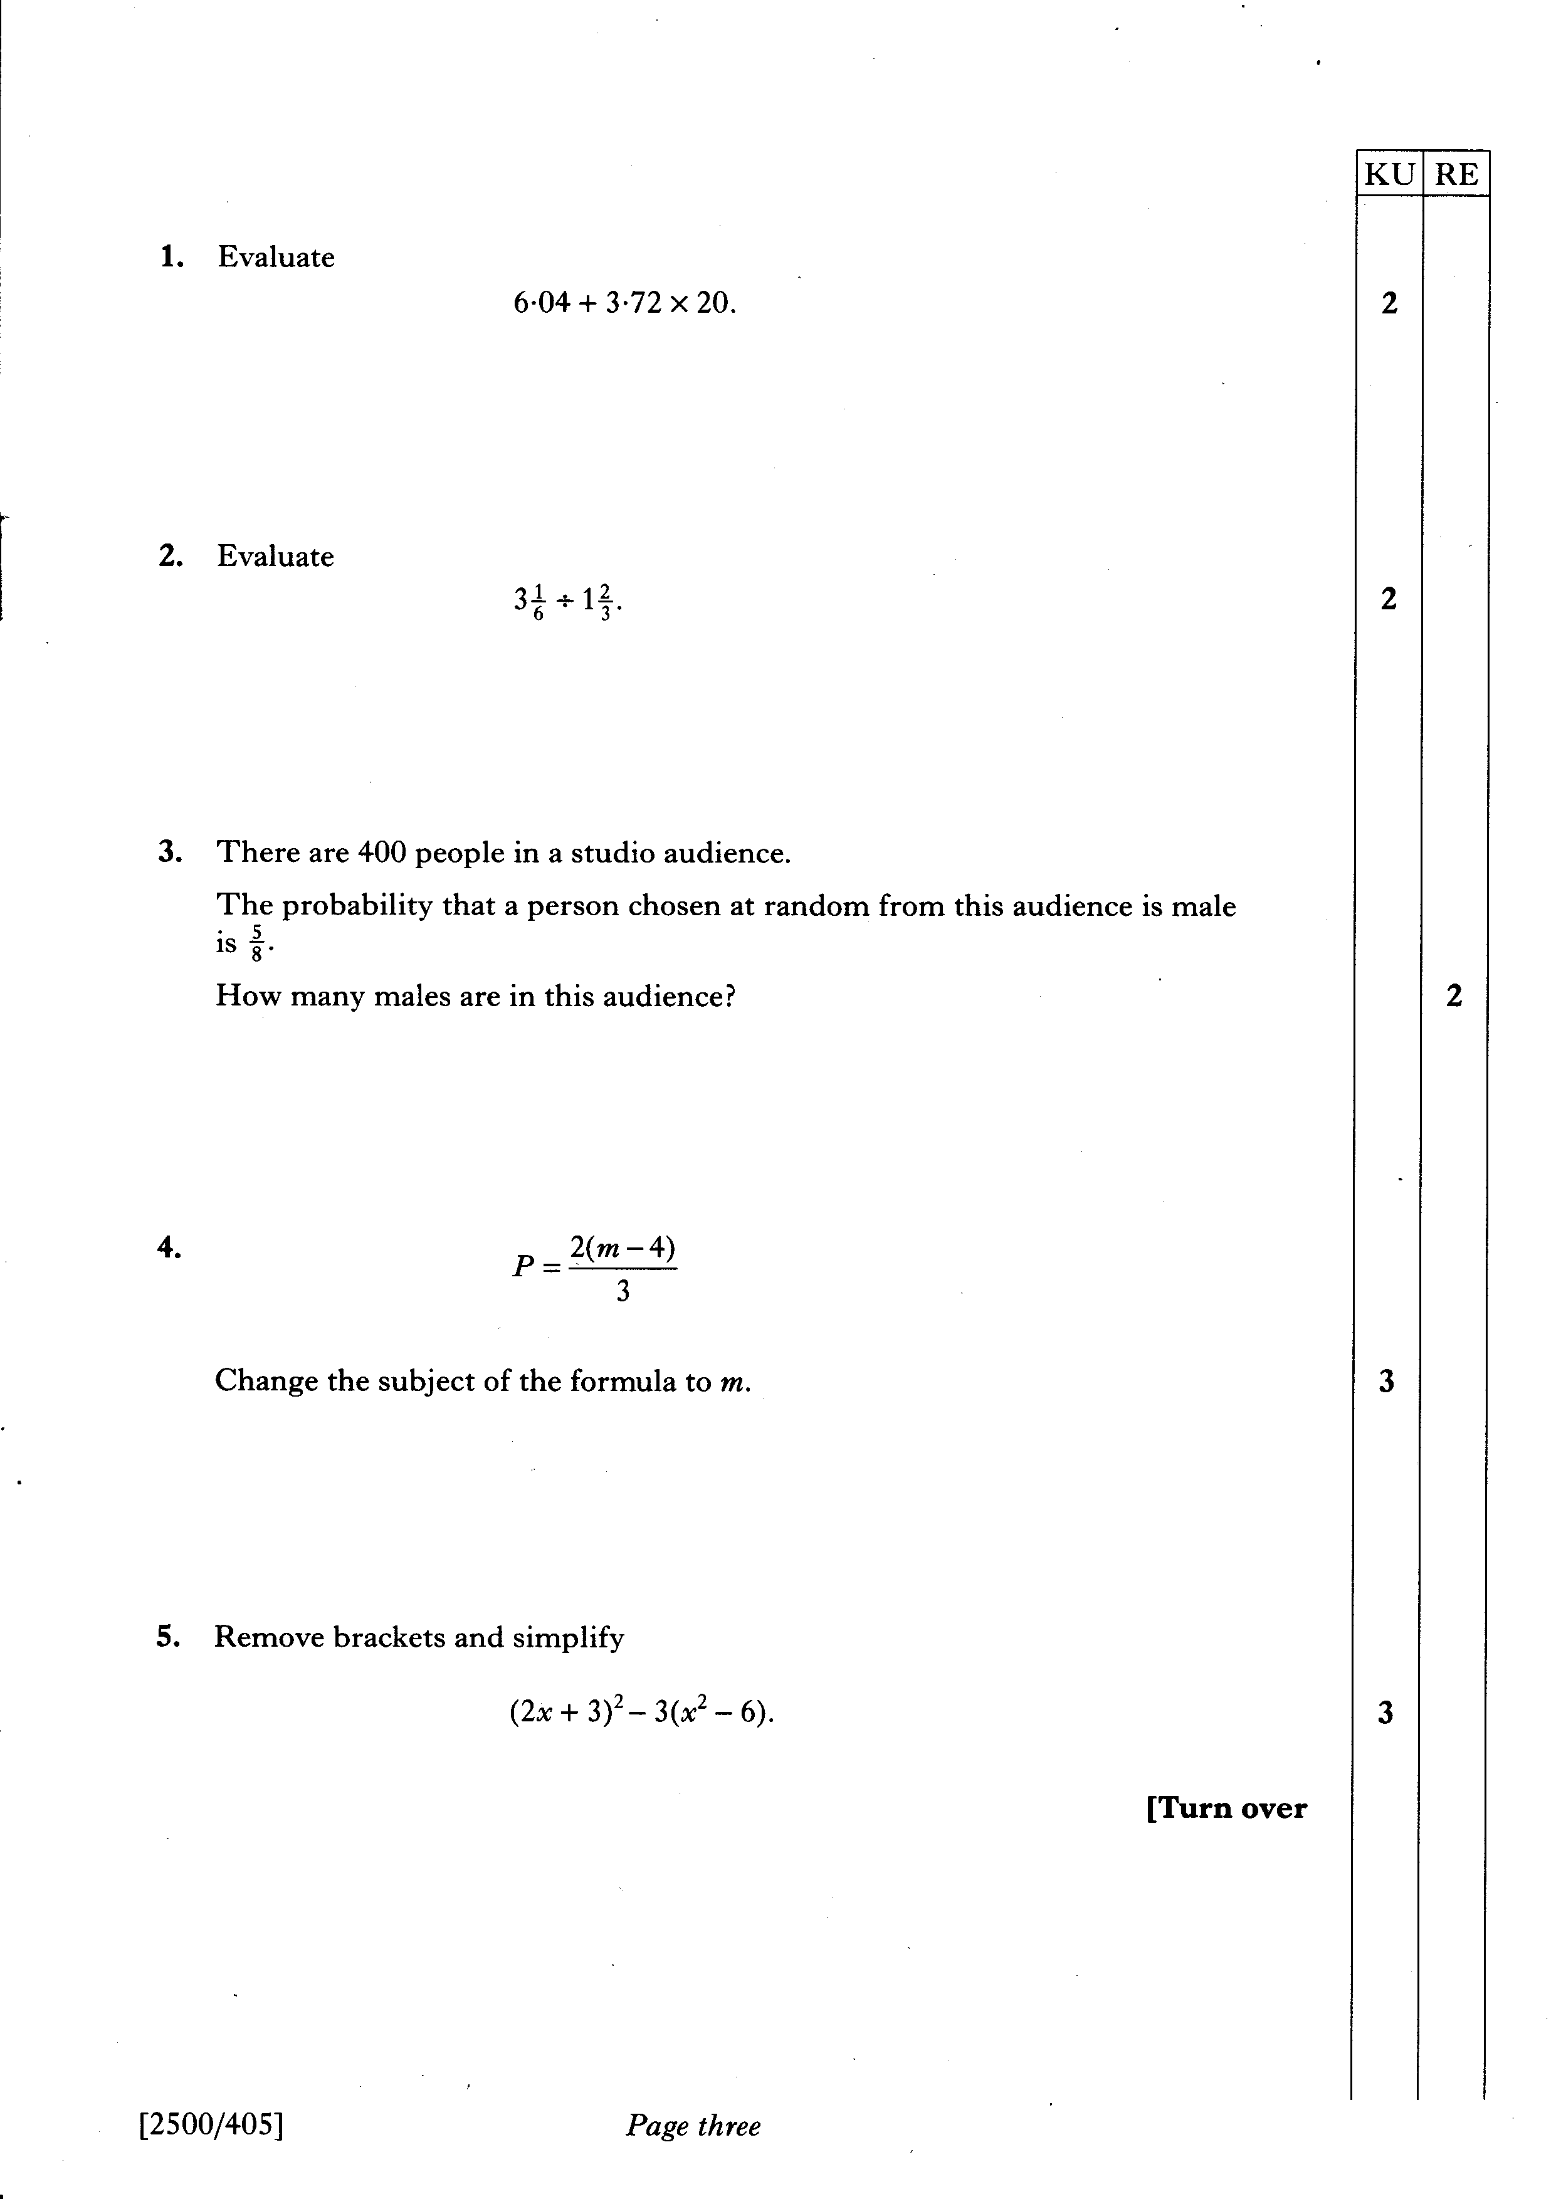

Slide 28
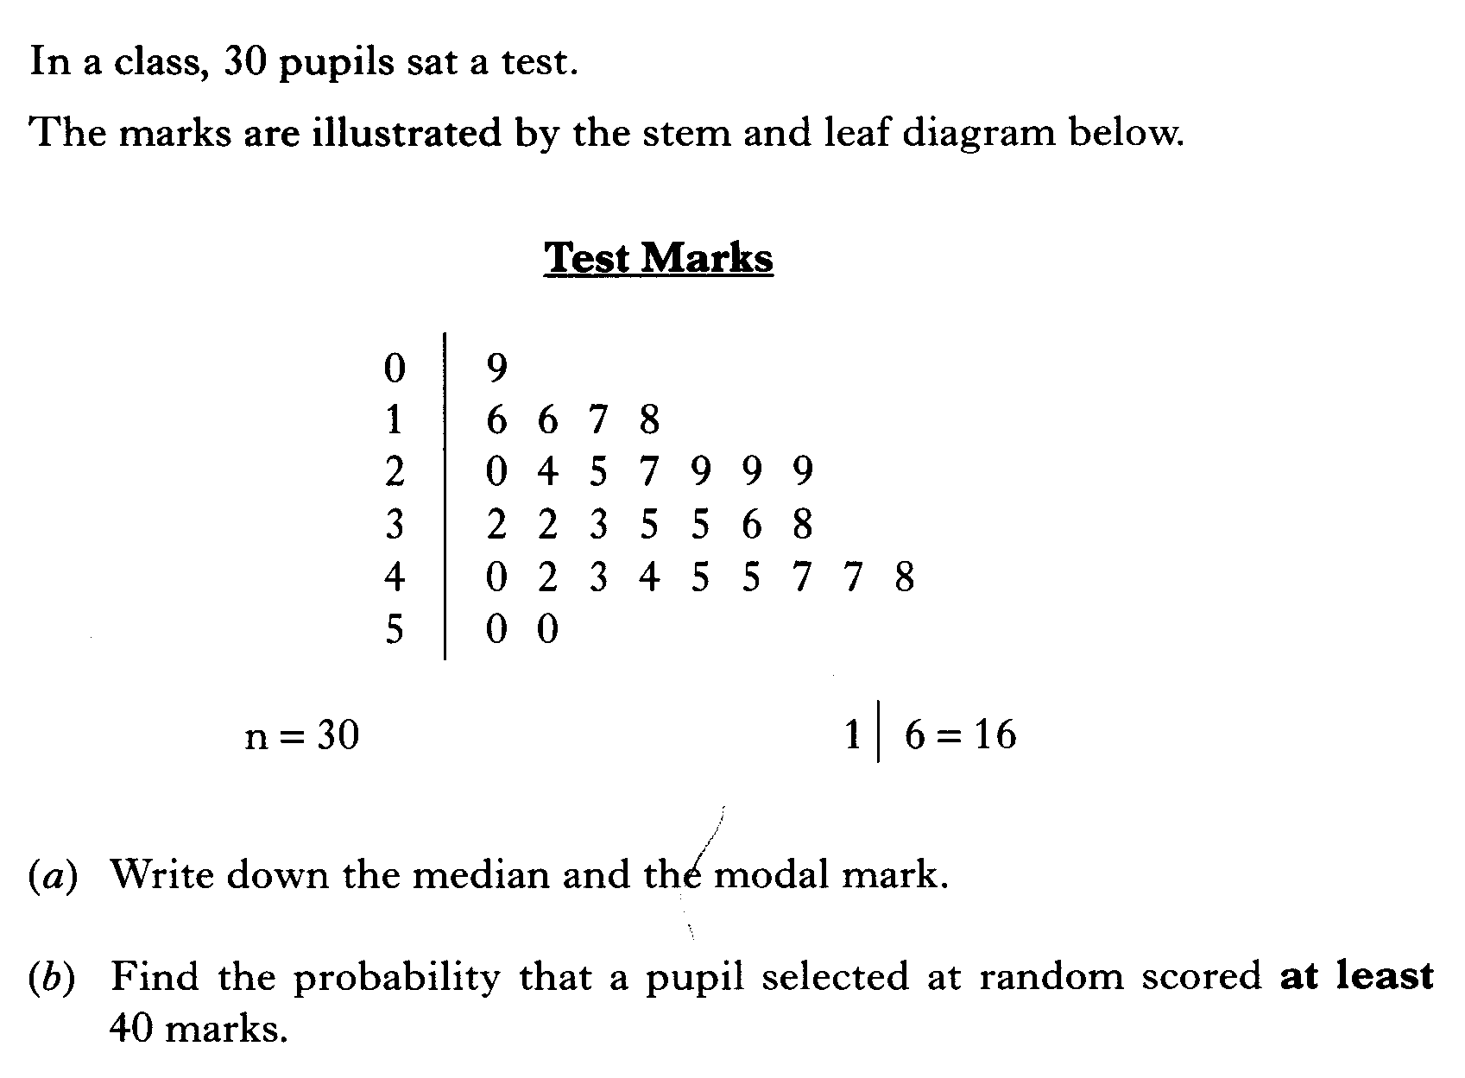

Slide 29
