Slide 1


Problem Solving
Length / Area
www.mathsrevision.com
Volume

Slide 2
Problem Solving
Problem Solving Notation
Learning Intention
Success Criteria
  We are learning how Problem Solve using Length / Area.
  Be able to Problem Solving using Length / Area.
www.mathsrevision.com

Slide 3
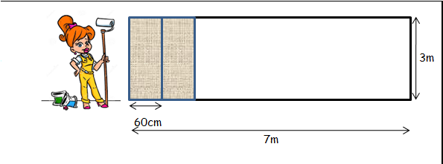
Problem Solving
Hannah wants to wallpaper one wall in her living room.
1 roll of wallpaper measures 9m in length and 60cm in width.
(a) Work out how many rolls of wallpaper she will need.
700 ÷ 60 = 11.67
36 ÷ 9 = 4 rolls
12 x 3m = 36m

Slide 4
Problem Solving
(b) Given one roll of wallpaper cost £14.40.
Calculate her total cost for the wallpaper.
14.40
x4
£57.60

Slide 5
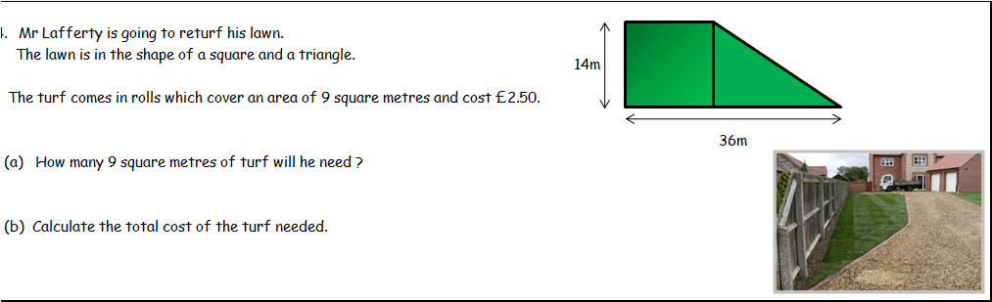
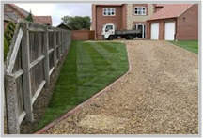
Problem Solving
(a) How many 9 square metres of turf will he need ?
A = l x b + ½bh
A = 14 x 14 + ½(22)(14)
350 ÷ 9 = 38.89
= 39 lengths
A = 196 + 154
A = 350m²

Slide 6
Problem Solving
(b) Calculate the total cost of the turf needed.
39 x 2.50
= £97.50

Slide 7
2 KU

Slide 8
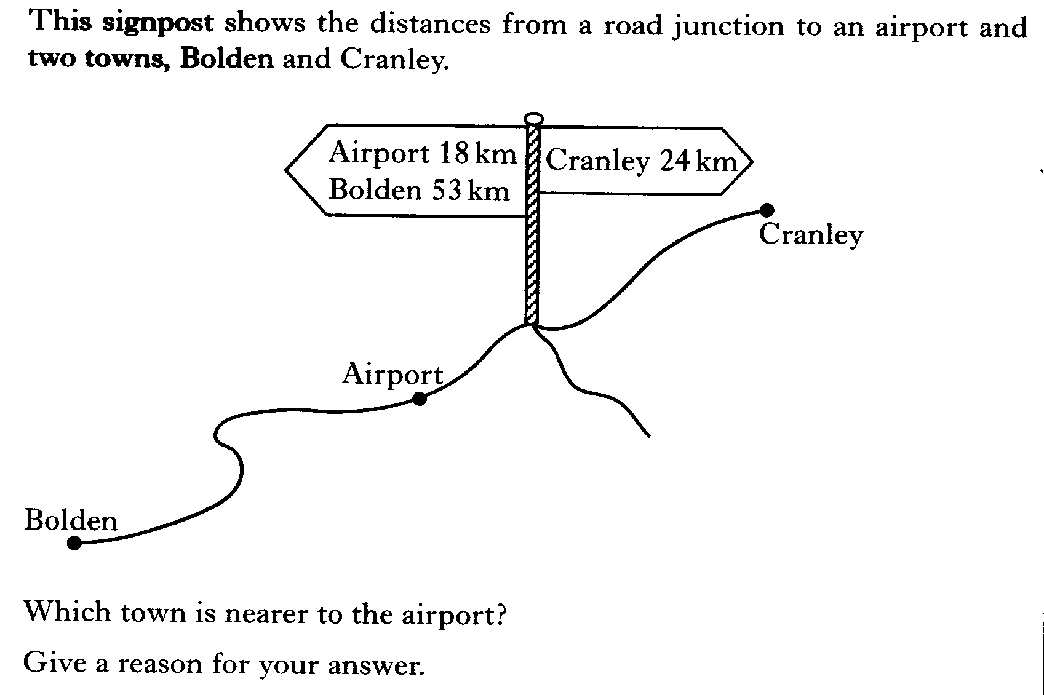

Slide 9
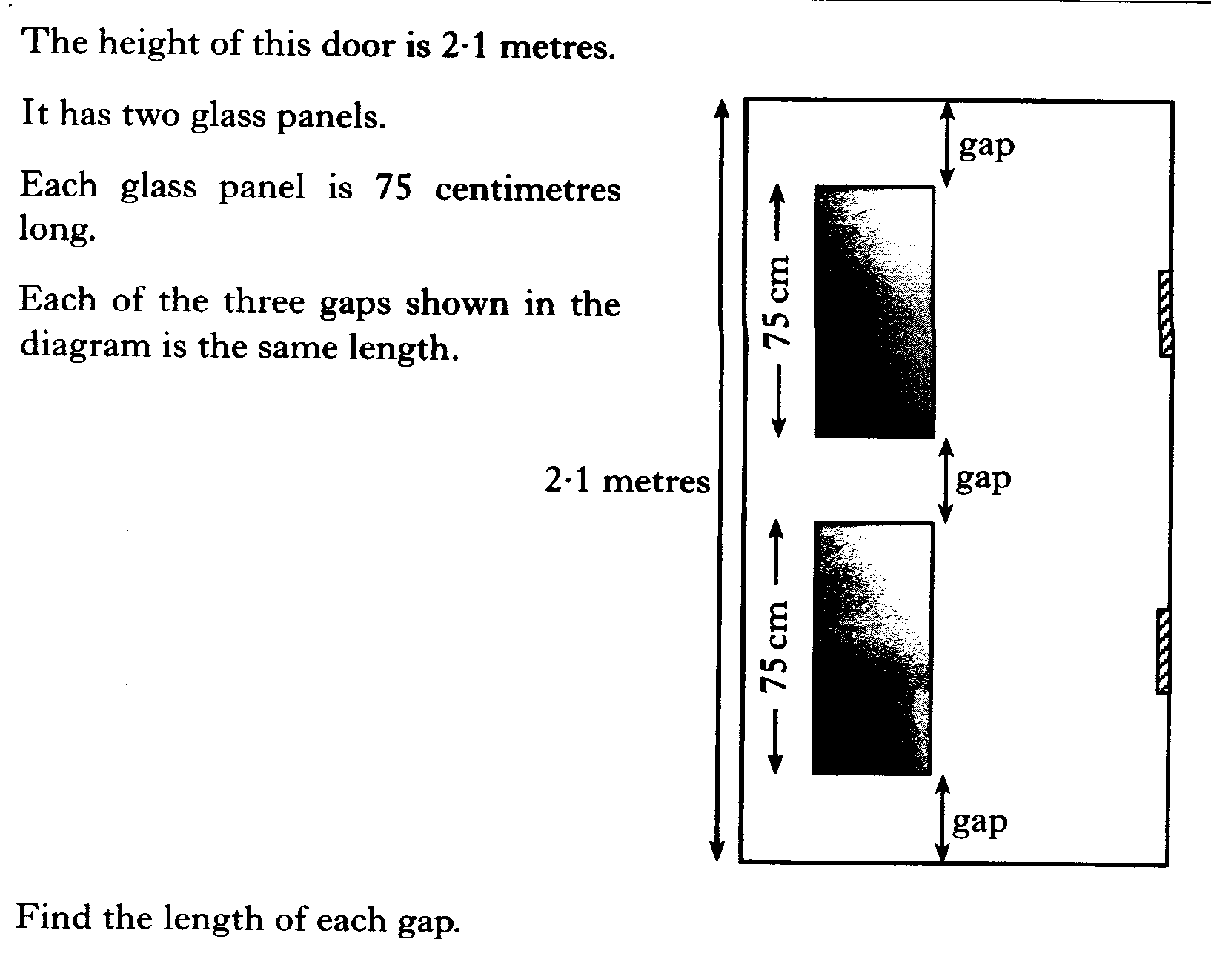

Slide 10
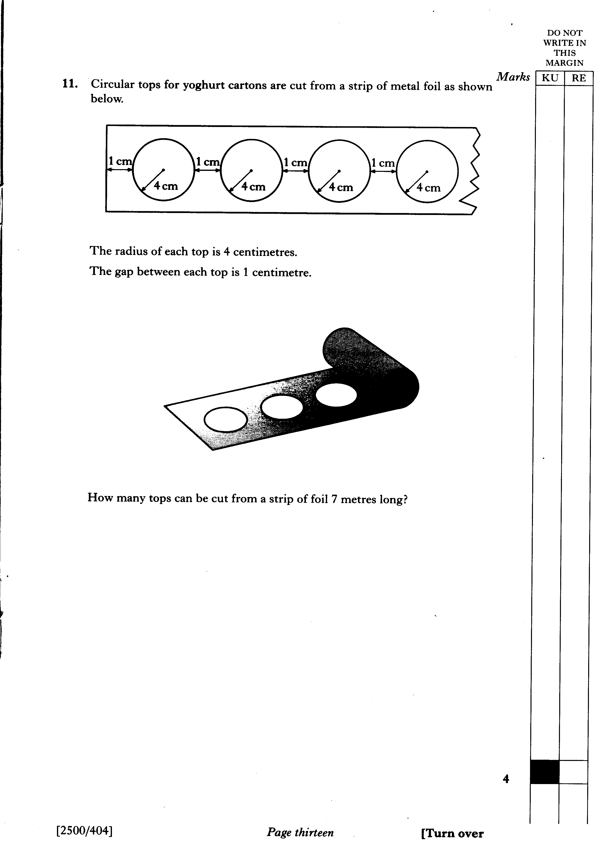

Slide 11
2 KU
3 KU

Slide 12
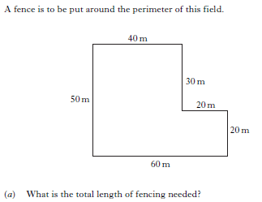


Slide 13
2 KU
2 KU

Slide 14
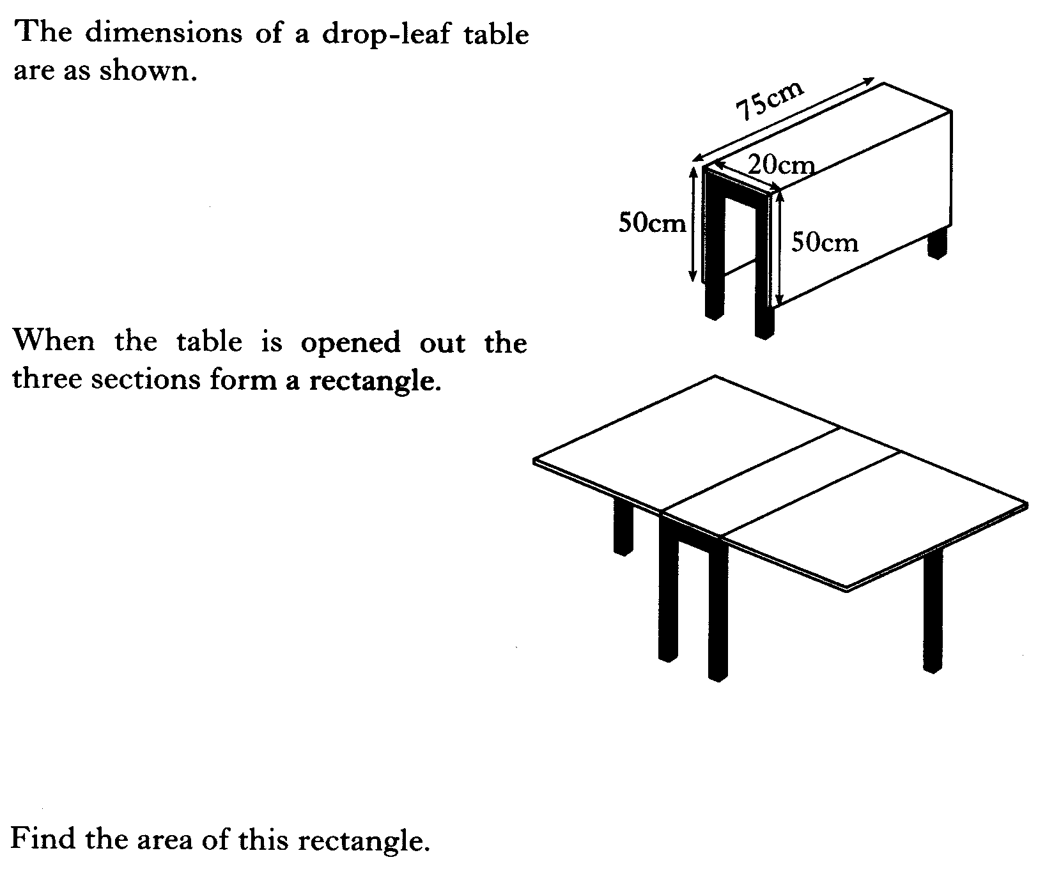

Slide 15
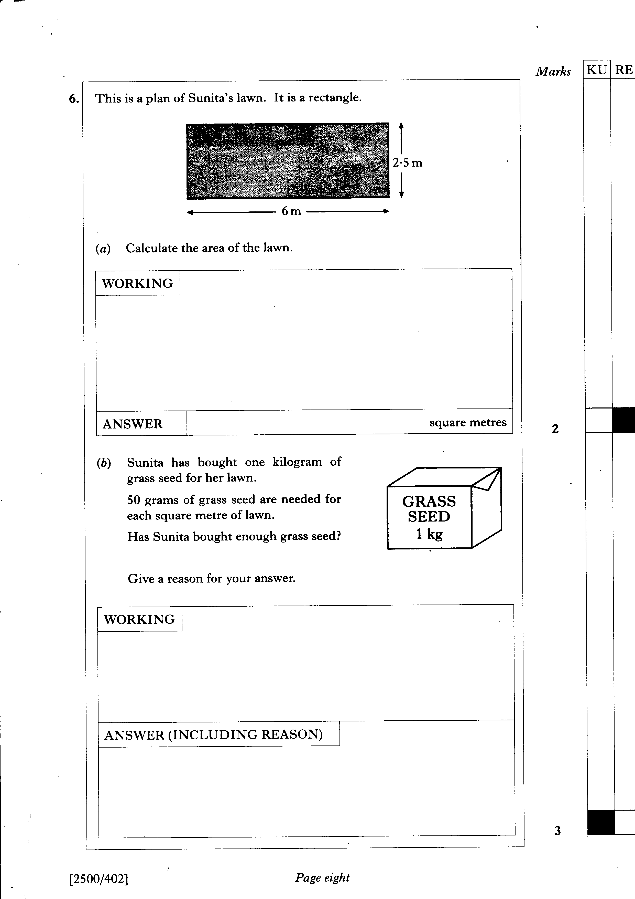

Slide 16
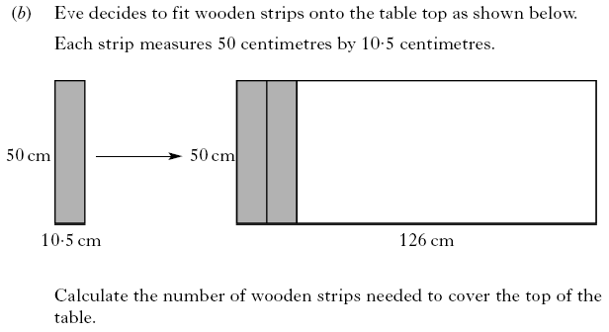
2 KU
2 KU

Slide 17
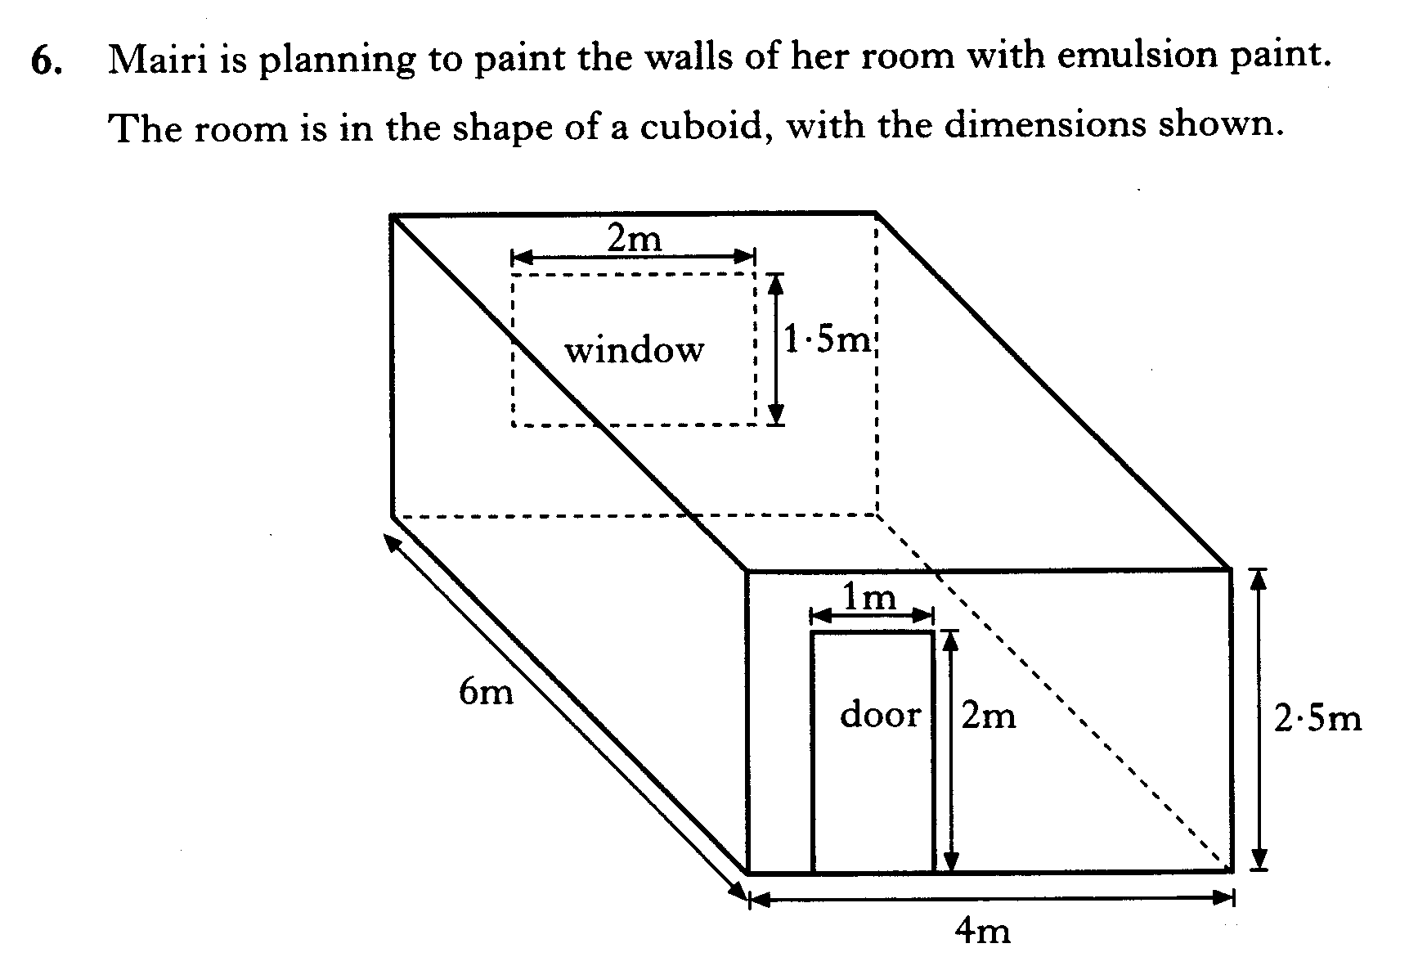
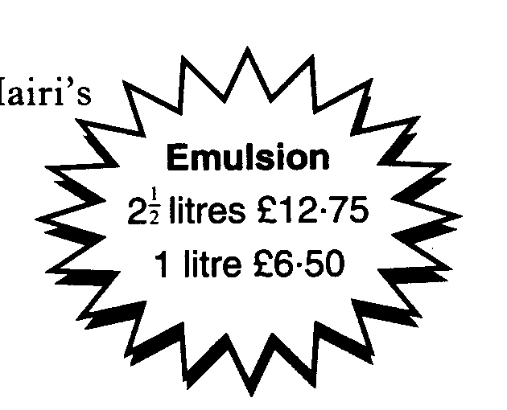
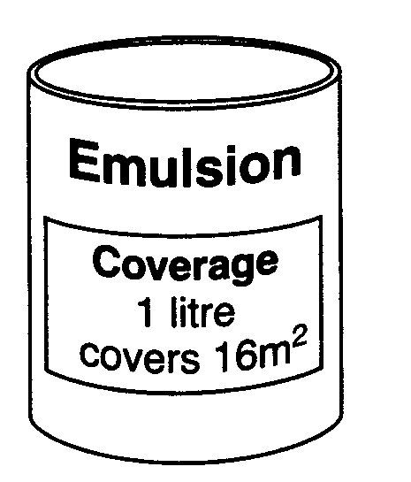
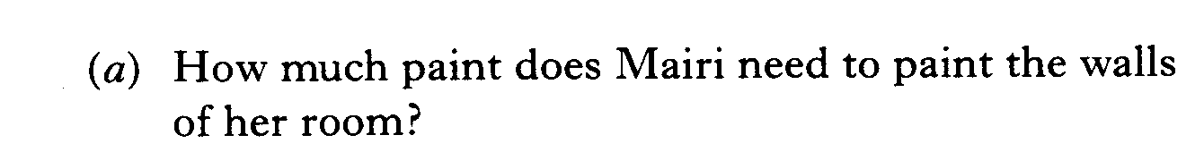
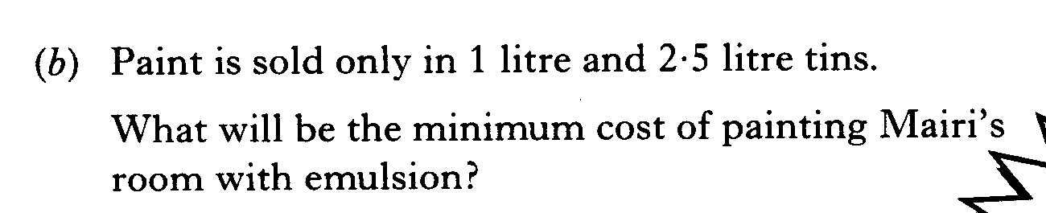

Slide 18

Problem Solving
Now Try
TJ N4 Lifeskills
Exercise 1
Ch23 (page 184)
www.mathsrevision.com

Slide 19
Problem Solving
Problem Solving Notation
Learning Intention
Success Criteria
  We are learning how Problem Solve using Volume.
  Be able to Problem Solving using Volume.
www.mathsrevision.com

Slide 20
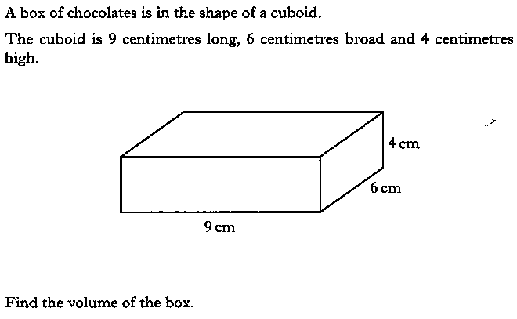

Slide 21
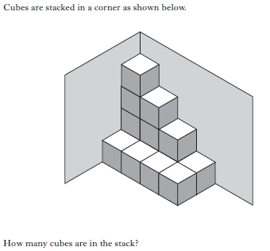

Slide 22
2 KU

Slide 23
2 KU

Slide 24
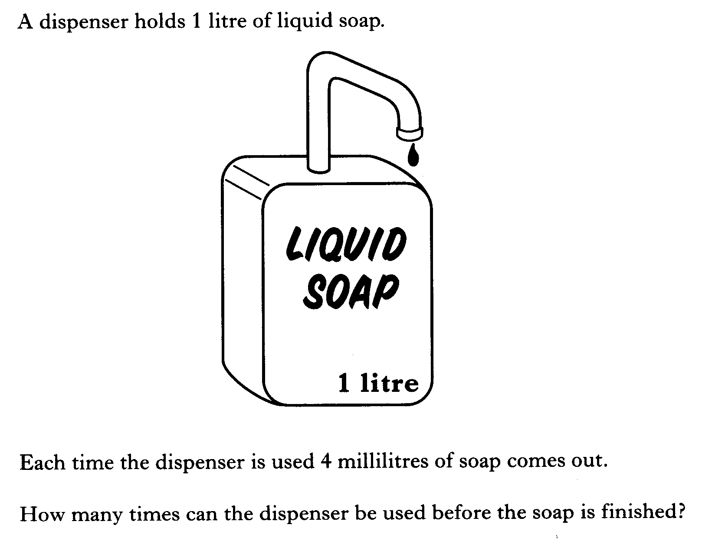

Slide 25
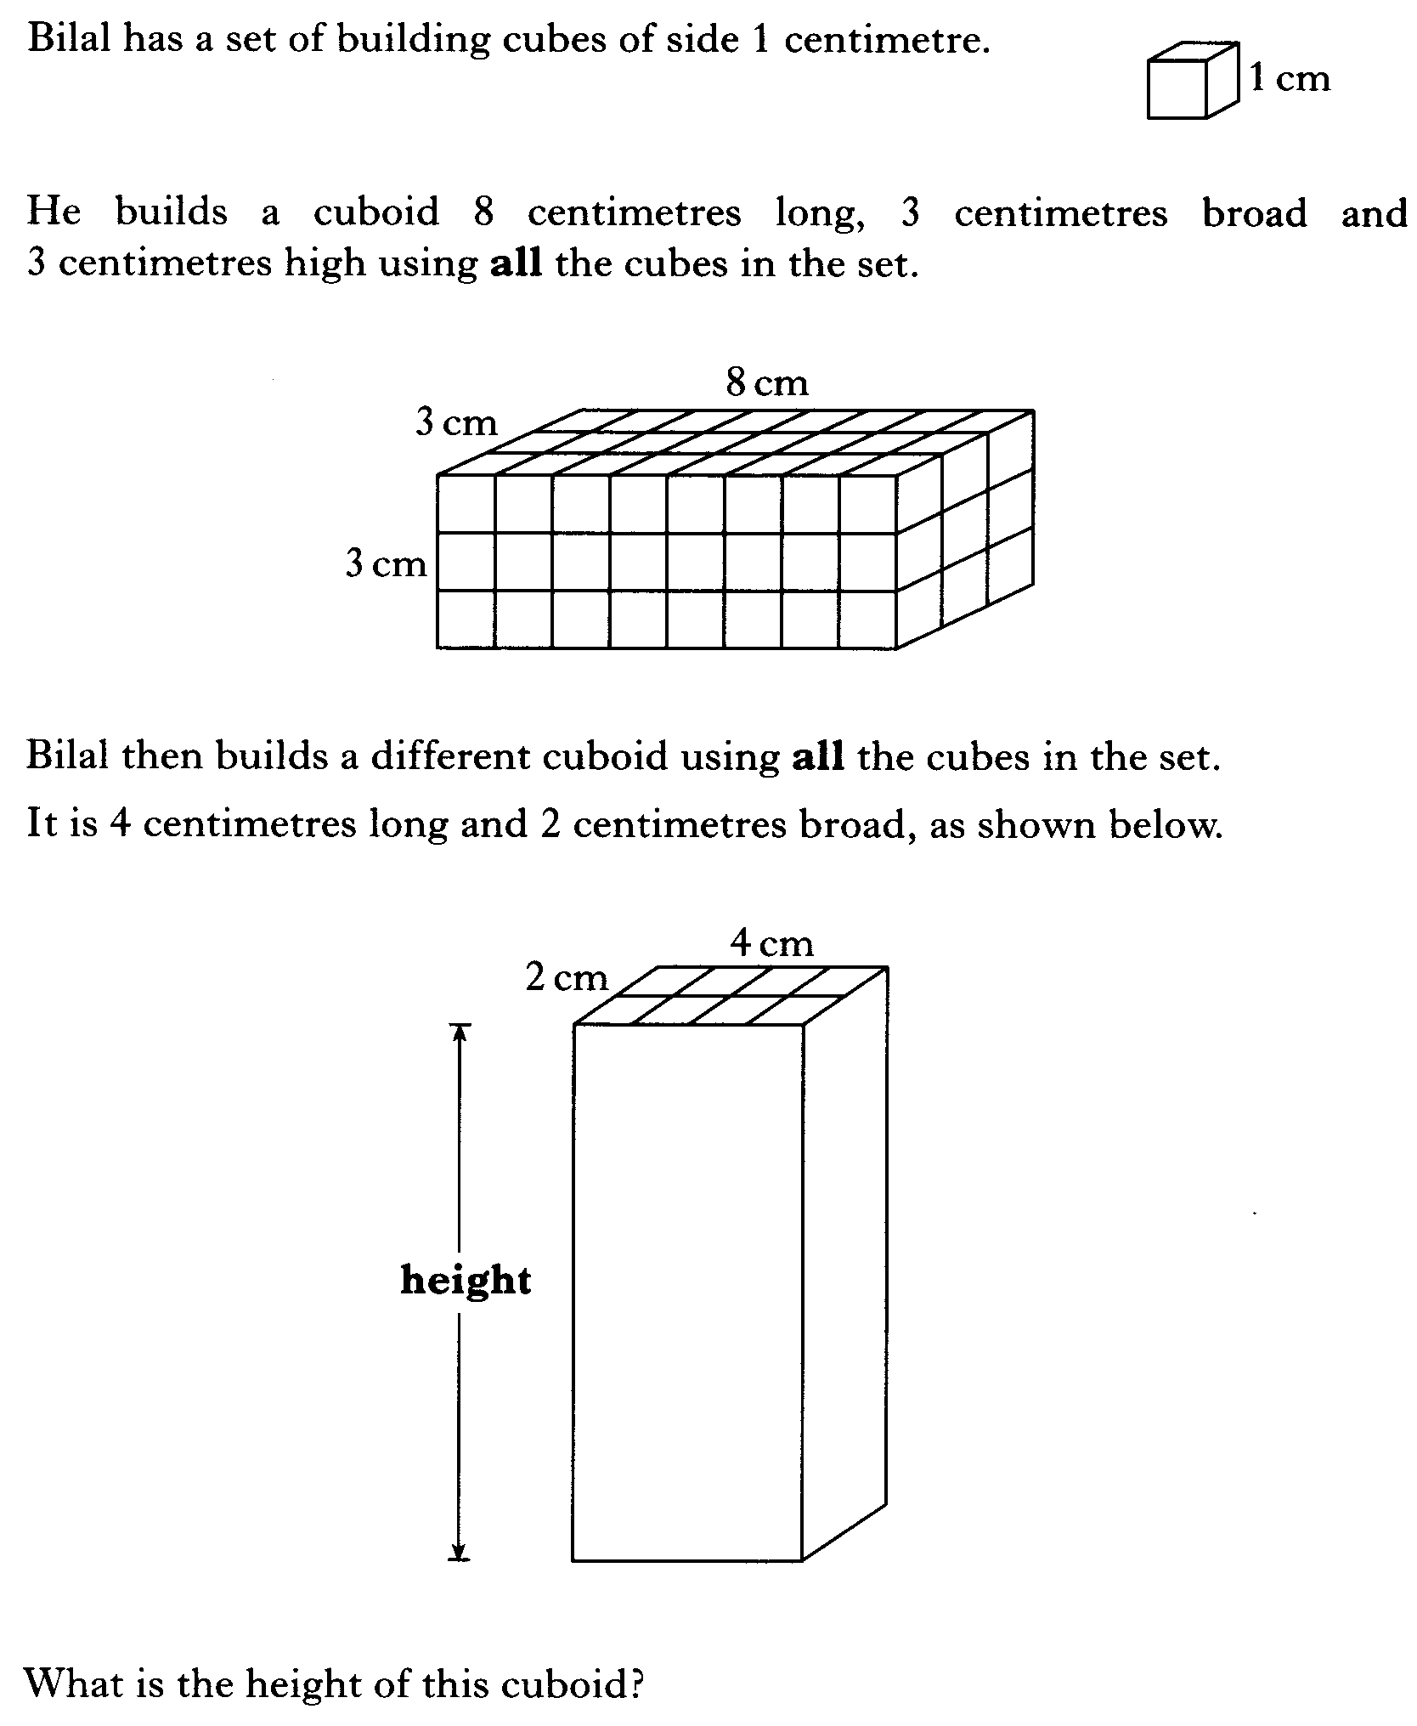

Slide 26
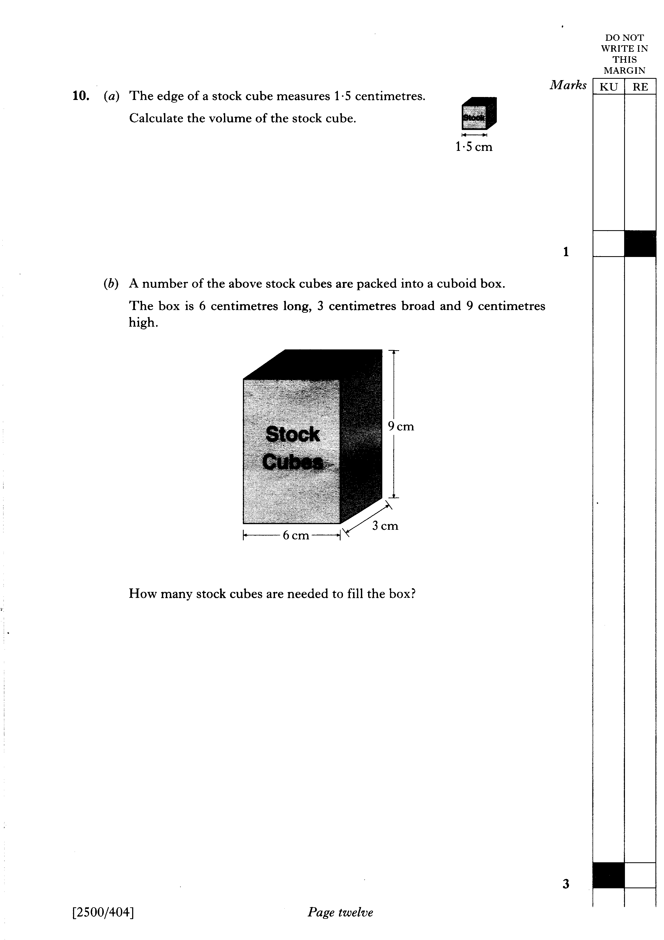

Slide 27
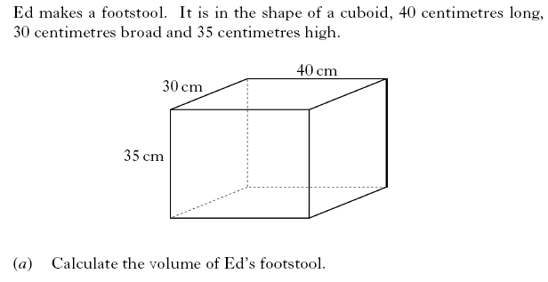
2 KU
3 RE

Slide 28

Have you updated your Learning Log ?
Problem Solving
Now Try
TJ N4 Lifeskills
Exercise 2
Ch23 (page 187)
www.mathsrevision.com

