Slide 1
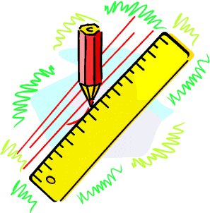

Tolerance
Tolerance Notation (percentages)
Tolerance effects
www.mathsrevision.com
Exam Type Questions

Slide 2
Starter Questions
What is Tolerance ?
www.mathsrevision.com

Slide 3
Tolerance
Learning Intention
Success Criteria
  1. We are learning what
  Tolerance is and correct
  notation.
  Understand the term Tolerance. .
  2. Calculate and simplify basic Tolerances.
www.mathsrevision.com

Slide 4
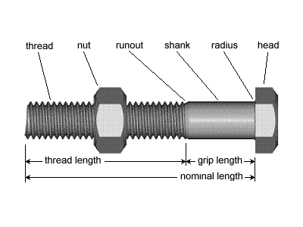
Tolerance
When a builder orders steel bolts to help build a to a house,
he would like them to be 50 millimetres long EXACTLY.
This is not always possible so the builder allows a ‘little error’ either side of this.
www.mathsrevision.com

Slide 5
Tolerance
Tolerance is written as
(50±2)mm
www.mathsrevision.com
He might be prepared to accept any bolt as long as it
lies between 48mm and 52mm
This means he will accept a bolt which is
within 2mm of the 50mm he asked for.
This is referred to as the
TOLERANCE for the measurement.

Slide 6

Tolerance
Tolerance Notation
Example : An acceptable size of apples on sale at Asda
must have a diameter between 8cm and 12cm.
Write the tolerance level in standard notation.
Calculate the middle value
www.mathsrevision.com
Tolerance is written as
(10±2)cm
8 + 12
= 10
2

Slide 7
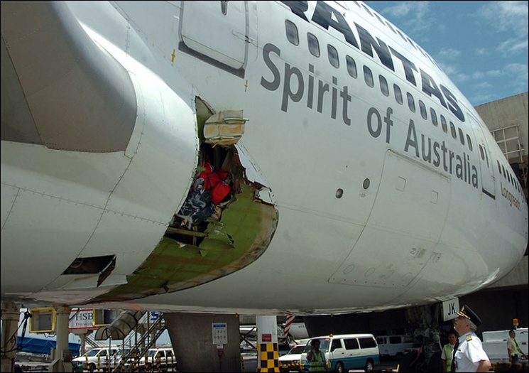
Tolerance
Tolerance Notation
Example : For safety reasons an acceptable rivet joint
for an aeroplane joint must be between
19.9mm and 20.1mm in diameter.
Write the tolerance level in standard notation.
www.mathsrevision.com
Calculate the middle value
Tolerance is written as
(20±0.1)mm
19.9 + 20.1
= 20
2

Slide 8
10% of 50mph
= 5mph
Tolerance
Paul wants drive his car at a speed of 50mph (±10%)
What range of values are acceptable ?
Minimum = 50 – 5 = 45mph
Maximum = 50 + 5 = 55mph
www.mathsrevision.com
Range between 45mph and 55mph
Notation format (50 ± 5)mph

Slide 9
5% of 140
= 7
Tolerance
Stuart wants to get fit so he decides to do 140 sit-ups
± 5% every day for 6 months.
What range of values are acceptable for him
to stay on track ?
Minimum = 140 – 7 = 133
www.mathsrevision.com
Maximum = 140 + 7 = 147
Range between 133 and 147
Notation format (140 ± 7) sit-ups

Slide 10

Tolerance
Now Try
TJ N5 Lifeskills
Exercise 1
Ch11 (page 112)
www.mathsrevision.com

Slide 11
Starter Questions
Why is Tolerance important ?
www.mathsrevision.com

Slide 12
Tolerance
Tolerance Notation
Learning Intention
Success Criteria
  We are learning the importance of tolerances in real life.
  Understand the effects of tolerance in real life.
www.mathsrevision.com

Slide 13
Depends !
Tolerance
Linda measures something and is 2cm out.
Is this acceptable ?
Length of her garden
Probability ok in relation to overall length.
www.mathsrevision.com
Width of window frame
Probability NOT the new window will not fit !!!

Slide 14
Tolerance
A fish tank contains 4500ml of water.
Every hour due the hot temperature (15 ± 1.5)% evaporates. What is the minimum and maximum volume in the tank after 1 hour.
Maximum volume left is
4500 – 607.5 = 3892.5 ml
www.mathsrevision.com
Minimum volume left is
4500 – 742.5 = 3757.5 ml

Slide 15

Have you updated your Learning Log ?
Tolerance
Tolerance Notation
Now Try
TJ N5 Lifeskills
Exercise 2
Ch11 (page 114)
www.mathsrevision.com

Slide 16
